Slide 1
Respiratory infections
Maisa Mansour , MD
Faculty of Medicine
Respiratory Department

Slide 2
Why is this important?
The respiratory system is the most commonly infected system.
Health care providers will see more respiratory infections than any other type.

Slide 3
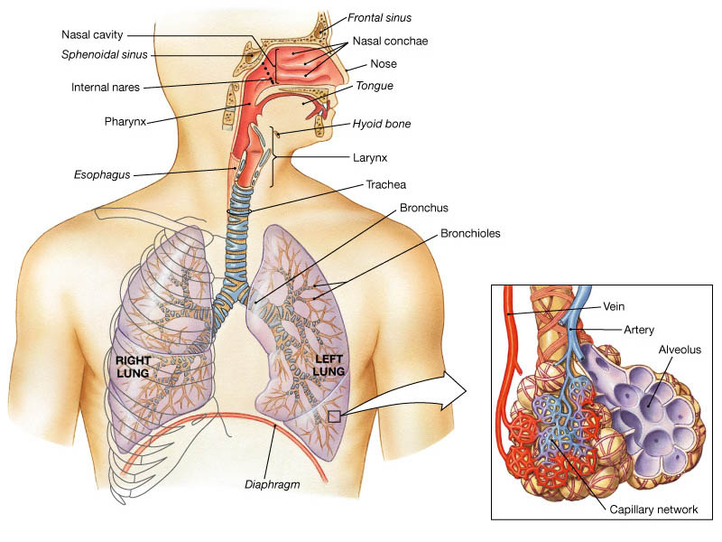

Slide 4
Respiratory System Functions
supplies the body with oxygen and release carbon dioxide( gas exchange).
filters inspired air
produces sound
contains receptors for smell
rids the body of some excess water and heat
helps regulate blood pH

Slide 5
Upper Respiratory Tract
Composed of the nose and nasal cavity, paranasal sinuses, pharynx (throat), larynx.
All part of the conducting portion of the respiratory system.

Slide 6
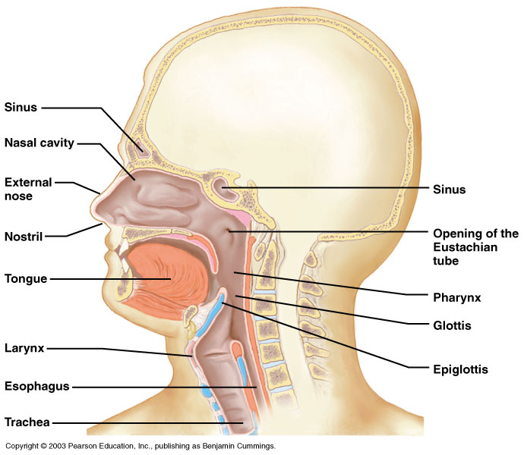
Upper respiratory tract

Slide 7
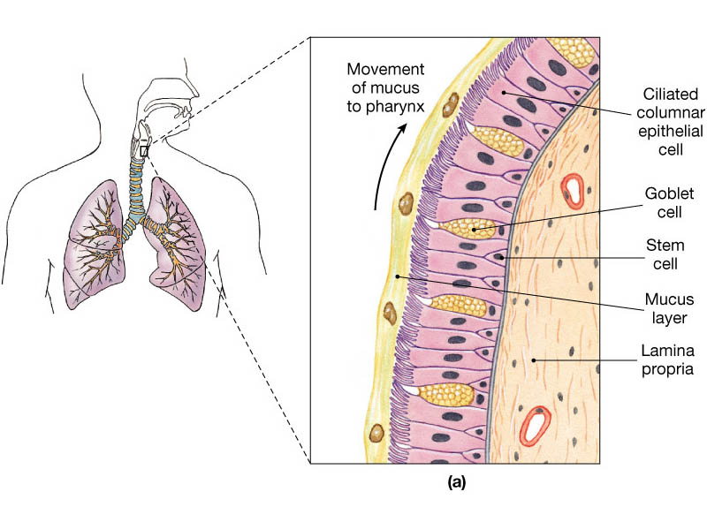

Slide 8
Lower Respiratory Tract
Conducting airways (trachea, bronchi, up to terminal bronchioles).
Respiratory portion of the respiratory system (respiratory bronchioles, alveolar ducts, and alveoli).

Slide 9
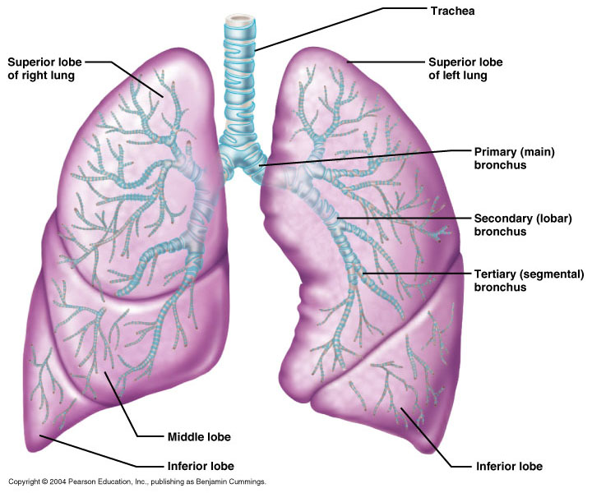
Conducting zone of lower respiratory tract

Slide 10
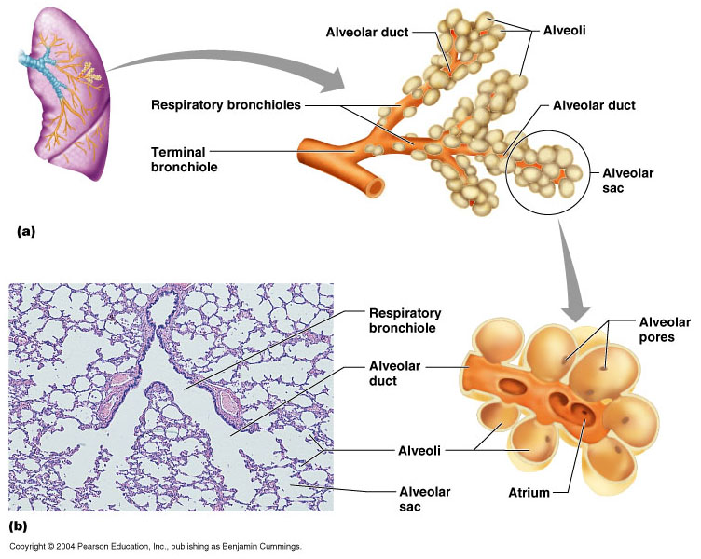
Respiratory Zone of Lower Respiratory Tract

Slide 11
Respiratory defense mechanism
Cough reflex.
Mucociliary clearance mechanisms.
Mucosal immune system:
Phagocytosis
Alveolar macrophages
Lysozyme
IgA
Interferons
Surfactant.

Slide 12
Upper respiratory tract infection
Acute tonsillitis
Acute pharyngitis
Acute otitis media
Acute sinusitis
Common cold
Acute laryngitis
Otitis externa
Acute epiglotitis

Slide 13
URT infections
Upper respiratory tract infection (URI) represents the most common acute illness evaluated in the outpatient setting.
Most common cause of sick leaves.
Short incubation period.
Most of the time symptomatic treatment
Secondary bacterial infection may occurred.

Slide 14
Pathophysiology
URIs involve direct invasion of the mucosa lining the upper airway.
viruses accounts for most URIs.
bacterial infections may present with a superinfection of a viral URI.
Inoculation by bacteria or viruses begins when secretions are transferred by touching a hand exposed to pathogens to the nose or mouth or by directly inhaling respiratory droplets from an infected person who is coughing or sneezing.

Slide 15
URT infections
Rhinitis - Inflammation of the nasal mucosa
Rhinosinusitis or sinusitis - Inflammation of the nares and paranasal sinuses, including frontal, ethmoid, maxillary, and sphenoid
Pharyngitis - Inflammation of the pharynx, hypopharynx, uvula, and tonsils

Slide 16
URT infections
Epiglottitis (supraglottitis) - Inflammation of the superior portion of the larynx and supraglottic area.
Laryngitis - Inflammation of the larynx
Laryngotracheitis - Inflammation of the larynx, trachea, and subglottic area.
Tracheitis - Inflammation of the trachea and subglottic area.

Slide 17
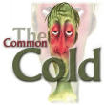
Common Cold
Adults Rhinovirus
Children Parainfluenzae and RSV

Slide 18
Virology
Over 200 viruses
Virus type Serotypes
Andenoviruses 41
Coronaviruses 2
Influenza viruses 3
Parainfluenza viruses 4
Respiratory syncytial virus 1
Rhinoviruses 100+
Enteroviruses 60+

Slide 19
Common cold
Self limiting disease.
Fatigue
Feeling cold.
Nose burning, obstruction, running
Sneezing
Less likely Fever.

Slide 20
Tonsilitis-pharyngitis
Bacteria
  S. Pyogenes
  (group A beta hemolytic streptoccocus)
  C. diphteriae
  N. gonorrhoeae
Viruses
  Epstein-Barr virus
  Adenovirus
  Influenza A, B
  Coxsackie A
  Parainfluenzae

Slide 21
Causative organisms
< 3 years
  ≅ 100 % viral
5-15 years
  15-30 % GABHS
Adult
  10 % GABHS

Slide 22
Due to streptococci:
Spreads by close contact and through air
Spread more in crowded areas (KG, school, army..)
Most common among 5-15 age group
More frequent among lower socio-economic classes
Most common during winter and spring
Incubation period 2-4 days

Slide 23
Signs/symptoms
Sore throat
Anterior cervical LAP
Fever > 38 °C
Difficulty in swallowing
Headache, fatigue
Muscle pain
Nausea, vomiting
Tonsillar hyperemia / exudates
Soft palate petechia
Absence of coughing
Absence of nose drip
Absence of hoarseness

Slide 24
Viral tonsillitis/pharyngitis
Having additional rhinitis, hoarseness, conjunctivitis and cough
Pharyngitis is accompanied by conjunctivitis in adenovirus infections
Oral vesicles, ulcers point to viruses

Slide 25
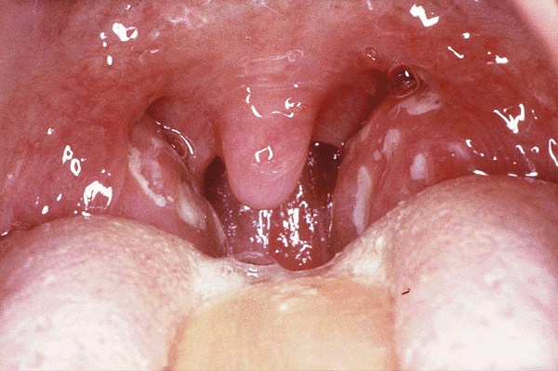
Exudates
GABHS

Slide 26
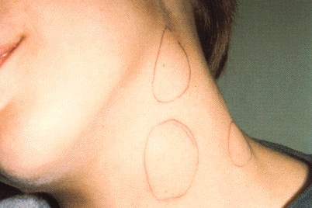
Lymphadenopathy
GABHS
Epstein-Barr virus
Adenovirus
Human herpesvirus type 6
Tularemia
HIV infection

Slide 27
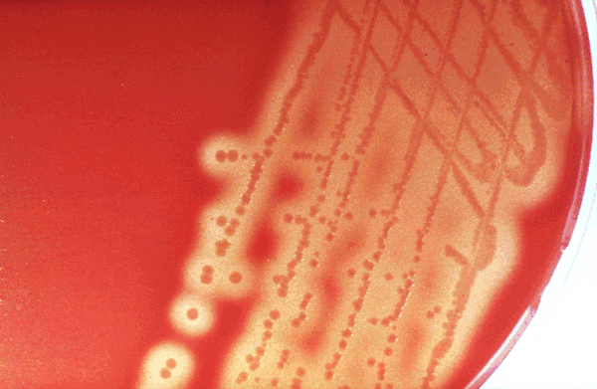
Laboratory
Throat swab
  Gold standard
Rapid antigen test
  If negative need swab
ASO
  May remain + for 1 year
WBC count
Peripheral smear

Slide 28
Tonsillitis due to Streptococci
Supurative complications
  Abscess
  Sinusitis, otitis, mastoiditis
  Cavernous sinus thrombosis
  Toxic shock syndrome
  Cervical lymphadenitis
  Septic arthritis, osteomyelitis
  Recurrent tonsillitis/pharyngitis
Nonsupurative complications
  Acute rheumatic fever
  Acute glomerulonephritis
Notes:
What about other streptococcal infections? E.g. Skin infections.. Do they cause RF as well?

Slide 29
Antibiotics in Tonsillitis/pharyngitis due to GABHS
ORAL
Penicilline V Cefuroxime | Children:2x250 mg or 3x250mg,10 days Adults:3x500 mg or 4x500mg,10 days
PARENTERAL
Benzathine penicilline |  | Adults:<27kg:600 000 U single dose, IM >27 kg:1.200 000 U single dose, IM
ALLERGY TO PENICILLINE
Erythromycine estolate |  |  | 20-40 mg/kg/day, 2x1 or 3x1, 10 days
Erythromycine ethyl succinate |  |  | 40 mg/kg/day, 2x1 or 3x1, 10 days

Slide 30
Acute Otitis Media causes
S. pneumoniae 30%
H. İnfluenzae 20%
M. Catarrhalis 15%
S. pyogenes 3%
S. aureus 2%
No growth 10-30%
Chronic otitis media: P. aeruginosa, S. aureus, anaerobic bacteria

Slide 31
Acute Otitis Media
85% of children up to 3 years experience at least one,
50% of children up to 3 years experience at least two attacks
AOM is usually self-limited. Rarely benefits from antibiotics.
81 % undergo spontaneus resolution.

Slide 32
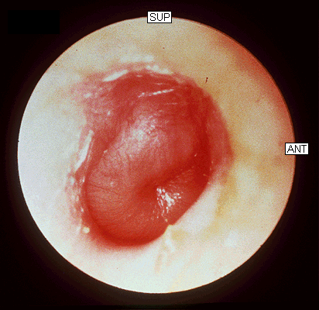
Signs and Symptoms
Symptoms
  Ear pain
  Ear draining
  Hearing loss
  Fever
  Fatigue
  Irritability
  Tinnitus, vertigo
Otoscopic findings
  Tympanic membrane erythema
  Inflammation
  Bulging
  Effusion
Hearing loss

Slide 33
Acute Rhinitis / Sinusitis
Acute sinusitis
Str. pneumoniae %41
H. influenzae %35
M. catarrhalis %8
Others %16
  Strep. pyogenes
  S. aureus
  Rhinovirus
  Parainfluenzae
Chronic sinusitis
Anaerobe bacteria:
Bactroides, Fusobacterium
S. aureus
Strep. pyogenes
Str. pneumoniae
Gram (-) bacteria
Fungal.
Symptoms more than 3 months.

Slide 34
Predisposition to Sinusitis
Anatomical: septal deviation,
Mucociliary functions: cystic fibrosis, immotile cilia synd.
Systemic dis., immune deficiency.: DM, AIDS, CRF
Allergy: Nasal polyps, asthma
Neoplasia
Environmental: smoking, air pollution, trauma...

Slide 35
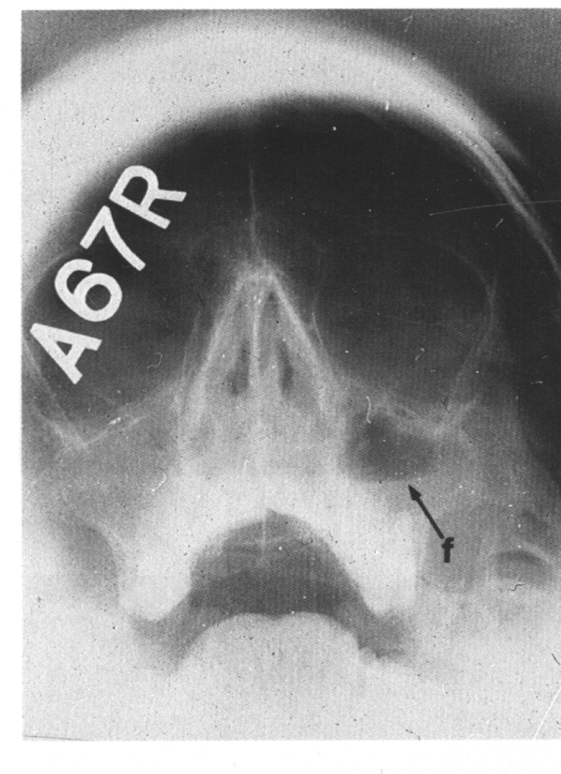
Management
Empirical antimicrobial therapy.
Acute sinusitis usually no need for Abs.
Symptomatic treatment.
Chronic sinusitis requires prolonged abs treatment 2-3 wks.

Slide 36
Acute bronchitis
Only lasts for a few days to weeks.
Generally viral in origin.
Rhinovirus, parainfluenzae, RSV, influenzae viruses.
expectorating cough, shortness of breath (dyspnea), and wheezing. chest pains, fever, and fatigue.
In addition, bronchitis caused by Adenovirus may cause systemic and gastrointestinal symptoms.
the coughs due to bronchitis can continue for up to three weeks or more even after all other symptoms have subsided

Slide 37
Acute Bronchitis
Only about 5-10% of bronchitis cases are caused by a bacterial infection.
Secondary bacterial infection can occur.
H. influenzae
S. pneumoniae
S.aureus.

Slide 38
Acute bronchitis
Diagnosis is mostly clinical(signs and symptoms).
No radiologic changes on chest X-Ray.
Usually no need for antibiotics Tx.
Antibiotics only for secondary bacterial infections proved by microbiology, or in patient with chronic lung disease(COPD exacerbations, bronchiactesis).

Slide 39
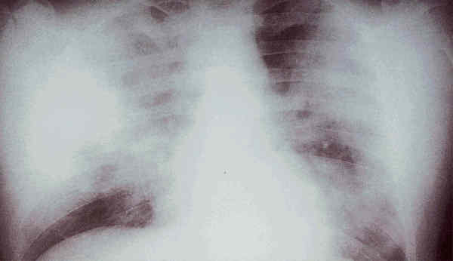
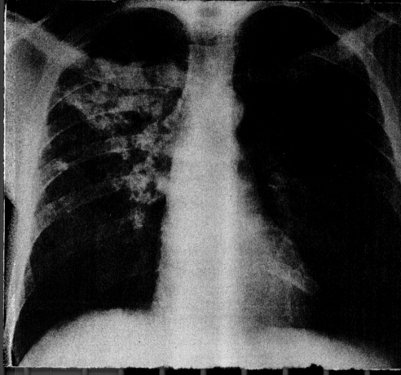
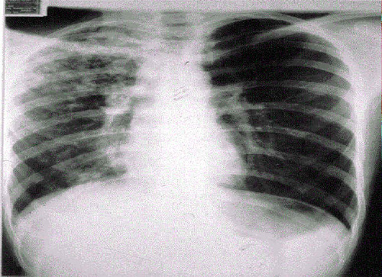
Pneumonia
S.pneumo
Legionella
TB
Plague
Tularemia
RICIN toxin
Staphylococcal Enterotoxin B
SARS

Slide 40
Pneumonia
Inflammation of the alveoli of the parenchyma of the lung with consolidation and exudation
Symptoms:
Cough.
Pleuritic chest pain
Production of purulent sputum.
Fever.

Slide 41
pneumonia
Risk factors:
COPD or structural lung disease.
Diabetes Mellitus DM
Cardiac / Renal failure
Immunosuppression
Reduced levels consciousness, neurological disease.
Anything that inhibits the gag / cough reflex

Slide 42
pneumonia
About 40-60% of persons with pneumonia do not have a defined etiology…
even after extensive testing for known respiratory pathogens.
Classified to:
Typical or Atypical pneumonia(microorganisim)
Community acquired, nosocomial .

Slide 43
Community Acquired Pneumonia
Infection of the lung parenchyma in a person who is not hospitalized or living in a long-term care facility for ≥ 2 weeks
5.6 million cases annually in the U.S.
Estimated total annual cost of health care = $8.4 billion
Most common pathogen = Streptoccocus. pneumonia (60-70% of CAP cases)

Slide 44
Community acquired pneumonia
S. pneumoniae
H. influenzae
Moraxella
K. pneumoniae (Friedlander’s bacillus)
Chlamydia.pneumonia
Staphylococcus. Aureus.

Slide 45
“Nosocomial” Pneumonia
Hospital-acquired pneumonia (HAP)
  Occurs 48 hours or more after admission, which was not incubating at the time of admission
Ventilator-associated pneumonia (VAP)
  Arises more than 48-72 hours after endotracheal intubation
Notes:
Despite this information, we have few studies that have used the same methodology to compare the bacteriology and outcomes of those persons with pneumonia arising in the community (ie, community-acquired pneumonia [CAP]) with those having health-care–associated pneumonia (HCAP), those nonintubated patients with hospital-acquired pneumonia (HAP), and those with ventilator-associated pneumonia (VAP)
VAP: patients who require intubation after developing szevere HAP shuld be managed similar to patients with VAP

Slide 46
“Nosocomial” Pneumonia
Healthcare-associated pneumonia (HCAP)
  Patients who were hospitalized in an acute care hospital for two or more days within 90 days of the infection; resided in a nursing home or LTC facility; received recent IV abx, chemotherapy, or wound care within the past 30 days of the current infection; or attended a hospital or hemodialysis clinic

Slide 47
Hospital acquired pneumonia
Risk factors include mechanical ventilation
Anerobes:
Enterobactericiae.
Gram negative:
Acinetobacter
Pseudomonas species
S.aureus (MRSA)

Slide 48
Streptococcus pneumonia
Most common cause of CAP
Gram positive diplococci
“Typical” symptoms (e.g. malaise, shaking chills, fever, rusty sputum, pleuritic hest pain, cough)
Lobar infiltrate on CXR
Suppressed host
25% bacteremic
Notes:
Predisposing factors: anorexia, ETOH, HIV, sickle cell disease, splenectomy, hematologic diseases

Slide 49
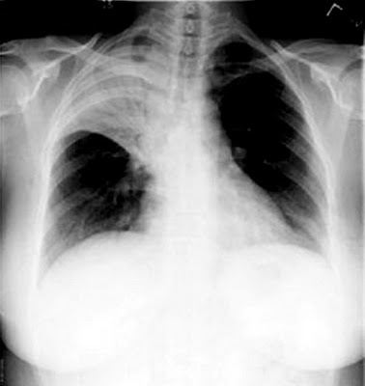
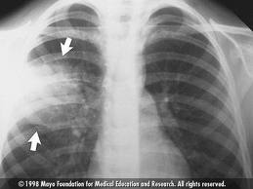

Slide 50
Atypical Pneumonia
Pneumonia
#2 cause (especially in younger population)
Commonly associated with milder Sx’s: subacute onset, non-productive cough, no focal infiltrate on CXR, usually diffuse infiltration.
Mycoplasma: younger Pts, extra-pulm Sx’s (anemia, rashes), headache, sore throat
Chlamydia: year round, URI Sx, sore throat
Legionella: higher mortality rate, water-borne outbreaks, hyponatremia, diarrhea

Slide 51
Atypical pneumonia
Mycoplasma pneumoniae .
Obligate human pathogen
Epidemics occur at 4-6 year intervals
Spread requires close contact
Common in children <5 years – mild illness
Most common in 5-20 year age group – walking pneumonia.

Slide 52
Atypical pneumonias
Chlamydia pneumoniae
Chlamydia psittaci
Legionairre’s disease
Q fever (Coxiella burnetti)
Hantavirus (ARDS)
Histoplasma.capsulatum

Slide 53
Other bacteria
Anaerobes
  Aspiration-prone Pt, putrid sputum, dental disease
Gram negative
  Klebsiella - alcoholics
  Morexella catarrhalis - sinus disease, otitis, COPD
  H. influenza
Staphylococcus aureus
  IVDU, skin disease, foreign bodies (catheters, prosthetic joints) prior viral pneumonia

Slide 54
Viral Pneumonia
More common cause in children
  RSV, influenza, parainfluenza
Influenza most important viral cause in adults, especially during winter months
Post-influenza pneumonia (secondary bacterial infection)
  S. pneumo, Staph aureus

Slide 55
Investigations for pneumonia
Blood culture
Resp specimens/blood for viruses, chlamydia & mycoplasma.
Urine for legionella & pneumococcal antigen testing
Sputum culture, gram stain.
BAL
Pleural fluid

Slide 56
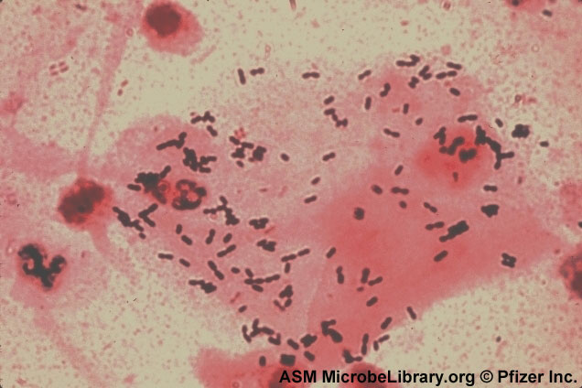
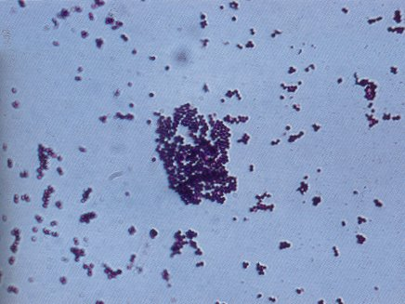
Streptococcus pneumonia(gram + diplococci)
Staphylococcus aureus(gram +cluster)

Slide 57
Infiltrate Patterns
Pattern | Possible Diagnosis
Lobar | S. pneumo, Kleb, H. flu, GN
Patchy | Atypicals, viral, Legionella
Interstitial | Viral, PCP, Legionella
Cavitary | Anaerobes, Kleb, TB, S. aureus, fungi
Large effusion | Staph, anaerobes, Kleb

Slide 58
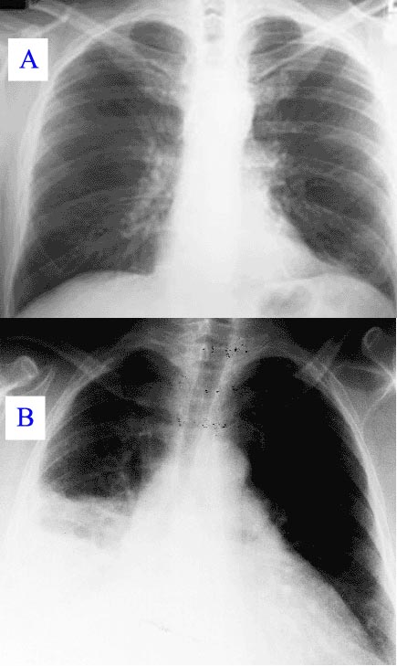
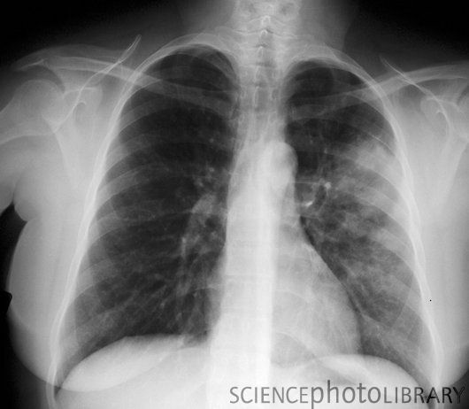
Minimal changes(atypical pneumonia)

Slide 59
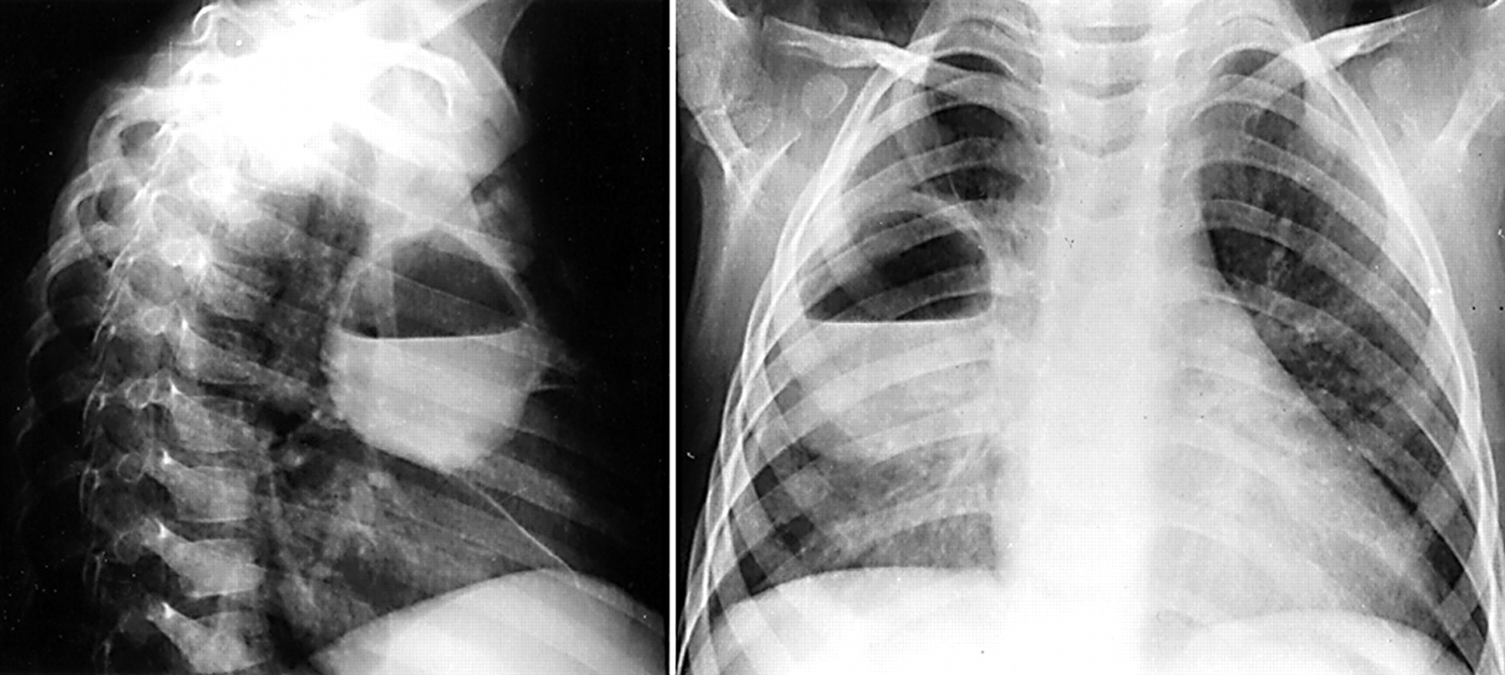
Air fluid level (lung abscess)

Slide 60
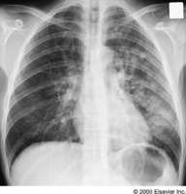
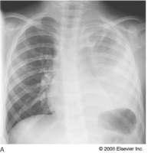
Bronchopneumonia
Pneumonia complicated empyema

Slide 61
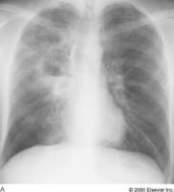
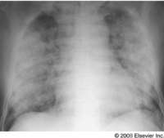
Anerobe causing cavity.
ARDS complicate severe viral pneumonia

Slide 62
Clinical Diagnosis
Assess overall clinical picture
CURP-65 score.
Pneumonia Severity Index (PSI)
  Aids in assessment of mortality risk and disposition
  Age, gender, NH, co-morbidities, physical exam lab/radiographic findings

Slide 63
Outpt Management in Pt with comorbidities
Comorbidities: cardiopulmonary disease or immunocompromised state
Organisms: S. pneumo, viral, H. flu, aerobic GN rods, S. aureus
Recommended Abx:
  Respiratory quinolone, OR advanced macrolide
Recent Abx:
  Respiratory quinolone OR
  Advanced macrolide + beta-lactam

Slide 64
Prevention
Smoking cessation
Vaccination per ACIP recommendations
  Influenza
    Inactivated vaccine for people >50 yo, those at risk for influenza compolications, household contacts of high-risk persons and healthcare workers
    Intranasal live, attenuated vaccine: 5-49yo without chronic underlying dz
  Pneumococcal
    Immunocompetent ≥ 65 yo, chronic illness and immunocompromised ≤ 64 yo
Notes:
Vaccination may be done either at hospital discharge or during outpatient treatment
ACIP: Advisory Committee on Immunization Practices

