Slide 1
Repairs for RPD

Slide 2
Repairs and additions to RPD
Occasionally needed.
How to avoid??
Careful diagnosis, treatment planning, adequate mouth prepara­tions, and the carrying out of an effective partial denture design with all component parts properly fabricated.
patient should be instructed in the proper placement and removal of the prostheses so that undue strain is not placed on clasp arms, on other parts of the denture, or on the abutment teeth that are contacted.

Slide 3
1- Broken clasp arm:
Reasons for breakage:
1- Breakage may result from repeated flexure into and out of too severe an undercut avoided by surveying.
2- Breakage may occur as a result of structural failure of the clasp itself providing the appropriate taper to flexible retentive clasp arms and uniform bulk to all rigid non retentive clasp arms. careless use of contouring pliers.
3- Careless handling by the pt. Clasp breakage can best be prevented by cautioning the patient against repeated lifting of the clasp arm away from the tooth with the fingernails during removal of the denture.

Slide 4
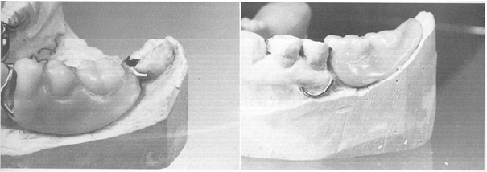
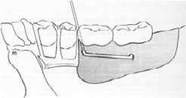
A broken retentive clasp arm, may be replaced with a wrought-wire retentive arm embedded in an acrylic resin base or matched to a metal base by electric soldering

Slide 5
2- Fractured occlusal rests
always occurs where it crosses the marginal ridge.
Improperly prepared occlusal rest seats are the reason too thin
or is thinned by adjustment in the mouth.
Method:
Relieve occlusal interferences impression with the PD in its terminal position. Dental stone is poured into the impression and allowed to set PD is then removed from the cast; and platinum foil is adapted to the rest seat and the marginal ridge and overlaps the guiding plane. PD is returned to the cast and, gold solder is electrically fused to the platinum foil and minor connector in sufficient bulk to form an occlusal rest.

Slide 6
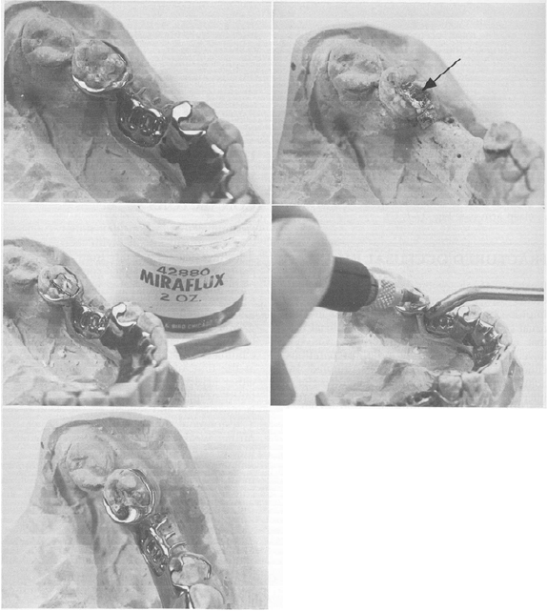

Slide 7
3-Distortion or breakage of other components- major and minor connectors:
Adequate bulk to ensure their rigidity, or abuse by the patient. weakened by adjustment to eliminate tissue impingement. Such adjustment at the time of initial placement is a result of either inadequate survey of the master cast or faulty design or fabrication of the casting. should be remade rather than further weakening the restoration by attempt to compensate for its inadequacies by relieving the metal.

Slide 8
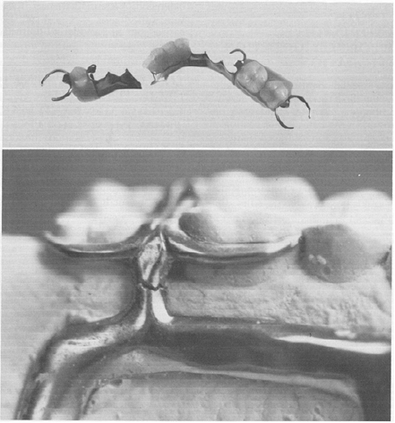
Repair of this component requires that platinum foil be adapted under fracture site on cast and soldering be used.

Slide 9
Commonly, repeated adjustment to a major or minor connector results in loss of rigidity to the point that the connector can no longer function effectively. In such situations, either a new restoration must be made or that part must be replaced by casting a new section and then reassembling the denture by soldering. This occasionally requires disassembly of denture bases and artificial teeth. The cost and probable success must then be weighed against the cost of a new restoration. Generally, the new restoration is advisable.

Slide 10
4- Loss of a tooth or teeth not involved in the support or retention:
The addition of teeth to metal bases is complex and necessitates either casting a new component and attaching it by soldering or creating retentive elements for the attachment of an acrylic resin extension, in bilateral extension saddle, the need for subsequent relining of the entire base should be considered. After the extension of the denture base, a relining procedure of both the new and old base should be carried out to provide optimum tissue support for the restoration.

Slide 11
5- Loss of an abutment tooth necessitating its replacement and making a new direct retainer:
In the event of a lost abutment, the next adjacent tooth to be selected, and it generally will require modification or a restoration. Any new restoration should be made to confirm to the original path of placement. Otherwise modification to the exiting tooth should be done the same as during any other mouth preparations, with proximal recontouring, preparation of an adequate occlusal rest seat, and any reduction in tooth, contours necessary to accommodate retentive and stabilizing components. A new clasp assembly may then be cast further tooth and the denture reassembled with the new replacement tooth added.

Slide 12
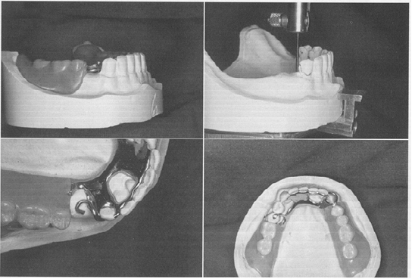
PM abutment had to be extracted. This Class I restoration could be returned to service by using canine as abutment and replacing lost first PM. B, Cast was surveyed to determine modifications required for added retainer compatible with original design of restoration. C, Necessary recontouring of canine abutment was accomplished. New retainer assembly was cast and soldered to major connector. Wrought-wire retentive arm was employed as part of retainer assembly. D, first PM was replaced.

Slide 13
6- Other types of repairs:
may include the replacement of a broken or lost prosthetically supplied tooth, the repair of a broken resin base, or the reattachment of a loosened acrylic resin base to the metal framework. Breakage is sometimes the result of poor design, faulty fabrication, or use of the wrong material.

Slide 14
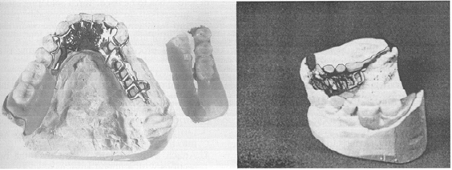
Fractured denture base became completely detached from framework. Remaining portion of denture was placed in patient's mouth, impression was made in irreversible hydrocolloid, and cast was formed. B, Buccal portion of denture base contained artificial teeth and could be accurately related to minor connector. Index was made in stone. Right basal seat area of cast was painted with separating medium, and cast, denture, and index were assembled. New base was made of autopolymerizing acrylic resin by sprinkling method.

Slide 15
REPAIR BY SOLDERING
Approximately 80% of all soldering in dentistry can be done electrically. Electric soldering units are available for this purpose and most dental laboratories are so equipped. Electric soldering permits soldering close to an acrylic resin base without removing that base, because of the rapid localization of heat at the electrode. The acrylic resin base needs only to be protected with a wet casting ring liner during soldering.

Slide 16
Relining and rebasing
relining is the resurfacing of the tissue surface of a denture base with new material to make it fit the underlying tissue more accurately, whereas rebasing is the replacement of the entire denture base with new material while preserving the occlusal relationship.
a new impression registration is necessary and uses the existing denture base as an impression tray for either a closed-mouth or an open-mouth impression procedure. One of several types of impression materials may be used. The impression may be made with a metallic oxide impression paste, with one of the rubber-base or silicone impression materials, with one of the tissue conditioning material, with an activated acrylic resin used as an impression material, or with a mouth-temperature wax.

Slide 17
Before relining or rebasing is undertaken, the oral tissues must be returned to an acceptable state of health and conditioning abused and irritated tissues.

Slide 18
Thank you

