Slide 1
PREOPERATIVE EVALUATION
Dr. Khaled Daradka

Slide 2
OBJECTIVES
To understand when preoperative testing is indicated and when its not…Most of the time!
The aim of preoperative evaluation is not to screen broadly for undiagnosed diseases, but rather to identify and quantify any comorbidity that may have an impact on the operative outcome.

Slide 3
CASE 1
You are asked to see a 43 year old male for a preoperative evaluation. He is scheduled for an inguinal hernia repair next week
His past medical history is notable only for obesity (BMI 32).
He has never used tobacco and has 1-2 oz of EtOH/week
He does construction work

Slide 4
CASE 1
He takes only a multivitamins
No previous surgeries
For preoperative testing you order:
  A) An ECG and CBC
  B) An ECG and creatinine
  C) A CBC and creatinine
  D) A CBC and INR
  E) No tests

Slide 5
CASE 2
You are asked to see a 78 year old female for a preoperative evaluation. She is scheduled for an elective R Total knee arthroplasty tomorrow
Her past medical history is noteworthy for hypertension, hyperlipidemia, obesity, and coronary artery disease for which she received 2 drug eluting stents 4 years ago.
She has had a hysterectomy in the past without complication

Slide 6
CASE 2
Her medications include simvastatin, metoprolol, aspirin
She is limited in her activity due to her knee, but was able to climb 2 flight of stairs within the past several months
Her exam reveals a BP of 143/80, P 60, BMI of 37, and a moderate effusion on the R knee. Cardiovascular and pulmonary exams are normal
You have an ECG available ( non-specific lateral ST changes) from 3 months ago

Slide 7
CASE 2
You have no other laboratory data available
Preoperatively you order:
  A) An ECG, electrolytes, creatinine
  B) Electrolytes, creatinine
  C) An ECG, electrolytes, creatinine, and INR
  D) Electrolytes, creatinine, ECG, and a dobutamine stress Echo
  E) No testing

Slide 8
CASE 3
You are asked to see a 58 year old male for a preoperative evaluation. He is scheduled for a lap chole next week
His past medical history is significant for hepatitis C but no history of cirrhosis. He had an inguinal hernia repaired as a child without complication. He has had no recent follow up regarding his liver.
Medications include multivitamin

Slide 9
CASE 3
His functional capacity is excellent
Preoperatively you order:
  A) An ECG, electrolytes, creatinine
  B) Electrolytes, LFT, creatinine
  C) LFT, INR, creatinine
  D) INR and aPTT
  E) No studies

Slide 10
REASON FOR EVALUATION
Anesthesia and surgery are physiologically stressful, invasive interventions which may exacerbate or uncover underlying disease processes
Some of the most feared complications include catastophic events such as myocardial infarction,difficulty oxygenating or ventilating, and cerebral vascular accident, among others
A proper pre-operative assessment allows the ability to stratify and reduce risk for the patient

Slide 11
SYSTEMIC APPROACH TO PREOPERATIVE EVALUATION

Slide 12
HISTORY & PHYSICAL EXAMINATION
PMH
PSH
Medications
Allergies
Bleeding tendency
Use of tobacco, alcohol and drugs
Activities

Slide 13
3 Critical Determinants for Cardiac Evaluation
1. Surgical Risk Category (High, Intermediate, or low)
2. Patient’s Clinical Risk Factors (adapted from the Revised Cardiac Risk Index)
3. Patient’s Functional Status

Slide 14
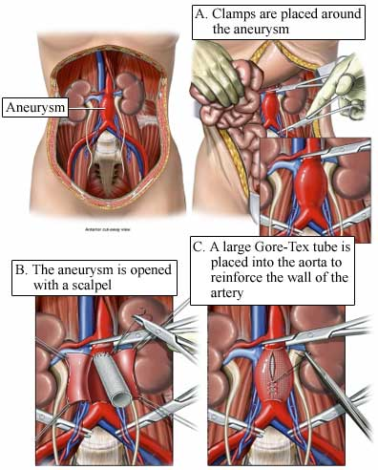
Surgical Risk Category
Surgery Specific Risk
High (Reported risk >5%)
  Emergent major operations, particularly in elderly
  Aortic and other major vascular surgery
  Surgical procedures associated with large fluid shifts and/or blood loss

Slide 15
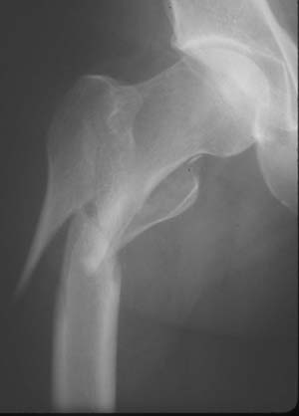
Surgical Risk Category
Surgery Specific Risk
Intermediate (Reported risk <5%)
  Carotid endarterectomy
  Head and neck surgery
  Intraperitoneal and intrathoracic procedures
  Orthopedic surgery
  Prostate surgery

Slide 16
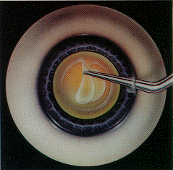
Surgical Risk Category
Surgery Specific Risk
Low (Reported risk <1%)
  Endoscopic procedures
  Superficial procedures
  Cataract surgery
  Breast surgery

Slide 17
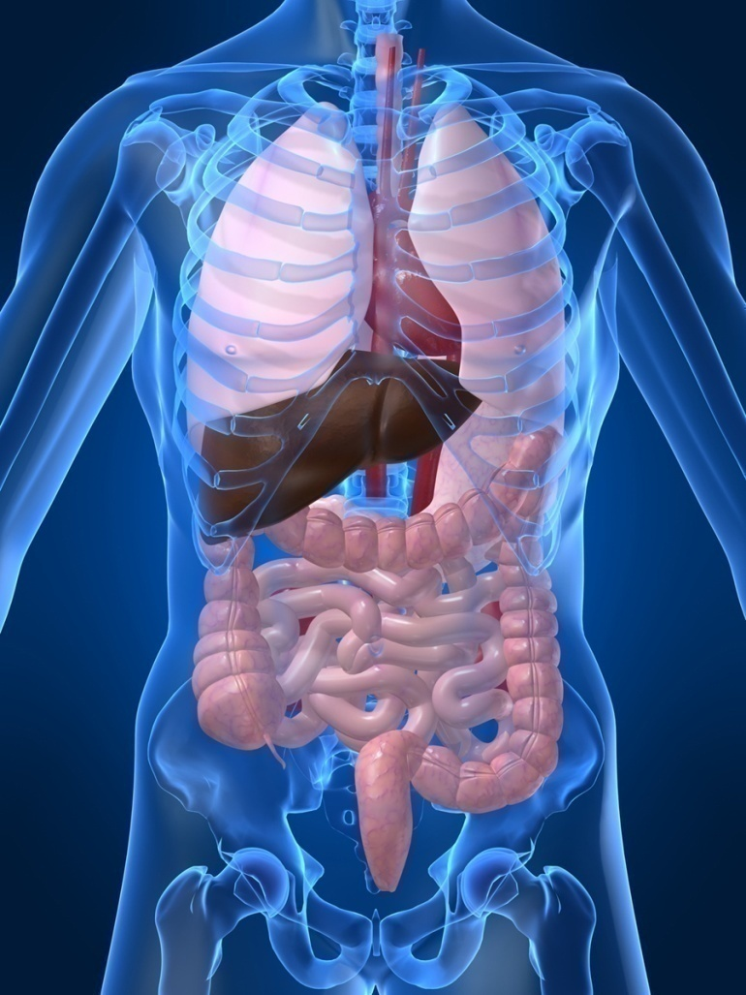
Patient’s Clinical Risk Factors
MAJOR
  Unstable coronary syndromes
    Acute (<7d) or recent MI (<1mo)
    with evidence of ischemic risk
    Unstable or severe angina
  Decompensated heart failure
  Significant arrhythmias
    High-grade AV block
    Symptomatic ventricular arrhythmia
    SVT uncontrolled rate
  Severe valvular disease

Slide 18
Patient’s Clinical Risk Factors
INTERMEDIATE
  Mild angina pectoris
  Previous myocardial infarction (>1mo) by history of pathological Q waves
  Compensated or prior heart failure
  Diabetes mellitus (particularly insulin dependent)
  Renal insufficiency (creatinine >2.0)

Slide 19
Patient’s Clinical Risk Factors
MINOR
  Advanced age
  Abnormal ECG (LVH, LBBB, ST-T abnormalities)
  Rhythm other than sinus (e.g. a fib)
  Low functional capacity (e.g. inability to climb one flight of stairs with a bag of groceries)
  History of stroke
  Uncontrolled systemic hypertension

Slide 20
FUNCTIONAL CAPACITY
  Metabolic equivalents
  1 MET – Can you take care of yourself? Eat, dress, use the toilet? Walk a block or two on level ground
  4 METs – Do light work around the house like dusting or washing the dishes? Climb 2 flight of stairs?
  >10 METs – Participate in strenuous sports like swimming, tennis, football?

Slide 21

FUNCTIONAL CAPACITY
Perioperative cardiac and long-term risk is increased in patients unable to meet a 4-MET demand during most normal daily activities.
Excellent: >10
Good: 7-10
Moderate: 4-7
Poor: <4

Slide 22
Is Preoperative Testing a Problem
Yes, and a big one
  It wastes valuable resources
  It exposes patients to needless blood work and procedures
  It can creat anxiety for patients
  It is costly…

Slide 23
PREOPERATIVE TESTING
CBC : anemia, risk of blood loss, malnutrition and chronic illness.
KFT : ag more than 50, diabetes, renal disease, HTN, if major surgery and hypotension is expected, nephrotoxic drugs will be used.
Pregnancy test.

Slide 24

CHEST X-RAY
Clinical characteristics to consider:
  Smoking, COPD, recent respiratory infection, cardiac disease
  Chest x-ray “reasonable” for patients over 60

Slide 25

ECG
Men older than 45 years
Women older than 55 years
HTN,cardiovascular disease, DM and arrythmias.
Patients at risk for electrolyte abnormalities, such as diuretic use
Anyone going for “high risk” surgery
Anyone with at least one cardiac risk factor going for “intermediate risk surgery”

Slide 26

TESTS THAT ARE NOT ROUTINELY ORDERED
Coagulation studies
Blood glucose, A1c
Electrolytes
Pulmonary function tests
Echocardiography
Liver enzymes
Blood Type and cross match
Urinalysis

Slide 27

PATIENTS WITH STENTS
Elective noncardiac surgery is not recommended within 4 to 6 weeks of bare-metal coronary stent implantation
No surgery within 12 months of drug-eluting coronary stent implantation. Thienopyridine therapy imperative to prevent in-stent thrombisis.

Slide 28
PATIENTS ON ASPIRIN
Monotherapy with aspirin should not be routinely discontinued for elective noncardiac surgery.
If the decision is made to stop aspirin, seven to ten days should elapse before surgery is undertaken
Resume approximately 24 hours (or the next morning) after surgery when there is adequate hemostasis

Slide 29
ANTICOAGULANT
If High Risk patient (Atrial fibrillation associated with valvular heart disease, Mechanical valve in the mitral position, Mechanical valve and prior thromboembolic event) Discontinue warfarin 3 to 5 days before procedure with “Bridge” Heparin while INR is below therapeutic level.

Slide 30
DIABETIC MEDICATIONS
Patients with type 2 diabetes who take oral hypoglycemic drugs should hold medicine on the morning of surgery.
All patients with diabetes should have their surgery as early as possible to minimize the disruption of their management routine while being NPO.
Most antidiabetic medications can be restarted after surgery when patients resume eating, except metformin, which should be delayed in patients with suspected renal hypoperfusion until documentation of adequate renal function.

Slide 31
DIABETIC MEDICATIONS
Sulfonylureas should be started only after eating has been well established.
Basal metabolic needs utilize approximately one half of an individual's insulin even in the absence of oral intake; thus, patients should continue with basal insulin even when not eating. This is mandatory in type 1 diabetes to prevent ketoacidosis (with maintenance D5).

Slide 32
DAY OF SURGERY
NPO status
Age
Comorbidities
Antibiotics

Slide 33
TAKE HOME POINTS
All preoperative testing should be dicatataed by your history and exam
Preoperative testing is NOT INDICATED unless there is a specific reason to perform the test and the result will change management, or mitigate perioperative risk

Slide 34
CASE 1
You are asked to see a 43 year old male for a preoperative evaluation. He is scheduled for an inguinal hernia repair next week
His past medical history is notable only for obesity (BMI 32)
He has never used tobacco and has 1-2 oz of EtOH/week
He does construction work

Slide 35
CASE 1
He takes only a multivitamins
For preoperative testing you order:
  A) An ECG and CBC
  B) An ECG and creatinine
  C) A CBC and creatinine
  D) A CBC and INR
  E) No tests

Slide 36
CASE 2
You are asked to see a 78 year old female for a preoperative evaluation. She is scheduled for an elective R Total knee replacement tomorrow
Her past medical history is noteworthy for hypertension, hyperlipidemia, obesity, and coronary artery disease for which she received 2 drug eluting stents 4 years ago.
She has had a hysterectomy in the past without complication

Slide 37
CASE 2
Her medications include simvastatin, metoprolol, aspirin
She is limited in her activity due to her knee, but was able to climb 2 flight of stairs within the past several months
Her exam reveals a BP of 143/80, P 60, BMI of 37, and a moderate effusion on the R knee. Cardiovascular and pulmonary exams are normal
You have an ECG available ( non-specific lateral ST changes) from 3 months ago

Slide 38
CASE 2
You have no other laboratory data available
Preoperatively you order:
  A) An ECG, electrolytes, creatinine
  B) Electrolytes, creatinine
  C) An ECG, electrolytes, creatinine, and INR
  D) Electrolytes, creatinine, ECG, and a dobutamine stress Echo
  E) No testing

Slide 39
CASE 3
You are asked to see a 58 year old male for a preoperative evaluation. He is scheduled for a lap chole next week
His past medical history is significant for hepatitis C but no history of cirrhosis. He had an inguinal hernia repaired as a child without complication. He has had no recent follow up regarding his liver.
Medications include multivitamin

Slide 40
CASE 3
His functional capacity is excellent
Preoperatively you order:
  A) An ECG, electrolytes, creatinine
  B) Electrolytes, LFT, creatinine
  C) LFT, INR, creatinine
  D) INR and aPTT
  E) No studies

Slide 41


