Slide 1
Management of complications in Oral surgery
Dr Hazem Al-Ahmad
Associate professor – Maxillofacial surgery
B.D.S, MSc(Lon), F.D.S.R.C.S (Eng)

Slide 2
Oro-antral communication
Factors predispose to OA communication
  Large antrum
  Large roots
  Fusion of teeth
  History of antral involvement

Slide 3
Oro-antral communication
May lead to:
Chronic sinusitis
Oroantral fistula

Slide 4
Oro-antral communication
Prevention:
Xray
Divergent roots
Avoid large amount of force

Slide 5
Oro-antral communication
Nose blowing test
Bone adhering to tooth after extraction

Slide 6
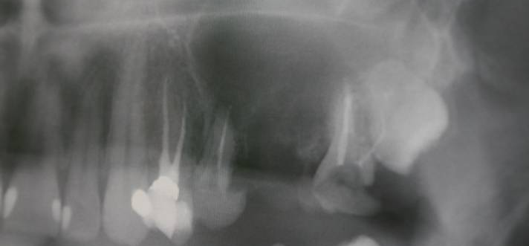
Oro-antral communication

Slide 7
Oro-antral communication
Management:
If less than 2mm
2-6mm
>6mm
  Close immediately with advancement flap
  Avoid nose blowing for 10 days
  Antibiotics
  Nasal decongestant
  Oral care

Slide 8
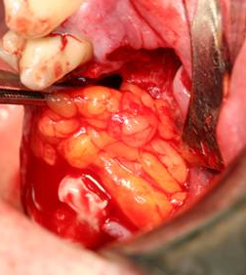
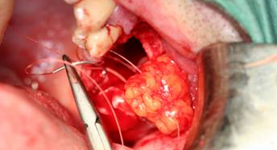
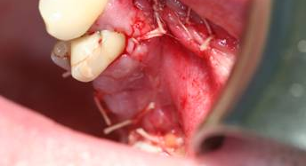
Displacement of tooth (or part of the tooth) into the maxillary sinus

Slide 9
Haemorrhage
Primary: at the time of surgery
Reactionary: within few hours after surgery
Secondary: up to 14 days post-op (infection)
Think of local and systemic causes
  Blood clotting disorders (haemophilia)
  Platelet disorders (thrombocytopaenia)
  Blood vessels disorders

Slide 10
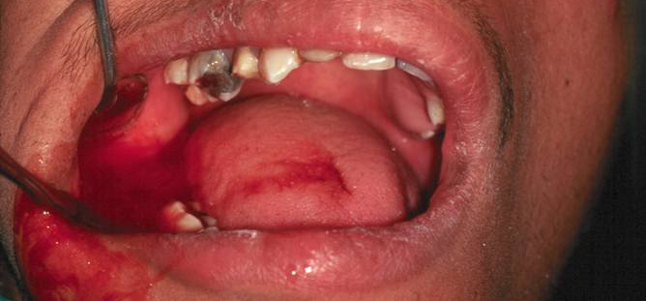
Haemorrhage

Slide 11
Bleeding
To minimize bleeding:
  Handle tissues carefully
  Avoid unnecessary trauma

Slide 12
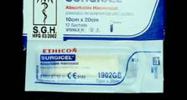
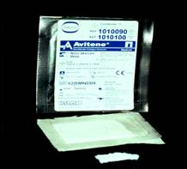
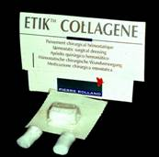
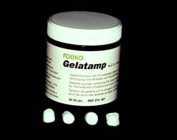
Haemorrhage
  Management
  Suction and good vision
  LA with vasoconstrictor
  Horizontal mattress suture
  Surgicel
  Bone wax or other material
  Apply pressure (bite on gauze for 10 min)
  Avoid mouth rinsing
  Tranexamic acid 5% wash
  Refer
  Haematology investigations if uncontrolled:
  PT, PTT, INR

Slide 13
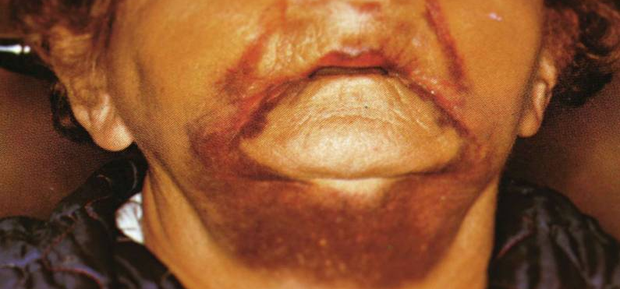
Haematoma and Echymosis

Slide 14
Interstitial Emphysema
Air forced under pressure into fascial planes.
Diagnosed by sudden occorrence of facial swelling, crepitation on palpation
Self limiting

Slide 15
Dry Socket
Acute pain and foul odour 3-4 days post extraction
Lysis of the blood clot
Greyish sloughing but no suppuration
10-14 days
Irrigate, Analgesia, Antibiotics (2ry infection)
Alvogel
Incidence: 2% to 5% with all extractions, around 20% after lower third molars extraction.

Slide 16
Dry Socket
Predisposing factors:
  Posterior Mandibular teeth
  Traumatic extraction
  Female on OCP
  Age of 20-40yrs
  Poor OH
  Excessive use of LA with vasoconstrictor
  Active pericoronitis
  Smoking
  Excessive use of mouth wash
  Pagets disease
  Previous history of dry socket
  Inexperienced surgeon

Slide 17
Control and Prevention of INFECTION
Pre-op preparation
Aseptic technique
Minimal trauma
Surgical debridement / saline irrigation
Drainage
Adequate wound closure + Haemostasis
Antibiotics
Oral hygiene and post-op care

Slide 18
Delayed healing
After 2-3 weeks
Dehiscence due to poor flap closure
Check medical history
Infection
Malignancy within socket

