Slide 1
Delivery and insertion

Slide 2
OUTLINE
At delivery appointment:
1- Adaptation of the RPD to its supporting tissues must be evaluated.
2- Analysis of the occlusion and articulation
3- Specific instructions on the care of RPD and oral tissues.
4- Periodic evaluation.

Slide 3
Soft tissue adaptation
Relationship of the components to the
underlying soft tissues:
Contact:
1-Denture base
2- Maxillary major connector, except where
crossing the gingival margins.
Relief:
1- Mandibular major connectors.
2- Minor connectors and proximal plates.
3- Bar clasps.

Slide 4
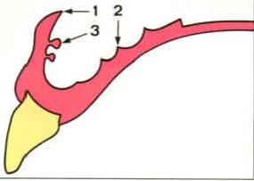
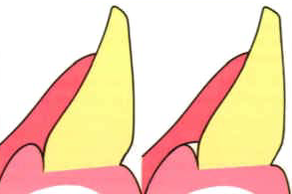
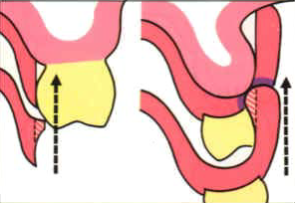
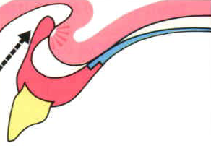

Slide 5
Procedure for tissue surface adjustment
1- Inspect visually and digitally for sharp
and rough.
2-Apply PIP.
3-Check paste displacement.
4-Relieve the pressure areas.
5-In the tooth-mucosa borne RPD, a pressure on the extension base area should not cause elevation from tooth contact, if so reline is indicated.

Slide 6
Evaluate the relationship of the components to the adjacent movable soft tissues. The RPD should not impinge on movable soft tissues.
a. Denture base
b. Major connector
c. Bar clasps

Slide 7
Procedure for periphery adjustment
Inspect the periphery of the seated RPD in the mouth visually.
Manually activate or instruct the patient to move the lips, tongue, cheeks and jaw through simulated functional movement.
Where the periphery cannot be adequately observed , the peripheral extension can be checked using disclosing wax.

Slide 8
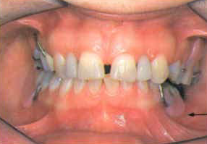

Slide 9
Abutment tooth adaptation
The framework components should be properly related to the abutment teeth.
1-The rests should demonstrate a complete and stable seating in their seats.
2-The clasps, minor connectors, and proximal plates should demonstrate the required contact with the abutment teeth.

Slide 10
Retention
The resistance to vertical dislodging forces should be evaluated . The retentive components require adjustment to provide optimum retention.
The amount of retention required is subjective as determined by the dentist and patient.

Slide 11
Occlusion and articulation
Maximum intercuspation. Posterior teeth
should demonstrate bilateral, simultaneous
contact.
OVD: PD should demonstrate occlusal contacts at the correct OVD. I t should not increase the VD.
Articulation: RPD components should demonstrate appropriate occlusal contacts with the opposing dentition during excursive mandibular movement.
Adjustments: tooth-borne RPD can be adjusted intraorally.
Tooth-mucosa borne RPD adjustment requires
clinical remount (deflective occlusal contacts can’t be
evaluated intraorally), as a result of displiceability of the
tissue supported extension.

Slide 12
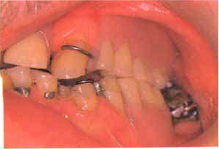
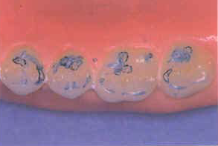
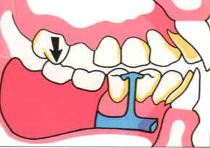

Slide 13
Patient instructions
Maintenance procedures:
1- brushing technique: Don’t squeeze denture, brush over a sink with water, use proper brush.
2- Cleaning agents
-hand soap. - Denture pastes or creams.
-Soak cleansers (not sodium hypochlorite
(bleach) solution)
3- Ultrasonic baths: adjunctive mean.
4- Not to use toothpastes or abrasive
cleansers.

Slide 14
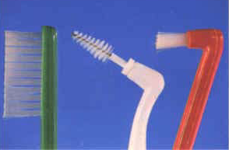
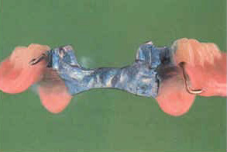
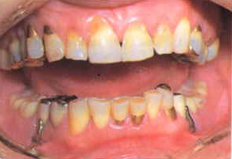
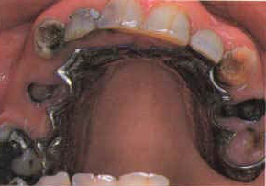

Slide 15
5- The pt should be advised not to adjust
Their RPD. They should contact their dentist.
Care of the oral tissues:
1- Sulcular brushing with a soft toothbrush
2- Flossing, interproximal brushes
3- Brushing the soft tissues adjacent and
covered with the denture using soft brush.
4- Rinses may be beneficial.
5- Fluoride, may be useful for patients who
demonstrate increased risk for caries.

Slide 16
Placement and removal of RPD
The proper placement and removal of RPD should be demonstrated and pt should be able to manage the denture before leaving the office.
Finger pressure To seat the RPD
Not to bite into place.

Slide 17
Wearing the partial denture
1-Bulk: days to weeks to accept RPD.
2-Speech: reading aloud.
3-Mastication: smaller portions of softer foods.
4-Saliva: initially.

Slide 18
RPD should be removed from the mouth
several hours daily to facilitate tissue health.
Exceptions are:
1-RPD that splints hypermobile teeth.
2- RPD that maintains OVD.

Slide 19
Maintenance
A- Periodontal
1- Recall intervals short intervals for pt
with active periodontal disease (2-4 months),
long for pt without active periodontal
disease (6-12 months).
Consider shorter intervals initially after RPD
delivery.
2- Plaque control instructions
Intraoral hygiene instructions, RPD instructions.

Slide 20
3- Evaluate periodontal health, especially RPD abutments.
4- Periodontal ttt as required.
B- Restorative
1- Tooth examination: Caries, defective
Restorations.
2- RPD examination: Extraoral fracture
of components, wear of artificial teeth
Intraoral Muco-osseous support,
retention, stability, occlusion and articulation.

Slide 21
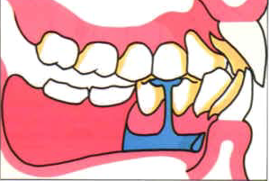
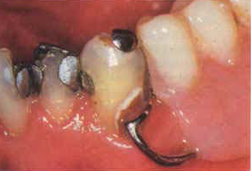
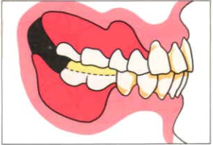
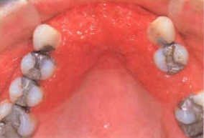
Teeth wear

Slide 22
Post placement adjustments
A- Soft tissue adaptation.
1-Pt subjective evaluation
2-Clinical examination of soft tissues
3- Adjustment:
a- apply PIP. b- place RPD into the mouth
and verify complete seating. c- indelible
pencil may be used.

Slide 23
B- Occlusion
1- Pt subjective evaluation.
2- Clinical examination: visual, articulating paper, wax, shim stock.
3-Adjustment
C- Framework
1-Clasps. Retention may be modified as needed.
2-Minor connectors and proximal plates. The amount and location of tooth contact may be modified.

Slide 24
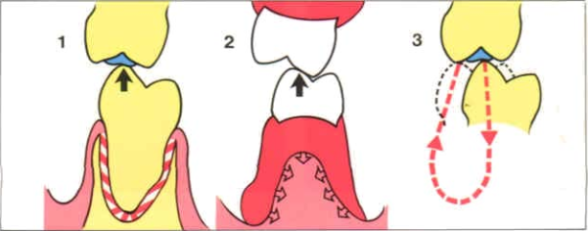

Slide 25
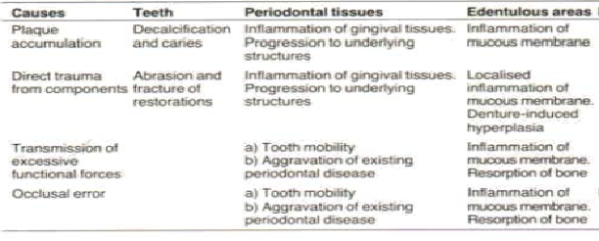
Summery of damage that may result from wearing a partial denture

Slide 26
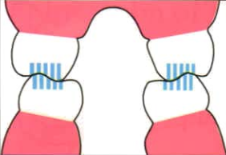
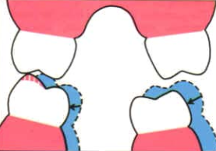
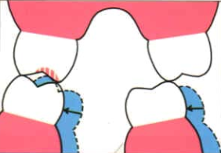
Supporting cusps maintain VD
Premature contact in ICP and lateral excu….. Reduce the cusp
Premature contact in ICP only….. Deepen the fossa

Slide 27
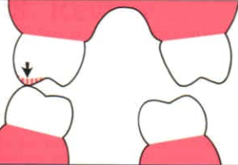
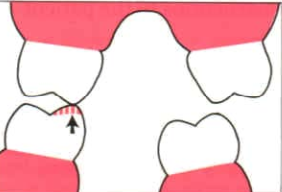
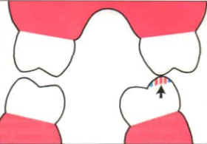
Premature contact b/w buccal Uand L cusp on
WS, BU adjusted
Premature contact b/w lingual Uand L cusp on
WS, LL adjusted (BULL rule)
Premature contact b/w supporting cusps on
NWS, the area of interference rather than area
of support

Slide 28
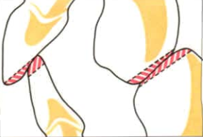
In protrusion, premature contacts eliminated
by grinding the distal facing inclines of U teeth
and mesial facing inclines of L teeth

