Slide 1


Slide 2
Vital signs
Dr H.A.Soleimani
MD. Gasteroentologist

Slide 3
General
Vital signs

Slide 4
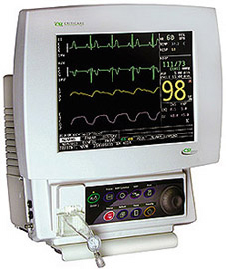
Vital sign
Vital signs are physical signs that indicate an individual is alive, such as heart beat, breathing rate, temperature, blood pressures and recently oxygen saturation.

Slide 5
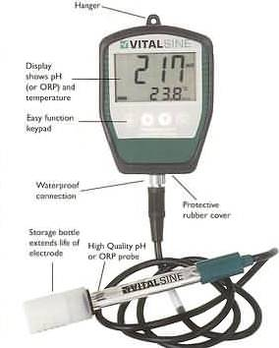
Vital sign
These signs may be observed, measured, and monitored to assess an individual's level of physical functioning.

Slide 6

Vital sign
Normal vital signs change with age, sex, weight, exercise tolerance, and condition.

Slide 7
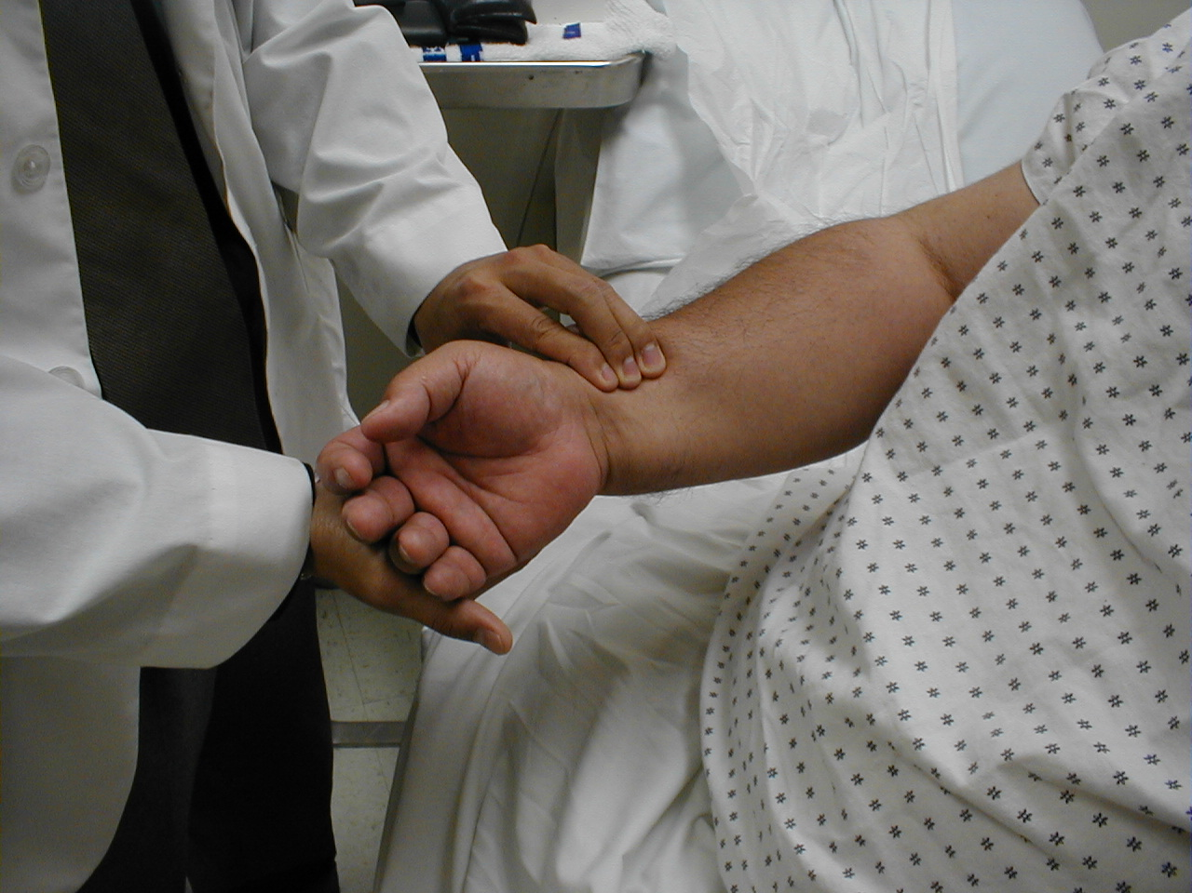
Vital sign
All measurements are made while the patient is seated.

Slide 8
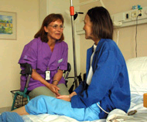
Vital sign
Prior to measuring vital signs, the patient should have had the opportunity to sit for approximately five minutes.

Slide 9
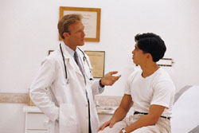
Observation
Before diving in, take a minute or so to look at the patient in their entirety.

Slide 10
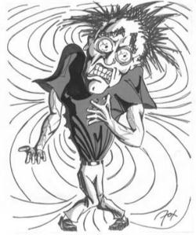
Observation
Does the patient seem anxious, in pain, upset? What about their dress and hygiene? Remember, the exam begins as soon as you lay eyes on the patient.

Slide 11
Temperature
Vital signs

Slide 12

Temperature
Old people, people with disabilities, babies and young children typically feel more comfortable at higher temperatures.

Slide 13

Temperature
Women notice that they are feeling cool quicker than men, which may be related to their different body size.

Slide 14
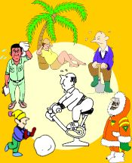
Temperature
The normal body temperature of a person varies depending on gender, recent activity, food and fluid consumption, time of day, and, in women, the stage of the menstrual cycle.

Slide 15
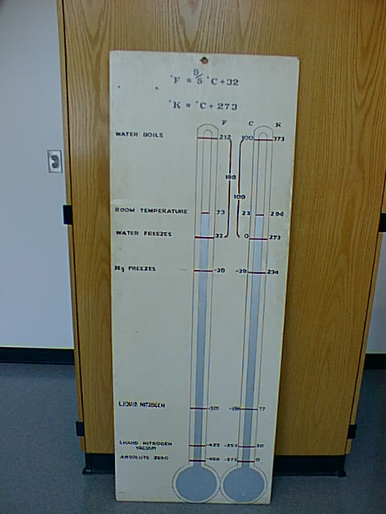
Temperature
Temperature is measured in either Celcius or Farenheit, with a fever defined as greater then 38-38.5 C or 101-101.5 F.

Slide 16
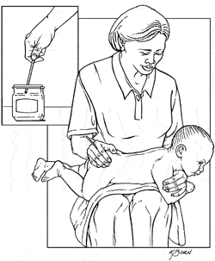
Temperature
Rectally temperatures taken rectally (using a mercury or digital thermometer) tend to be 0.5 to 0.7° (Fahrenheit) higher than when taken by mouth.

Slide 17
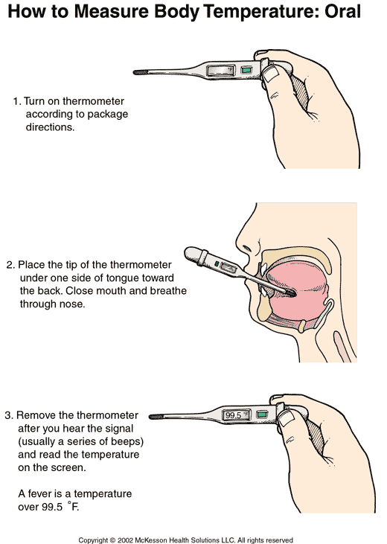
Temperature
Oral temperature can be taken by mouth using classic glass mercury-filled or digital thermometers.

Slide 18
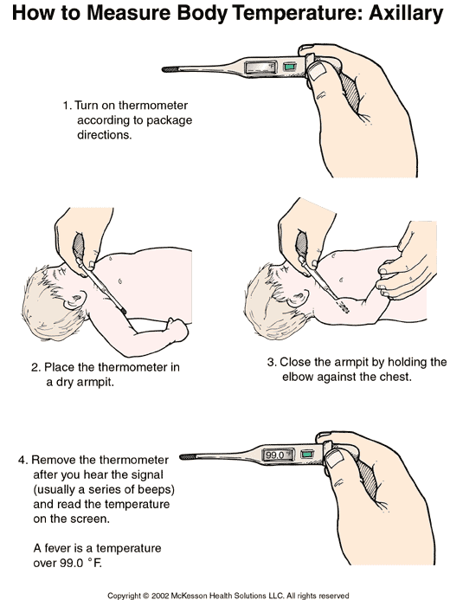
Temperature
Axillary temperatures can be taken under the arm. Temperatures taken by this route tend to be 0.3 to 0.4° (Fahrenheit) lower than those temperatures taken by mouth.

Slide 19
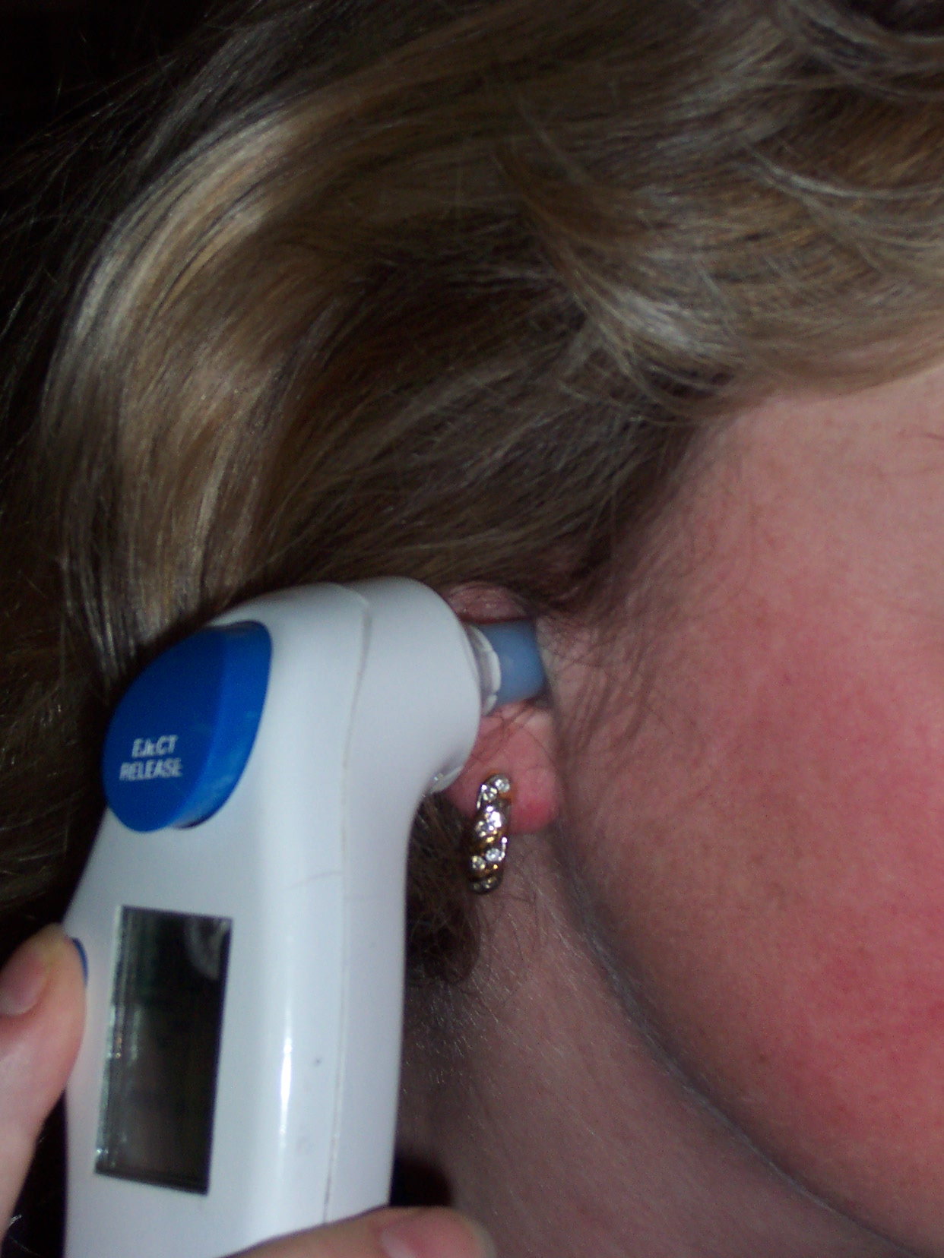
Temperature
By ear a special thermometer can quickly measure the temperature of the ear drum, which reflects the body's core temperature.

Slide 20
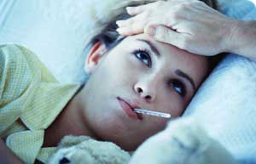
Fever
A fever is indicated when body temperature rises above 98.6° F orally or 99.8° F rectally.

Slide 21
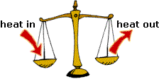
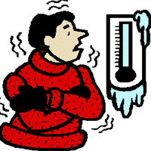
Hypothermia
Hypothermia is defined as a drop in body temperature below 95° F.

Slide 22
Respiration rate
Vital signs

Slide 23
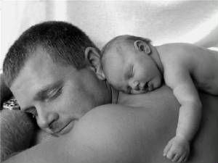
What is the respiration rate?
The respiration rate is the number of breaths a person takes per minute.

Slide 24
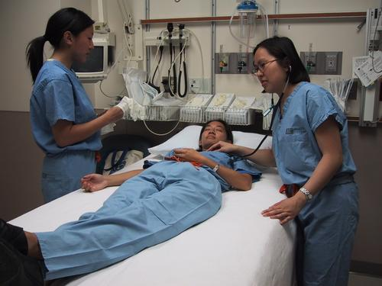
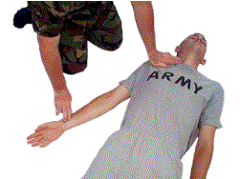
Respiratory Rate
Try to do this as surreptitiously as possible. Observing the rise and fall of the patient's hospital gown while you appear to be taking their pulse.

Slide 25
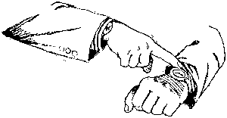
Respiratory Rate
They should be counted for at least 30 seconds 15 second period is rather small and any miscounting can result in rather large errors when multiplied by 4.

Slide 26
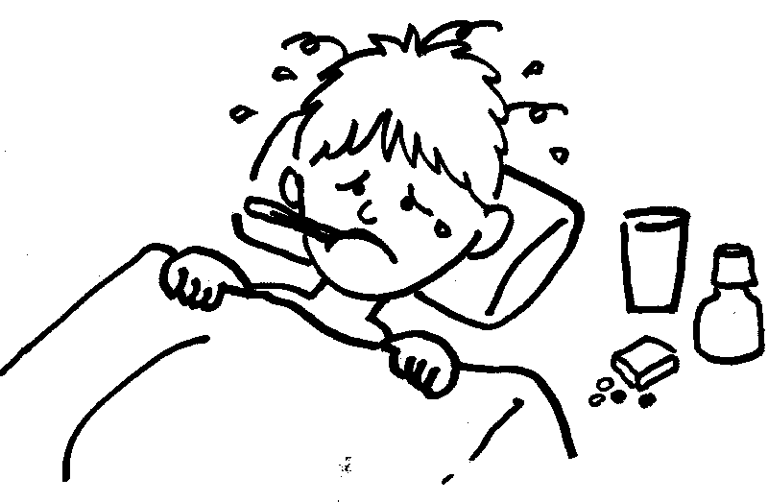
Respiratory Rate
Respiration rates may increase with fever, illness,…. When checking respiration, also note whether a person has any difficulty breathing.

Slide 27
Abnormal Respiratory Rate
Respiration rates over 25 or under 12 breaths per minute (when at rest) may be considered abnormal
under 12 breaths
over 25 breaths

Slide 28
Respiratory Rate
Normal respiration rates at rest range from 15 to 20 breaths per minute. In the cardio-pulmonary illness, it can be a very reliable marker of disease activity.
15
20

Slide 29
Pulse
Vital signs

Slide 30
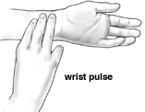
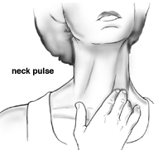
Pulse rate
The normal pulse for healthy adults ranges from 60 to 100 beats per minute.

Slide 31
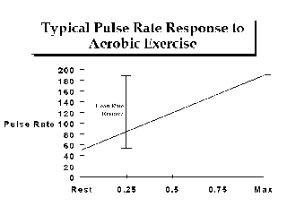
Pulse rate
The pulse rate may fluctuate and increase with exercise, illness, injury, and emotions. Girls ages 12 and older and women, in general, tend to have faster heart rates than do boys and men.

Slide 32
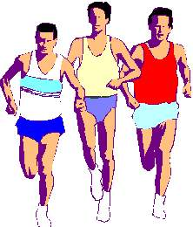
Pulse rate
Athletes, such as runners, may have heart rates in the 40's and experience no problems.

Slide 33
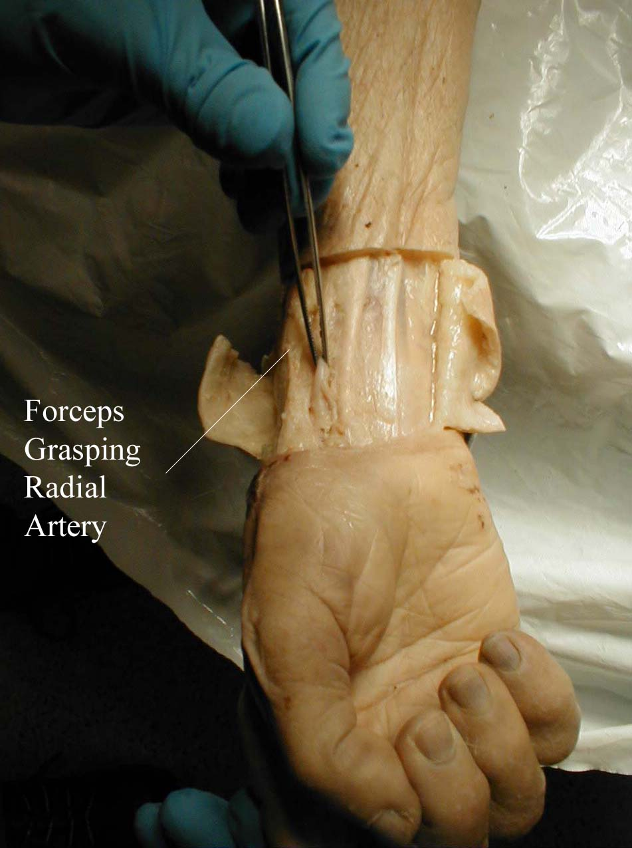
How to check your pulse
You feel the beats by firmly pressing on the arteries, which are located close to the surface of the skin at certain points of the body.

Slide 34
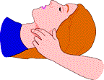
How to check your pulse
The pulse can be found on the side of the lower neck, on the inside of the elbow, or at the wrist.

Slide 35
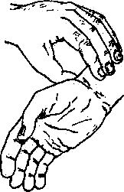
Pulse
Place the tips of your index and middle fingers just proximal to the patients wrist on the thumb side, orienting them so that they are both over the length of the vessel.

Slide 36
Pulse
Push lightly at first, adding pressure if there is a lot of subcutaneous fat or you are unable to detect a pulse. If you push too hard, you might occlude the vessel and mistake your own pulse for that of the patient.

Slide 37
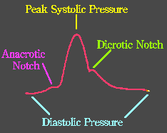
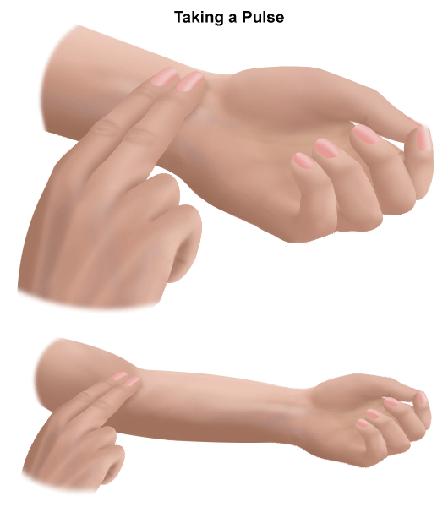
Pulse: Quantity
Measure the rate of the pulse (recorded in beats per minute). Count for 30 seconds and multiply by 2 (or 15 seconds x 4).

Slide 38
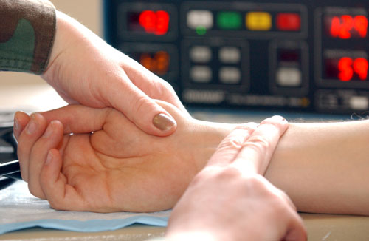
Pulse: Quantity
If the rate is particularly slow or fast, it is probably best to measure for a full 60 seconds in order to minimize the error.

Slide 39
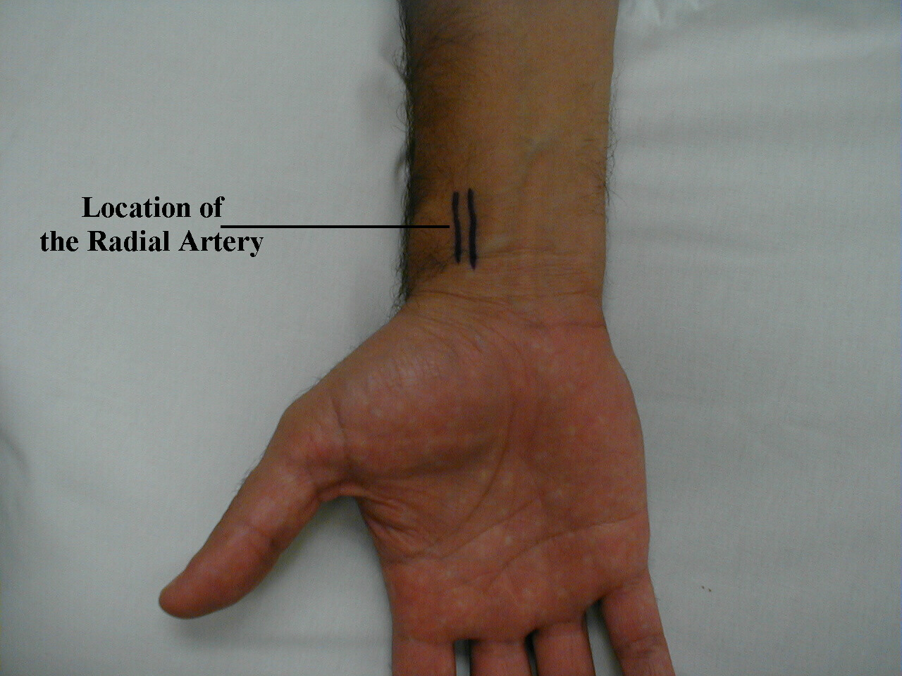
Pulse: Regularity
Is the time between beats constant?. Irregular rhythms, are quite common.

Slide 40
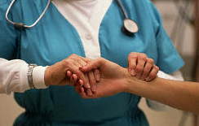
Pulse: Volume
Does the pulse volume feel normal? This reflects changes in stroke volume. In hypovolemia, the pulse volume is relatively low

Slide 41
Blood pressure
Vital signs

Slide 42
Preparation for measurement

Slide 43

Preparation for measurement
Patient should abstain from eating, drinking, smoking and taking drugs that affect the blood pressure one hour before measurement.

Slide 44


Remember the following for accuracy of your readings
Instruct your patients to avoid coffee, smoking or any other unprescribed drug with sympathomimetic activity on the day of the measurement

Slide 45
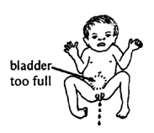
Preparation for measurement
Because a full bladder affects the blood pressure it should have been emptied.

Slide 46
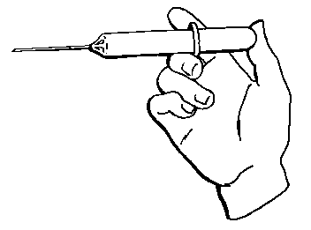
Preparation for measurement
Painful procedures and exercise should not have occurred within one hour.
Patient should have been sitting quietly for about 5 minutes.

Slide 47
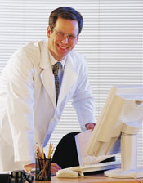
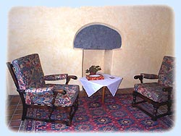
Preparation for measurement
BP take in quiet room and comfortable temperature, must record room temperature and time of day.

Slide 48
Position of the Patient

Slide 49
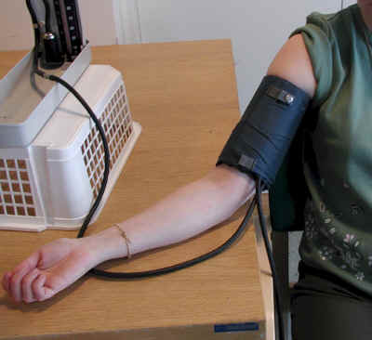
Position of the Patient
Sitting position
Arm and back are supported.
Feet should be resting firmly on the floor
Feet not dangling.

Slide 50
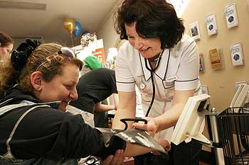
Position of the arm
The measurements should be made on the right arm whenever possible.
Patient arm should be resting on the desk and raised (by using a pillow)
Notes:
a triangular cavity of the elbow joint that contains a tendon of the biceps, the median nerve, and the brachial artery

Slide 51
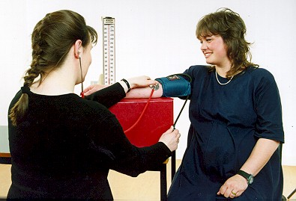
Position of the arm
Raise patient arm so that the brachial artery is roughly at the same height as the heart. If the arm is held too high, the reading will be artifactually lowered, and vice versa.

Slide 52
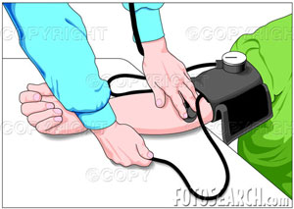
Position of the arm
Palm is facing up.
The arm should remain somewhat bent and completely relaxed
Notes:
a triangular cavity of the elbow joint that contains a tendon of the biceps, the median nerve, and the brachial artery

Slide 53
Equipment

Slide 54
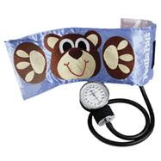
In order to measure the Blood Pressure (equipment)
Pediatric Cuff size
  Minimum Cuff Width: 2/3 length of upper arm
  Minimum Cuff length: Bladder nearly encircles arm

Slide 55
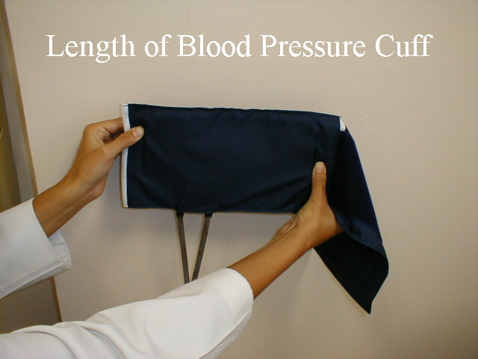
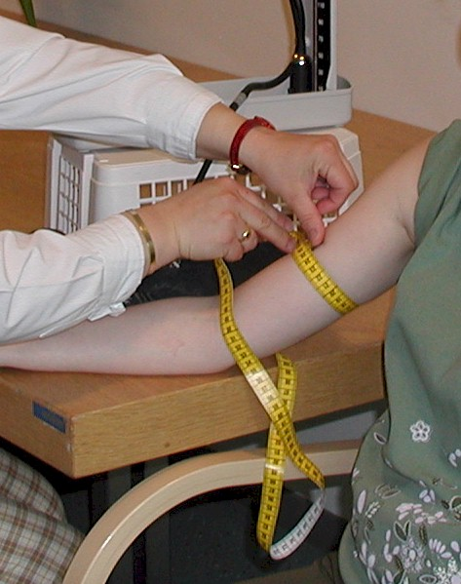
In order to measure the Blood Pressure (equipment)
Adult Cuff size
  Cuff Width: 40% of limb's circumference
  Cuff Length: Bladder at 80% of limb's circumference

Slide 56
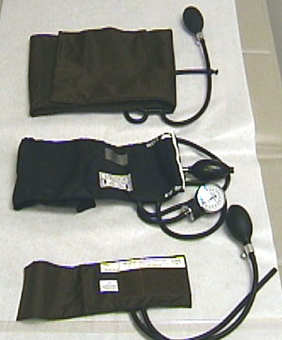
In order to measure the Blood Pressure (equipment)
Adult Cuff size
  Indications for large cuff or thigh cuff
    Upper arm circumference >34 cm
  Indications for forearm cuff (with radial palpation)
    Upper arm circumference >50 cm

Slide 57
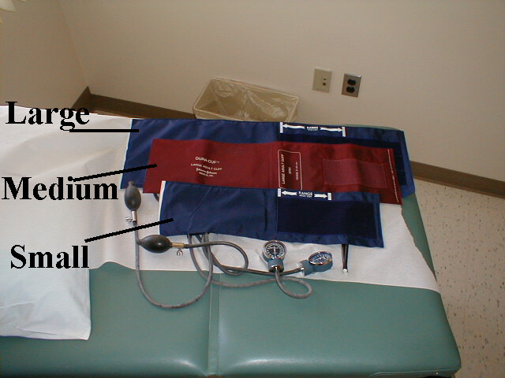
Blood Pressure
If it is too small, the readings will be artificially elevated. The opposite occurs if the cuff is too large. Clinics should have at least 2 cuff sizes available, normal and large.

Slide 58
Cuff Position

Slide 59
In order to measure the Blood Pressure (Cuff Position)
Patient's arm slightly flexed at elbow
Push the sleeve up, wrap the cuff around the bare arm

Slide 60
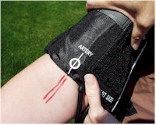
In order to measure the Blood Pressure (Cuff Position)
Cuff applied directly over skin (Clothes artificially raises blood pressure )
Position lower cuff border 2.5 cm above antecubital
Center inflatable bladder over brachial artery

Slide 61
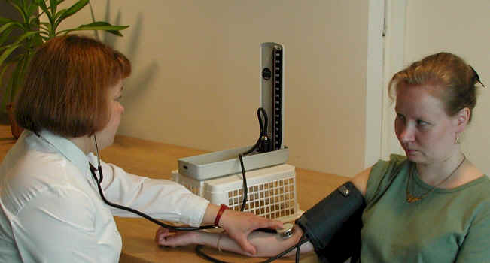
Measurement of the pulse rate
The manometer scale should be at eye level, and the column vertical. The patient should not be able to see the column of the manometer

Slide 62
Technique of BP measurement

Slide 63
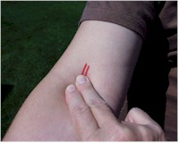
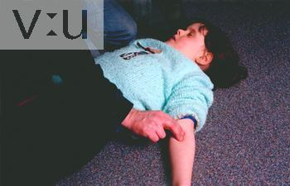
In order to measure the BP
Feel for a pulse from the artery coursing through the inside of the elbow (antecubital fossa).

Slide 64
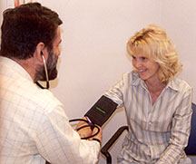
In order to measure the BP
Wrap the cuff around the patient's upper arm
Close the thumb-screw.

Slide 65

In order to measure the BP
With your left hand place the stethoscope head directly over the artery you found. Press in firmly but not so hard that you block the artery.

Slide 66

Technique of BP measurement
Use your right hand to pump the squeeze bulb several times and Inflate the cuff until you can no longer feel the pulse to level above suspected SBP

Slide 67

Technique of BP measurement
If you immediately hear sound, pump up an additional 20 mmHg and repeat

Slide 68

Technique of BP measurement
Deflate cuff slowly at a rate of 2-3 mmHg per second until you can again detect a radial pulse

Slide 69

Technique of BP measurement
Listen for auditory vibrations from artery "bump, bump, bump" (Korotkoff)

Slide 70

In order to measure the BP
Systolic blood pressure is the pressure at which you can first hear the pulse.

Slide 71

In order to measure the BP
Diastolic blood pressure is the last pressure at which you can still hear the pulse

Slide 72
In order to measure the BP
Avoid moving your hands or the head of the stethescope while you are taking readings as this may produce noise that can obscure the Sounds of Koratkoff.

Slide 73

Technique of BP measurement
BP must take in both arms and one lower extremity.

Slide 74

In order to measure the BP
The two arm readings should be within 10-15 mm Hg. Differences greater then 10-15 imply differential blood flow.

Slide 75

In order to measure the BP
If you wish to repeat the BP measurement you should allow the cuff to completely deflate, permit any venous congestion in the arm to resolve and then repeat a minute or so later.

Slide 76

Remember the following for accuracy of your readings
If the BP is surprisingly high or low, repeat the measurement towards the end of your exam (Repeated blood pressure measurement can be uncomfortable).

Slide 77

In order to measure the BP
You can verify the SBP by palpation. Place the index and middle fingers of your right hand over the radial artery.

Slide 78
What Abnormal Results Mean

Slide 79

In order to measure the BP
Diastolic blood pressure allow free flow of blood without turbulence and thus no audible sound. These are known as the Sounds of Koratkoff.

Slide 80

Blood pressure
The minimal SBP required to maintain perfusion varies with the individual. Interpretation of low values must take into account the clinical situation.

Slide 81

Blood pressure for adult
Physician will want to see multiple blood pressure measurements over several days or weeks before making a diagnosis of hypertension and initiating treatment.

Slide 82
What Abnormal Results Mean
Pre-high blood pressure: systolic pressure consistently 120 to 139, or diastolic 80 to 89
Stage 1 high blood pressure: systolic pressure consistently 140 to 159, or diastolic 90 to 99

Slide 83

What Abnormal Results Mean
Stage 2 high blood pressure: systolic pressure consistently 160 or over, or diastolic 100 or over

Slide 84

What Abnormal Results Mean
Hypotension (blood pressure below normal): may be indicated by a systolic pressure lower than 90, or a pressure 25 mmHg lower than usual

Slide 85

Hypertension
High blood pressure greater than 139-89..

Slide 86

Blood pressure (mm Hg)
Normal blood pressure 100/60 and 139/89.
Prehypertension 120,139-80,89…

Slide 87
Blood pressure may be affected by many different conditions

Slide 88

Blood pressure may be affected by many different conditions
Cardiovascular disorders
Neurological conditions
Kidney and urological disorders

Slide 89

Blood pressure may be affected by many different conditions
Pre eclampsia in pregnant women
Psychological factors such as stress, anger, or fear
Eclampsia

Slide 90


Blood pressure may be affected by many different conditions
Various medications
"White coat hypertension" may occur if the medical visit itself produces extreme anxiety

Slide 91
Orthostatic Hypotention

Slide 92

Remember the following for accuracy of your readings
Orthostatic (postural) measurements of pulse and blood pressure are part of the assessment for hypovolemia.

Slide 93

Remember the following for accuracy of your readings
First measuring BP when the patient is supine and then repeating them after they have stood for 2 minutes, which allows for equilibration.

Slide 94

Remember the following for accuracy of your readings
Systolic blood pressure does not vary by more then 20 points when a patient moves from lying to standing.

Slide 95

Remember the following for accuracy of your readings
Orthostatic measurements may also be used to determine if postural dizziness (diabethic autonomic nervous system dysfunction) is the result of a fall in blood pressure.

Slide 96
Oxygen Saturation
Vital signs

Slide 97

Oxygen Saturation
Over the past decade, Oxygen Saturation measurement of gas exchange and red blood cell oxygen carrying capacity has become available in all hospitals and many clinics.

Slide 98

Oxygen Saturation
Oxygen Saturation provide important information about cardio-pulmonary dysfunction and is considered by many to be a fifth vital sign.

Slide 99

Oxygen Saturation
For those suffering from either acute or chronic cardio-pulmonary disorders, Oxygen Saturation can help quantify the degree of impairment.

Slide 100
THANK TOU

