Slide 1
Renal disease in dentistry

Slide 2
Introduction
The kidneys are vital organs for maintaining homeostasis
Maintenance of water and electrolytes balance
Maintenance of acid base balance
Synthesis of erythropoietin
Vitamin D metabolism
Regulation of B.P through the renin- angiotensine system

Slide 3
Kidney function
GFR: 100-150ml/minute
<20%: renal failure
<25%:end stage renal disease
25-40%: renal insufficiency
60-75%: decreased renal reserve
BUN: 10-20mg/dl
Creatinin:0.3-1.5 mg/dl
Electrolytes (Na, K , p ,Ca ):
Urine analysis: PH, colour, specific gravity, proteins, RBC, leukocytes

Slide 4
Kidney disease
Chronic renal failure
Dialysis
Renal transplant
Nephrotic syndrome

Slide 5
Chronic renal failure
A slowly progressive disease characterised by irreversible reduction of GFR over a period of months to years.
Signs and symptoms depend on the degree of renal malfunction
Asymptomatic-----nocturia, anorexia-------ESRD (uremic syndrome)

Slide 6
Clinical features of chronic renal failure
Cardiovascular: HTN, CHF
Gastrointestinal: anorexia, nausea, vomiting, peptic ulcer
Neurological: lassitude, headache, tremor
Dermatological: itching, hyperpigmentation
Haematological: bleeding tendency, anaemia, susceptibility to infection
Musculoskeletal: renal osteodystrophy, growth retardation
Metabolic: thirst, polyuria, secondary hyperparathyroidism

Slide 7
Classification of chronic renal failure
Stage 1: kidney damage with normal GFR (90%)
Stage 2: mildly decreased GFR (60-90%)
Stage 3: moderately decreased GFR (30-60%)
Stage 4: severely decreased GFR (15-30%)
Stage 5: kidney failure (GFR<15%)

Slide 8
Causes of chronic renal failure
Diabetes mellitus
Hypertension
Glomerulonephritis
Poly cystic kidney disease
Reno-vascular disease
Idiopathic

Slide 9
Management of chronic renal failure
Conservative: mild to moderate disease: this involves
– restricting fluid intake
restricting protein to minimise the increase in BUN
Restricting dietary Na, K, Cl, Mg, p, Al
Diuretics to maintain appropriate fluid balance
Control of blood pressure

Slide 10
Management of chronic renal failure
Dialysis: severe disease when medical management fails
Removes fluid and wastes and equilibrate electrolytes and acid-bases
Relies on the patient’s blood being exposed to a solution hypotonic in metabolites (dialysate) across a semi-permeable membrane
Two types
Peritoneal
Haemodialysis

Slide 11
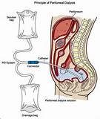

Peritoneal dialysis: performed by the patient
A dialysis catheter is surgically placed into the peritoneum, which is a semipermeable membrane and is used for access. This form of dialysis is performed by the patient four to five exchanges a day, whereby 2 to 3 L of dialysate is infused over 30 minutes, allowed to dwell within the peritoneum for 2 to 4 hours, and then allowed to drain.

Slide 12
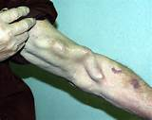
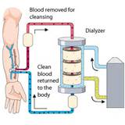
Haemodialysis: a vascular access is achieved by forming an arteriovenous fistula
uses an artificial kidney that circulates blood along a semipermeable membrane.
Haemodialysis is typically performed three times a week; each session is for about 4 hours.
Heparin is used to prevent activation of the clotting cascade by dialysis membranes

Slide 13
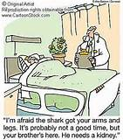
Management of chronic renal failure
Renal transplant: ESRD
Is limited by the availability of donor organs
Survival of renal transplant at 1 year is 90% and at 10 years is 55%
Complications include
Increased incidence of cardiovascular disease
Increased incidence of malignancies (skin, lymphoma...)
Side effects of drugs: steroids, Immunosuppression

Slide 14
Dental aspect of CRF
Oral manifestations
Halitosis due to increased blood level of urea and ammonia
Xerostomia (fluid restriction, medications)
Metallic taste due to increased blood level of urea and changes in salivary PH
Mucosal pallor due to anaemia
Uremic stomatitis: usually seen in ESRD and present as oral mucosal erythema and ulceration
Petechia and echymosis due to uremia induced platelet dysfunction
Delayed eruption of teeth and enamel hypoplasia in children
Salivary gland swelling in dialysis

Slide 15
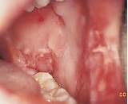
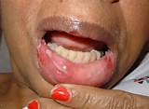
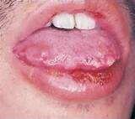
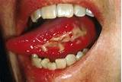

Slide 16

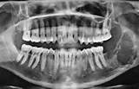
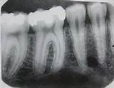
Oral manifestations related to renal osteodystrophy and include
Osteoporosis and osteolytic areas
Loss of lamina dura
Decreased bone trabeculation
Ground glass appearance
Secondary hyperparathyroidism may lead to giant cell lesions (brown tumour)

Slide 17
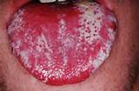
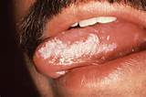
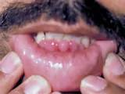
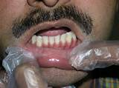
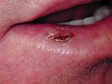
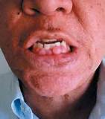
Oral manifestations related to Immunosuppression after renal transplant and include
oral infections (candidiosis, HSV....)
Hairy leukoplakia
Cyclosporine induced gingival hyperplasia
Increased incidence of skin and lip cancer

Slide 18
Dental aspect of CRF
Dental treatment may be complicated by
Bleeding tendency due to uraemia induced platelet dysfunction or the use of heparin
Anaemia due to reduced erythropoietin production
Associated co morbidities such as diabetes, hypertension, and congestive heart failure
Dysrhythmias due to hyperkalaemia
Impaired drug excretion
Increased susceptibility to infection
Blood born infections (HBV, HCV, HIV)
Corticosteroid and Immunosuppression therapy post transplant

Slide 19
Dental aspect of CRF
Consultation with renal physician is advised
Most patients are best treated under LA; GA can be complicated by anaemia and electrolytes disturbances
Patients are best treated the day after dialysis when there has been maximal benefit from dialysis and the effect of heparin has worn off
Bleeding tendency should be excluded before surgical procedures (BT, PT, PTT, INR) and local haemostatic measures should be applied

Slide 20
Dental aspect of CRF
Antibiotic prophylaxis is recommended before surgical procedures because of the increased susceptibility to infection and to prevent infection of the arterio-venous fistulae in dialysis patients
Early and aggressive treatment of odontogenic infections is advised to prevent spread of infection
Corticosteroid boost may be required before surgical procedures in patients treated with systemic steroids
Avoid the use of A-V fistula for blood pressure measurement , I.V sedation or venepuncture

Slide 21
Dental aspect of CRF
Many drugs are metabolised or excreted by the kidney
Drug dosage should be adjusted according to renal function
Nephrotoxic drugs should be avoided

Slide 22
Dental aspect of CRF
NSAIDs, aspirin, tetracyclins, gentamycin are nephrotoxic and should be avoided
Local anaesthesia is safe
Paracetamole is safe
amoxicillin, ampicillin, metronidazole, clindamycin, lincomycin: dose should be reduced according to renal function (GFR)
Erythromycin, azithromycin, doxycycline, minocycline, cloxacillin, flucloxacillin: are generally safe at normal dose
Codeine: dose should be reduced according to the GFR

Slide 23
Dental aspect of CRF
Mild CRF managed conservatively:
Consult physician to determine the stage of the disease
Be aware of associated co-morbidities such as diabetes and hypertension
Avoid nephrotoxic drugs (NSAIDs, tetracycline, aminoglycosides), and adjust drug dosage according to GFR
Consider bleeding tendency if invasive dental procedure is planned (arrange BT, hemostatic measures)

Slide 24
Dental aspect of CRF
Patients on peritoneal dialysis:
Consult physician to determine the stage of the disease
Be aware of associated co-morbidities such as diabetes and hypertension
Avoid nephrotoxic drugs (NSAIDs, tetracycline, aminoglycosides) , and adjust drug dosage according to GFR
Consider bleeding tendency if invasive dental procedure is planned (arrange BT, hemostatic measures)

Slide 25
Dental aspect of CRF
Patients on haemodialysis:
+
Dental treatment is best performed the day after dialysis
avoid trauma to the A-V fistula, don't use for blood pressure measurement or venepuncture
Adjust drug dosage according to GFR
Prophylactic antibiotics are recommended before surgical proceduresto prevent infection of A-V fistula
Cross infection hazard (HBV, HCV, HIV)

Slide 26
Dental aspect of CRF
Patients with kidney transplant
+
Consider steroid cover
Consider prophylactic antibiotics; patients are immunosuppressed. Erythromycin is contraindicated in patients taking cyclosporine
Adjust drug dosage according to GFR
Examine oral mucosa and skin carefully; patients have increased risk of malignancy

Slide 27
Nephrotic syndrome
Proteinurea
Hypoalbumenemia
Hyperlipidemia
Hypercoaguabiity (increased blood concentration of clotting factors)

Slide 28
Nephrotic syndrome
Causes
Diabetes
Amyloidosis
SLE, other autoimmune diseases
Idiopathic

Slide 29
Dental aspect
Dental treatment is influenced by the degree of kidney malfunction
Patients are usually treated with systemic steroids
Patients are more susceptible to infection due to steroid therapy, hypoproteinemia, and hypoimmunoglubulinemia
Patients are usually treated with anti-coagulants (warfarin, heparin) to prevent thrombosis

Slide 30
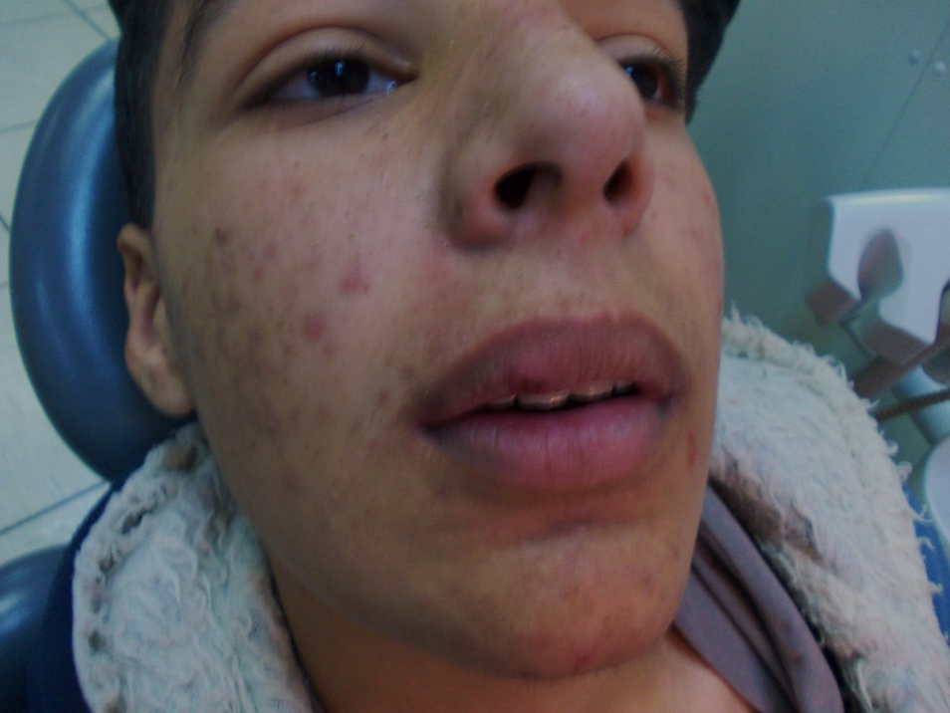
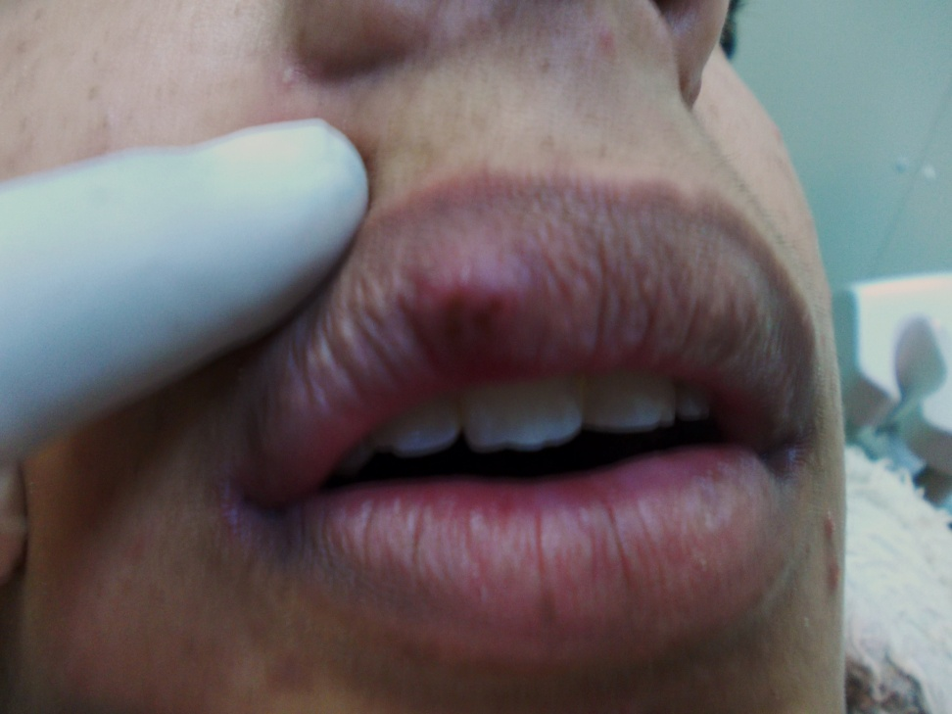
Dental aspect
Facial and labial oedema is common finding in these patients

