Slide 1
ACUTE RENAL FAILURE
Dr. Abdelaziz Ahmed
3/12/2013

Slide 2
ANATOMY

Slide 3
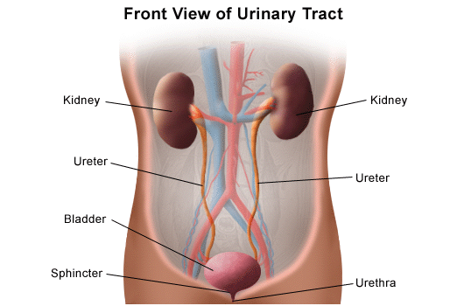

Slide 4
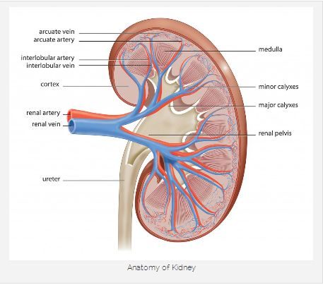

Slide 5
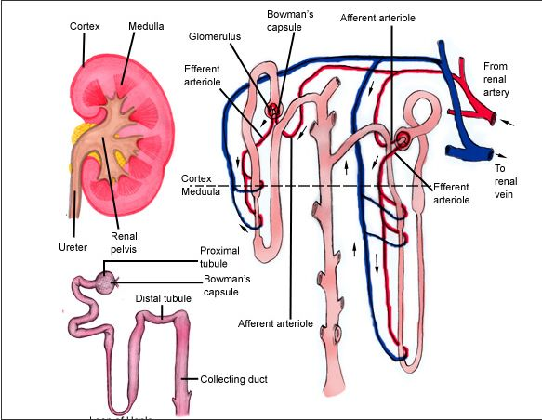

Slide 6
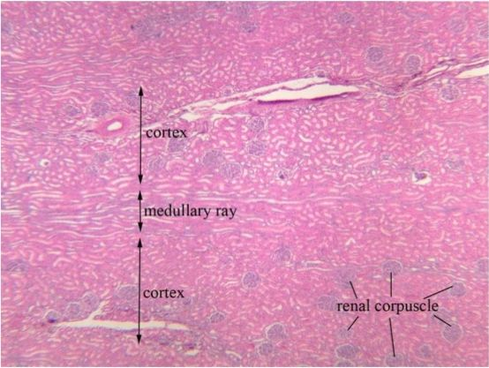

Slide 7
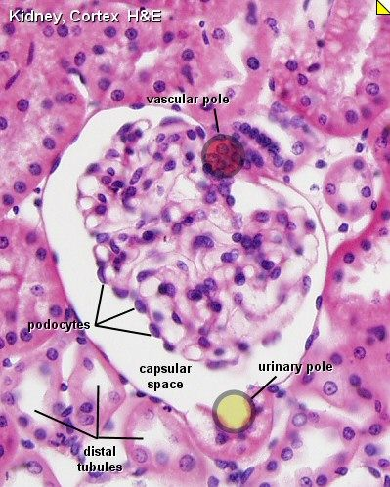

Slide 8
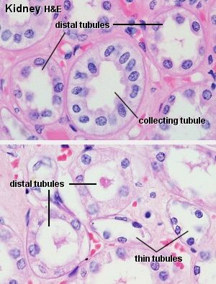

Slide 9
Physiology

Slide 10
what does the kidney do?
Excretion of wastes
Reabsorption of vital nutrients
Acid-base homeostasis
Osmolality regulation: ADH
Blood pressure regulation
Hormone secretion: Erythropoietin, Vit. D

Slide 11
Acute Renal Failure

Slide 12
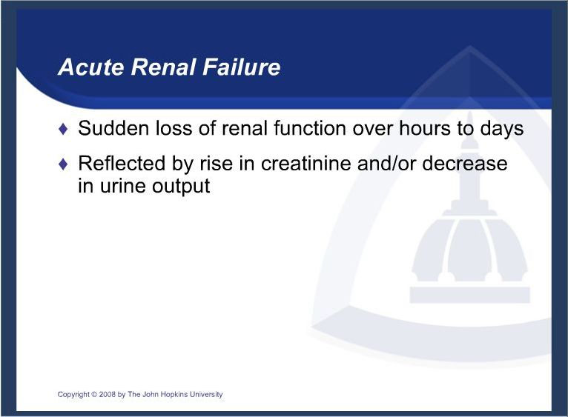

Slide 13
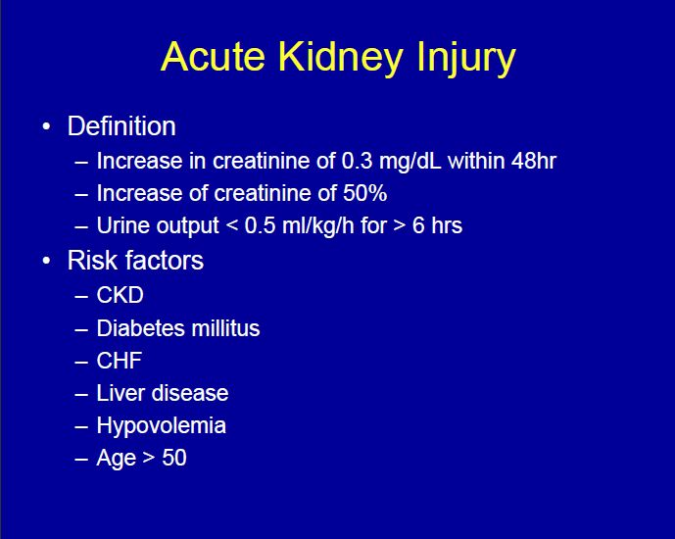

Slide 14
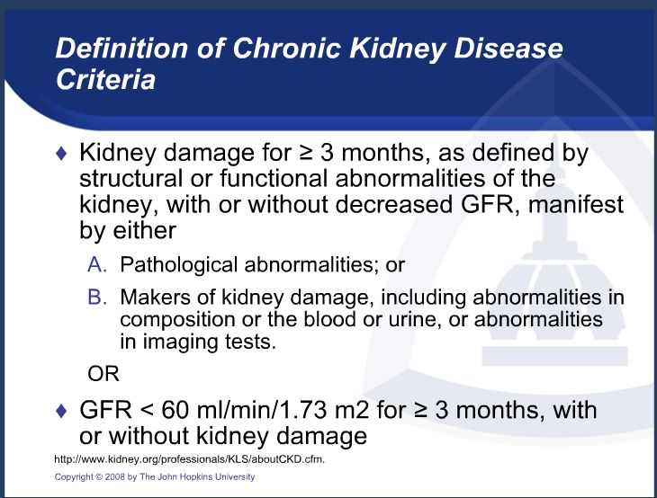

Slide 15
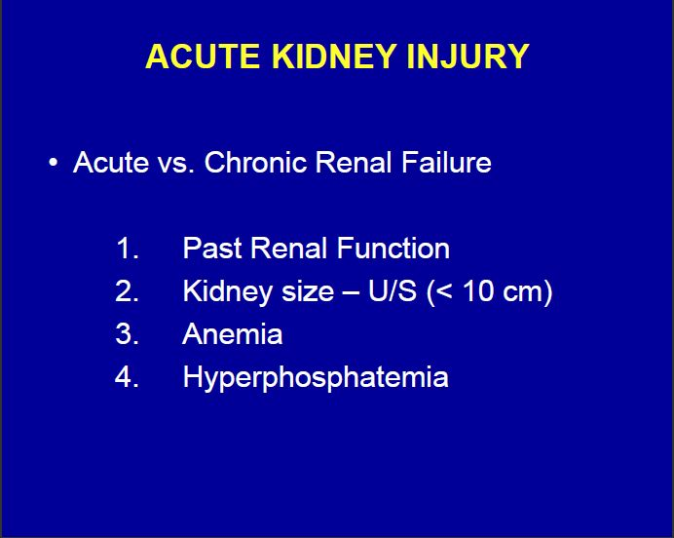

Slide 16
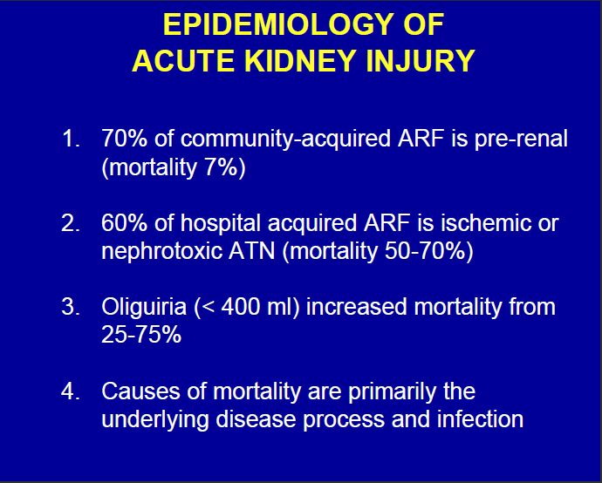

Slide 17
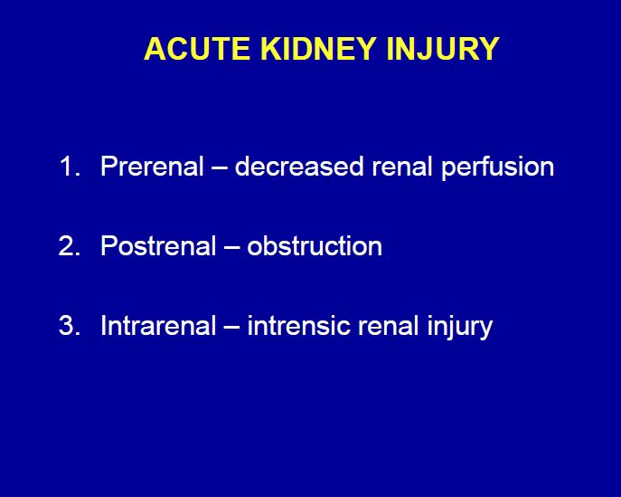

Slide 18
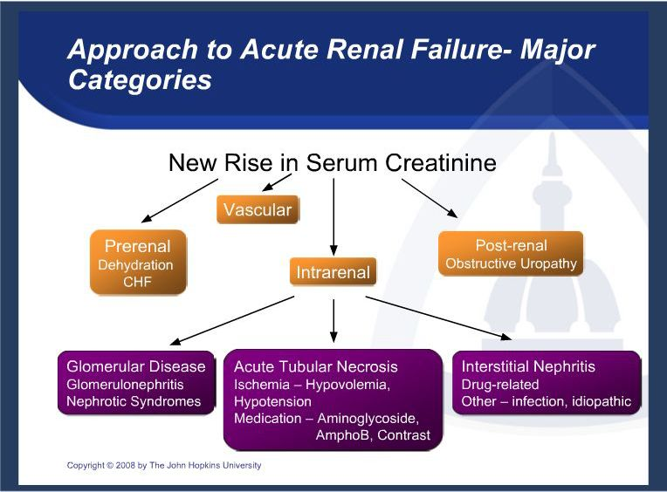

Slide 19
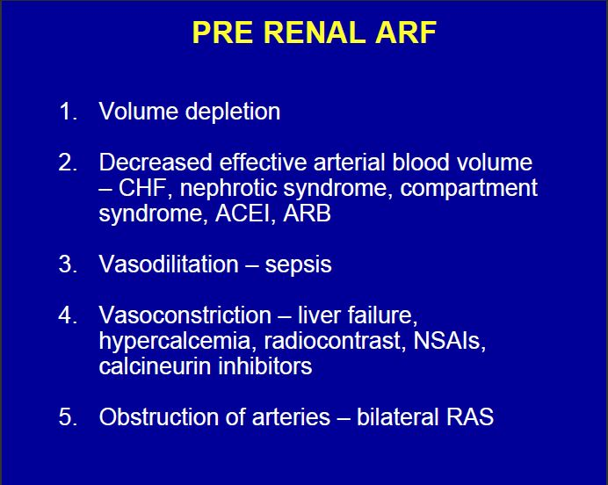

Slide 21
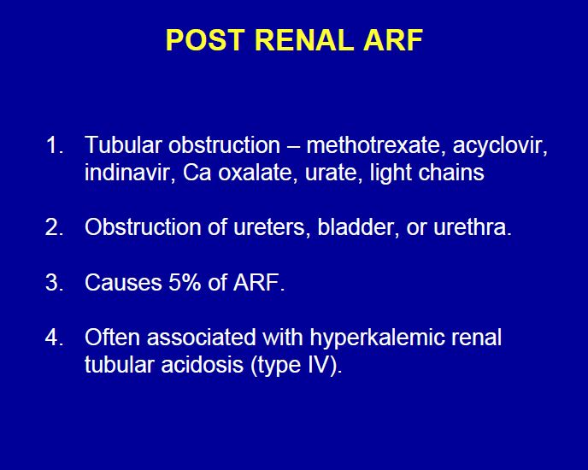

Slide 23
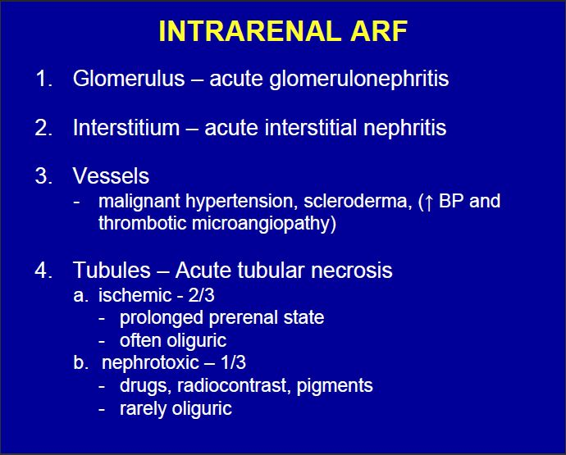

Slide 25
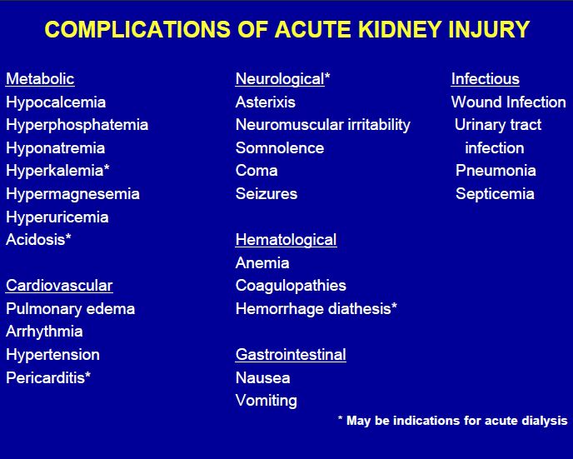

Slide 26
Scenarios

Slide 27
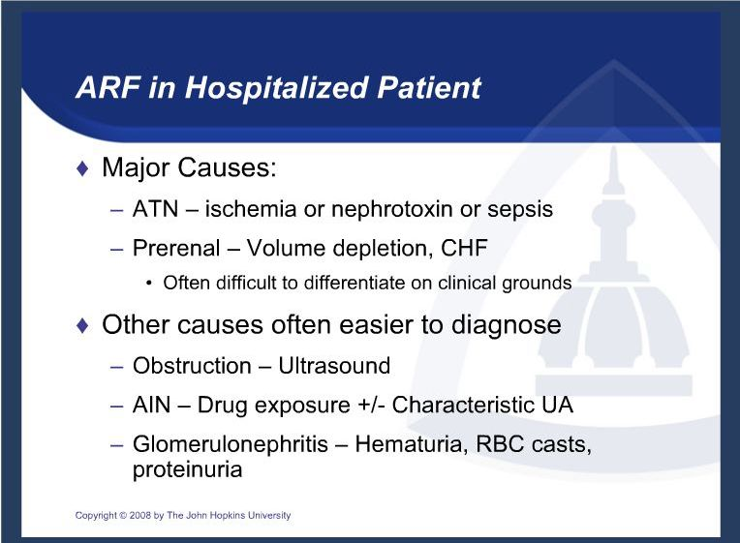

Slide 28
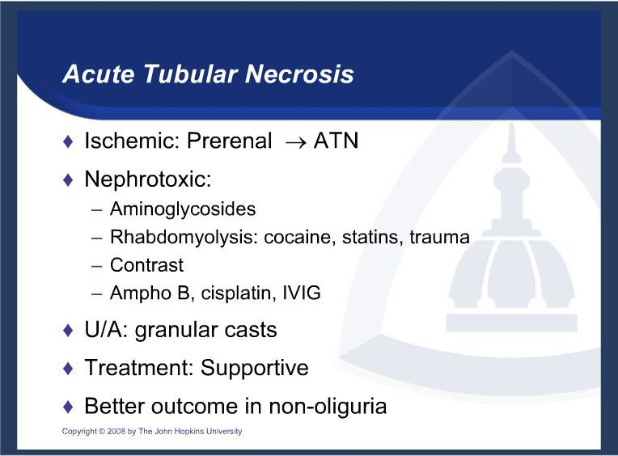

Slide 29
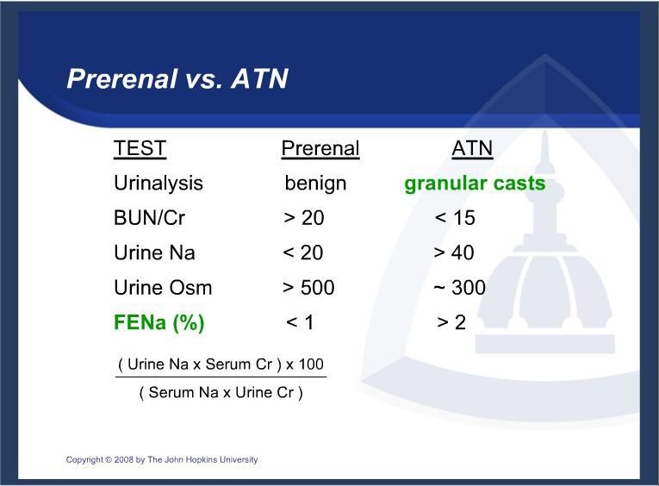

Slide 30
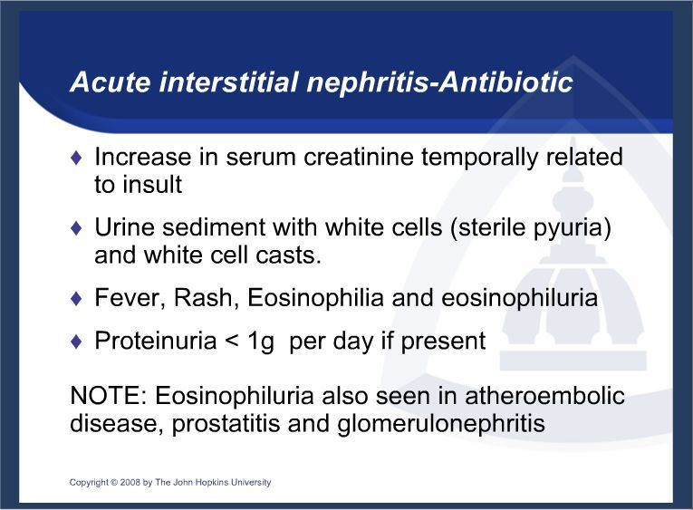

Slide 31
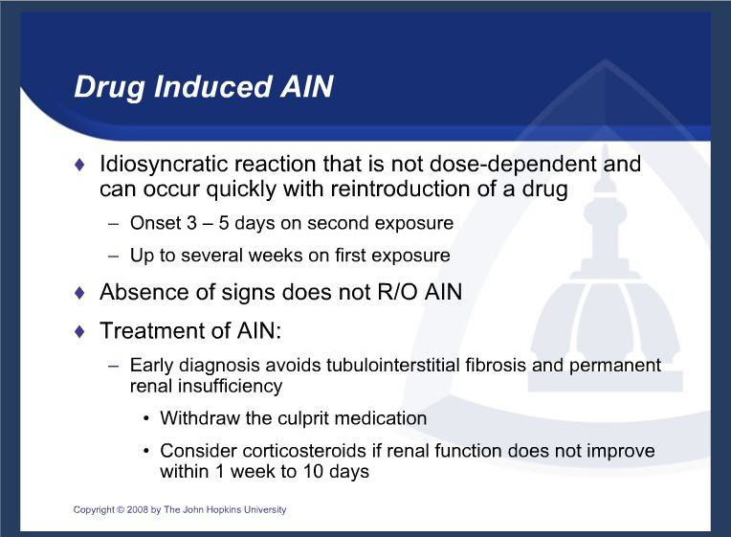

Slide 32
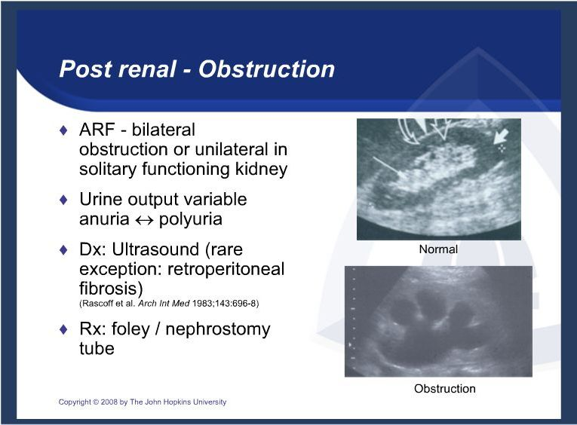

Slide 34
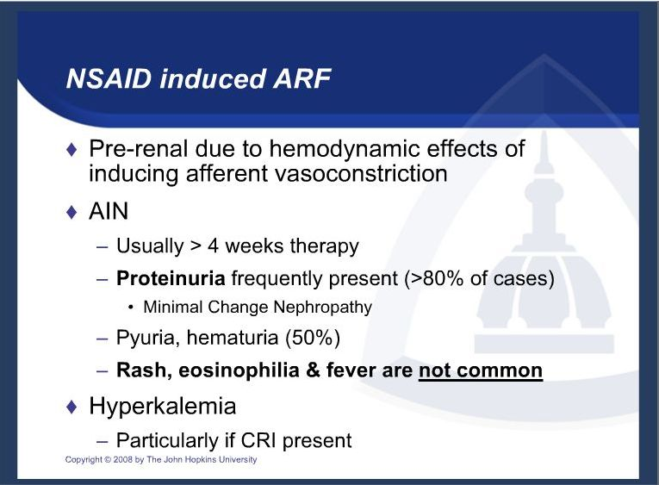

Slide 35
Radiocontrast-Induced
Acute Renal Failure
Induces renal vasoconstriction and direct cytotoxicity via oxygen free radical formation
Usually non-oliguric ARF; irreversible ARF rare

Slide 36
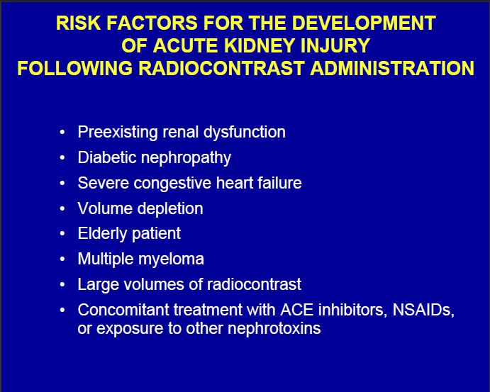

Slide 37
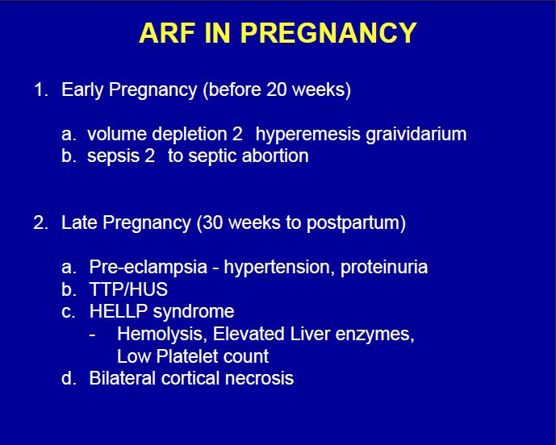

Slide 38
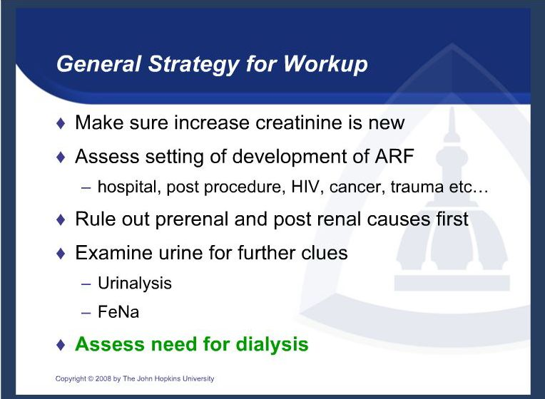

Slide 39
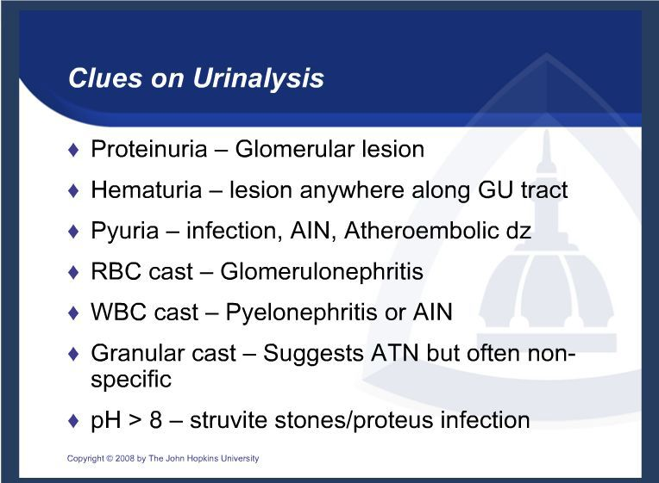

Slide 40
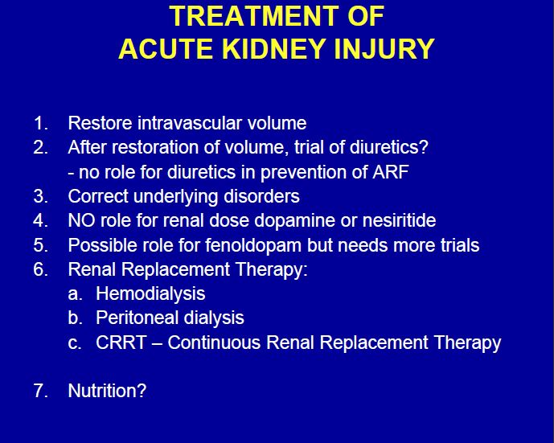

Slide 41
