Slide 1
Medical Emergencies
Dr Ashraf Abu Karaky

Slide 2
Management of Medical Emergencies
Medical emergencies can and do happen
  Advances in medicine
  Longer lifespan
  Multiple medications
  Medically compromised
  Longer appointments

Slide 3
Incidence
A survey done in the 90’s showed that, over a A survey done in the 90’s showed that, over a 10 year period, 90% of dentists have encountered at least one medical emergencies.
riod, 90% of dentists have encountered at least one medical emergencies.

Slide 4
• Be prepared
• Access to appropriate drugs and equipment
• Training
• Who to call
• Medical history

Slide 5
Prevention
PHYSICAL EVALUATION
Length of time since last evaluation
Vital signs
Visual inspection of patients
Referral to physician

Slide 6
ASA I
A patient without systemic disease
A normal healthy patient
Can tolerate stress involved
In dental treatment
No added risk of serious
Complications
Treatment modification
Usually not necessary

Slide 7
ASA II
Represent minimal risk during dental treatment
Routine dental treatment
With minor modifications
-Short early appointments
-Antibiotic prophylaxis
-Sedation
A patient with mild systemic disease
Example:
-Well-controlled diabetic
-Well-controlled asthma
-ASA I with anxiety

Slide 8
ASA III
Elective Dental Treatment is not Contraindicated
Treatment Modification is Required
- Reduce Stress
- Sedation
- Short Appointments
A patient with severe systemic disease that limits activity but is not incapacitating
Example:
- a stable angina
- 6 mos. Post - MI
- 6 mos. Post - CVA
- COPD

Slide 9
ASA IV
Elective dental care should be postponed
Emergency dental care only
  Rx only to control pain and infection
  Other treatment in hospital
    (I&D, extraction)
A patient with incapacitating systemic disease that is a constant threat to life
Example:
- Unstable angina
- M I within 6 months
- CVA within 6 months
- BP greater than 200/115
- Uncontrolled diabetic

Slide 10
ASA V
A morbid patient not expected to survive
Example:
- End stage renal disease
- End stage hepatic disease
- Terminal cancer
- End stage infectious disease
Elective treatment definitely contraindicated
Emergency care only to relieve pain

Slide 11
• Collapse
• Chest pain
• Shortness of breath
• Mental disturbances
• Reactions to drugs or sedation
• Bleeding

Slide 12
Likely causes of sudden loss of consciousness and collapse
• Simple faint
• Diabetic collapse secondary to hypoglycaemia
• Epileptic seizure
• Anaphylaxis
• Cardiac arrest
• Stroke
• Adrenal crisis

Slide 13
PREVENTION
• Repeatedly assessing the patient whilst undertaking treatment, noting any changes in appearance or behaviour.
• Never practising dentistry without another competent adult in the room
Always having accessible the telephone numbers for the emergency services and nearest hospital accident and emergency department. The patient’s general medical practitioner details should be recorded in the notes
• Training staff in emergency service contact protocols and emergency procedures: this should be repeated annually.

Slide 14
All dental clinics should have a defined protocol for how the emergency services are to be alerted. The protocol should include clear directions for the emergency services to locate and access the clinic and, in a large building, a member of the team should meet the paramedics at the main entrance.

Slide 15
• Having a readily accessible emergency drugs box and
equipment checked on a weekly basis
• Taking a careful medical history, assessment of disease
severity, careful treatment scheduling and planning and,
in some cases, administration of medication prior to
treatment.
• Using the simple intervention of laying the patient supine
prior to giving local analgesia (LA) will prevent virtually
all simple faints – the commonest emergency.
• Ensuring diabetic patients have had their normal meals,
appropriately administered medication, and are treated
early in the morning session or immediately after lunch is
likely to prevent hypoglycaemic collapse

Slide 16
MANAGING EMERGENCIES
A Airway Identify foreign body obstruction and stridor
B Breathing Document respiratory rate, use of accessory muscles,
Presence of wheeze or cyanosis
C Circulation Assess skin colour and temperature, estimate capillary refill
time (normally, this is 2 seconds with hand above heart), assess rate of pulse (normal is 70 beats/min)
D Disability Assess conscious level
• Alert
• responds to Voice
• responds to Painful stimulus
• Blood glucose Unresponsive
E Exposure Respecting the patient’s dignity, try to elicit the cause of acute
deterioration (e.g. rash, or signs of recreational drug use)

Slide 17
COLLAPSE
• collapse at the sight of a needle or during an injection is
likely to be a simple faint
• following some minutes after an injection of penicillin,
collapse is more likely to be due to anaphylaxis
• collapse of a diabetic at lunchtime, for example, is likely to be caused by hypoglycaemia
• collapse of a patient with angina or previous myocardial
infarction may be caused by a new or further myocardial
infarction.

Slide 18
simple faint
Signs and symptoms o:
• premonitory dizziness, weakness or nausea
• pallor
• cold clammy skin
• dilated pupils
• pulse is initially slow and weak, then rapid and full
• loss of consciousness

Slide 19
MANAGEMENT
Lie individuals flat, ideally with their legs raised.
Leave them in this position until fully recovered.
Slowly return the chair to the upright position
Record that the event occurred and identify the likely cause.
• Aim to prevent further episodes.

Slide 20
Anaphylaxis
Diagnosis is as follows:
facial flushing, itching, paraesthesiae, oedema or sometimes
urticaria, or peripheral cold clammy skin
stridor or wheeze
abdominal pain, nausea
loss of consciousness
pallor going on to cyanosis
rapid, weak or impalpable pulse.

Slide 21
Cardiac arrest
• Cardiac arrest can occur in a patient with no previous history
of cardiac problems, but is more likely in those with
a history of ischaemic heart disease, diabetics and older
people.
• Previous angina or myocardial infarction predisposes to
cardiac arrest.
• Ventricular fibrillation accounts for most sudden cardiac
arrests. Causes are myocardial infarction, hypoxia, drug
overdose, anaphylaxis or severe hypotension.
• After airway and breathing assessment, basic life support
(BLS) needs to be initiated immediately to maintain
adequate cerebral perfusion until the underlying cause is
reversed

Slide 22
Diabetic collapse: hypoglycaemia
• Hypoglycaemia is the most dangerous complication of diabetes
mellitus because the brain becomes starved of glucose.
• Diabetics treated with insulin, those with poor blood glucose
control or poor awareness of their hypoglycaemic
episodes have a greater chance of losing consciousness.
• Remember a collapse in a diabetic may be caused by other
emergencies, for example a faint or myocardial infarctionIschaemic heart disease is common in long-standing
diabetes.
• Hypoglycaemia may present as a deepening drowsiness,
disorientation, excitability or aggressiveness, especially if it
is known that a meal has been missed.

Slide 23
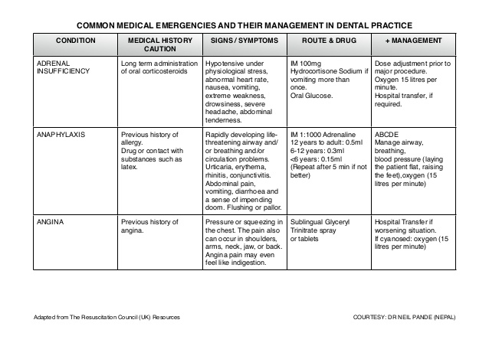

Slide 24
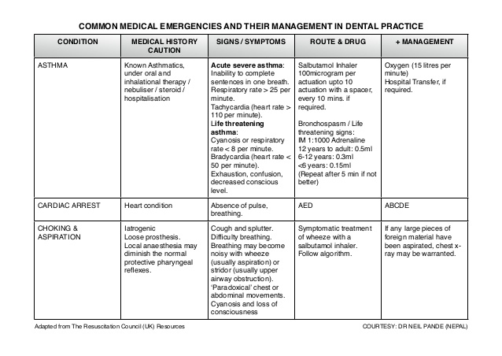

Slide 25
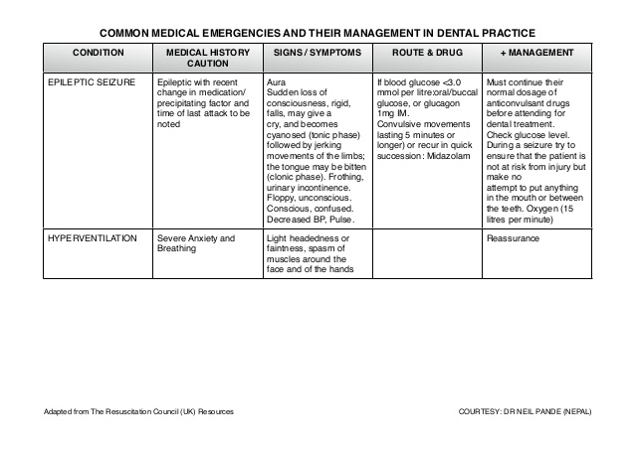

Slide 26
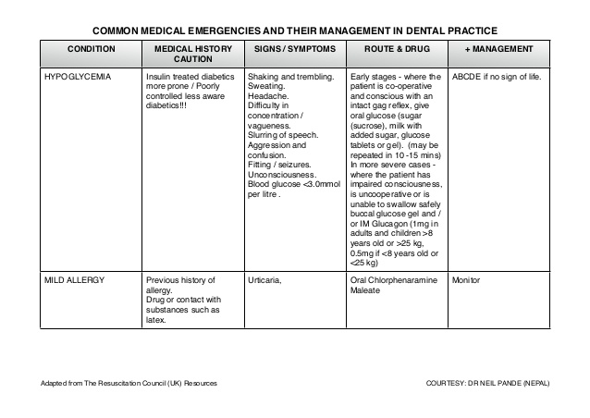

Slide 27
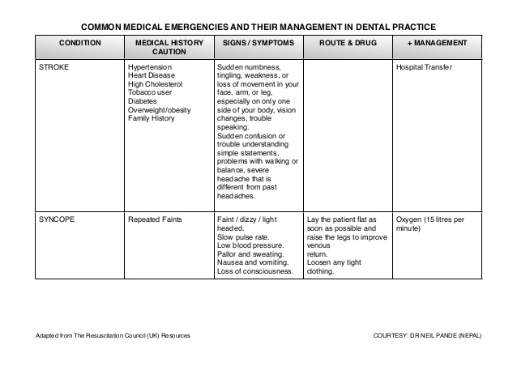

Slide 28
Thank you

