Slide 1

Periodontitis as a manifestation of systemic diseases
By Dr. Omar Alkaradsheh

Slide 2
AAP Classification of Periodontal diseases 1999
Gingival diseases
  Dental plaque-induced gingival lesions.
  Non plaque induced lesions
Periodontitis
Chronic periodontitis
Aggressive Periodontitis
Periodontitis as a manifestation of systemic diseases
Necrotising periodontal diseases
Abscesses of the periodontium
Periodontal-endodontic lesions
Developmental or acquired deformities and conditions

Slide 3
AAP Classification of Periodontal diseases 1999
Gingival diseases
  Dental plaque-induced gingival lesions.
  Non plaque induced lesions
Periodontitis
Chronic periodontitis
Aggressive Periodontitis
Periodontitis as a manifestation of systemic diseases
Necrotising periodontal diseases
Abscesses of the periodontium
Periodontal-endodontic lesions
Developmental or acquired deformities and conditions

Slide 4
AAP Classification of Periodontal diseases 1999
Periodontitis as a manifestation of systemic diseases
Associated with Haematological disorders
Associated with genetic disorders
Not otherwise specified

Slide 5
Periodontitis as a manifestation of systemic diseases
Associated with Haematological disorders
    Acquired neutropenia
    Leukemias
    Others
Associated with genetic disorders
    Familial and cyclic neutropenia
    Down syndrome
    Leukocyte adhesion deficiency syndrome
    Papillon-Lefevre syndrome
    Chediak-Higashi syndrome
    Infantile genetic agranulocytosis
    Histiocytosis syndromes
    Ehlers-Danlos syndrome ( Type IV and VIII)
    Hypophosphatasia
    Cohen Syndrome
    Marfan syndrome
    Other

Slide 6
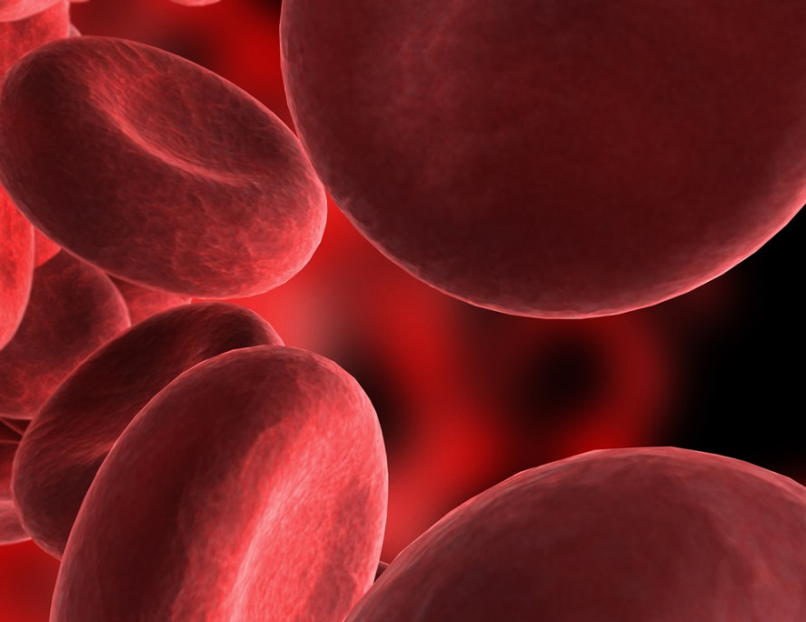
Haematological Disorders
WBC disorders
RBC
Platelets

Slide 7
Haematological Disorders
Anaemia: low RBC/HB
  Oral manifestation : red, shiny tongue and oral ulcerations
  No gingival manifestations
Except Aplastic Anaemia
Thrombocytopenia: excessive bleeding with the least provocation

Slide 8
WBCs Disorders
Quantitative:
  (neutropenia, agranulocytosis)
  generalised periodontal destruction.
Qualitative:
  Leukocyte adhesion deficiency syndrome
  often localised periodontitis.

Slide 9
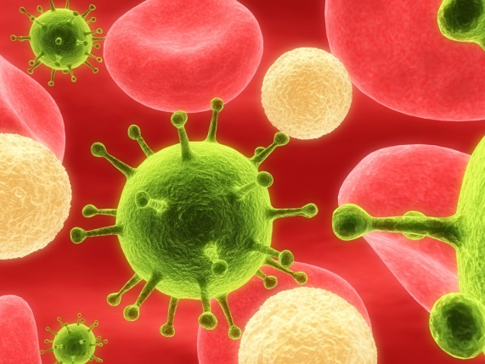
Neutropenia
Low level of circulating neutrophils
Caused by disease, medications, chemicals, infections, idiopathic or hereditary disorders.
Chronic, cyclic , severe or benign
An absolute neutrophil count (ANC)
1000-1500
500-1000
ANC < 500 cells/µl

Slide 10
Cyclic Neutropenia
Cyclic depression of PMN counts (40%)
Every 3 weeks, lasts 3-6 days.
Oral ulcerations, severe gingivitis, rapid periodontal breakdown and alveolar bone loss
Most bone loss around incisors and first molars.
Fever, malaise and sore throat

Slide 11
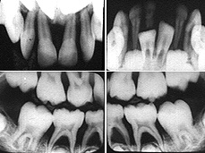
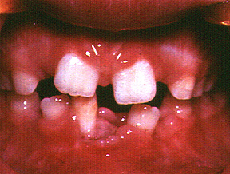
Cyclic Neutropenia
Note the marked destruction of the periodontium and the acute necrotizing gingivitis type lesions.

Slide 12
Familial Neutropenia
Autosomal dominant trait.
neutrophils are not released properly from the marrow.
A slight monocytosis occurs, possibly as compensation, together with the moderate neutropenia.
The condition is often diagnosed in patients with a history of recurrent infections.
The periodontal manifestations
  fiery red, oedematous gingivitis, often hyperplastic
  accompanied by periodontal bone loss.

Slide 13
Agranulocytosis:
Reduction in circulating granulocyes
Defined as an ANC less than 100 cells
Also involves monocytes, basophils and eosinophils
Severe infections
Ulcerative necrotizing lesions in oral, skin , GI ,genitourinary
Fever, malaise and sore throat
Acute or cyclic
Drug Idiosyncrasy

Slide 14
Leukocyte Adhesion Deficiency Syndrome (LAD)
Rare
Defects in cell surface receptors
PMNs cannot leave blood vessels and migrate to the infected area; PMN cells absent from gingival tissue.
Primary & permanent teeth.
Severe acute inflammation of the gingiva
Rapid destruction of bone
treatment rarely results in long-term retention of teeth.
More than 75% of children will die before the age of 5 years if they do not receive a bone marrow transplant

Slide 15
Leukaemia
Malignant neoplasias of WBCs or their precursors
Acute or Chronic
Replacement of bone marrow with leukemic cells reduced the normal production of RBCs, Platelets, and WBCs.

Slide 16
The periodontium of leukemic patients
Bleeding:
  Can be an early sign of leukaemia
  Occur in the absence of gingivitis
Oral ulcerations & Infections (Herpes, NUG)
Gingiva:
  Leukemic gingival enlargement (acute > chronic)
  Clinically: Swelling, bluish red, cyanotic, roundness and tenseness of the gingival margin, spontaneous bleeding.
  Areas of necrosis and pseudomembrane formation.
Periodontium & Alveolar bone: localised areas of necrosis due to leukemic infiltration of the marrow.

Slide 17
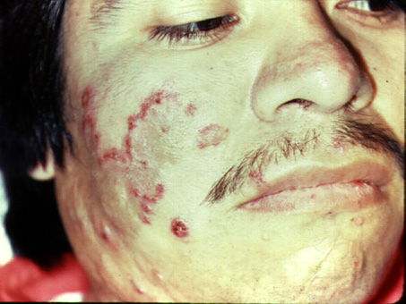
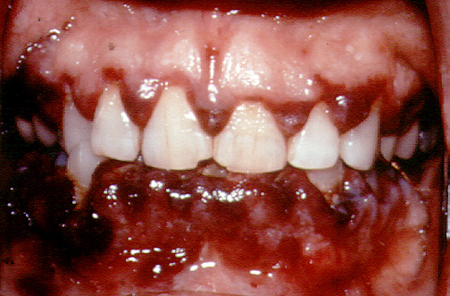
Leukaemia
Note the generalized facial pallor and skin ecchymosis. The gingiva is hypertrophic and shows a typical intra-gingival hemorrhage

Slide 18
classification for the aetiology of gingival lesions in leukaemic patients
Category 1 :
  direct leukemic infiltration and includes gingival enlargement.
Category 2
  deals with direct drug toxicity caused by chemotherapeutic agents.
Category 3
  comprises the detrimental effects of graft-versus-host reactions
  the transplanted lymphocytes react against host antigens.
Category 4
  involves secondary effects from the depression of marrow/lymphoid tissue.
  includes haemorrhage, neutropenic ulceration and an increased susceptibility to infections

Slide 19
Periodontitis as a manifestation of systemic diseases
Associated with genetic disorders
    Familial and cyclic neutropenia
    Down syndrome
    Leukocyte adhesion deficiency syndrome
    Papillon-Lefevre syndrome
    Chediak-Higashi syndrome
    Infantile genetic agranulocytosis
    Histiocytosis syndromes
    Ehlers-Danlos syndrome ( Type IV and VIII)
    Hypophosphatasia
    Cohen Syndrome
    Marfan syndrome
    Other

Slide 20
Down syndrome
Trisomy of Chromosome 21
1 out of 800 births
Mental deficiency and growth retardation
Periodontitis occurring in almost 100% of patients <30 years old
Oral and periodontal disease-related features:
Poor OH
Local factors: Diastema, high frenal attachment, crowding, malocclusion
Level of inflammation exceeds being explainable by plaque and local factors.
Destructive periodontitis
Generalised deep periodontal pockets, gingival inflammation
NUG

Slide 21
Down Syndrome
Possible causes of higher prevalence and severity:
Poor terminal circulation
Decreased T-cell maturation and PMN cells chemotaxis and phagocytosis
collagen biosynthesis, abnormal capillary morphology, and hyperinnervation of the gingiva.
P. intermedia?

Slide 22
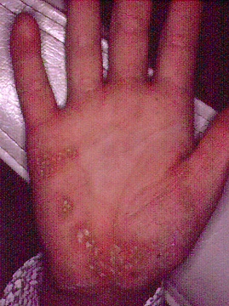
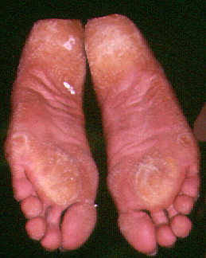
Papillon-Lefevre Syndrome
Clinical features:
Palmar-planter hyperkeratosis (sometimes knees and elbows)
Severe periodontal disease
Calcification of the dura

Slide 23
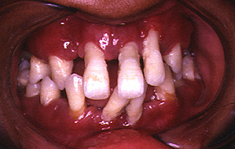
Papillon-Lefevre Syndrome
Palmar-planter hyperkeratosis (sometimes knees and elbows)
Severe periodontal disease
Calcification of the dura

Slide 24
Papillon-Lefevre Syndrome
Autosomal recessive inheretence.
Onset: cutaneous and oral signs appear before the age of 4
Primary teeth are lost by the age of 5-6
Permanent teeth lost by the age of 15.
No alteration in WBC
Defect in Cathepsin C gene
Systemic administration of
synthetic retinoids + non-surgical periodontal treatment in addition to topical antimicrobials such as chlorhexidine, and systemic antibiotic therapy, may give the best chance for preventing progression of periodontitis and retaining teeth

Slide 25
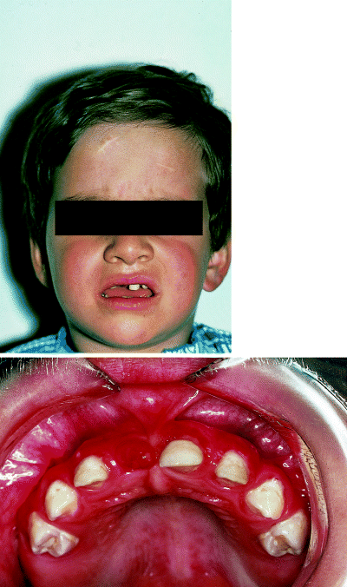
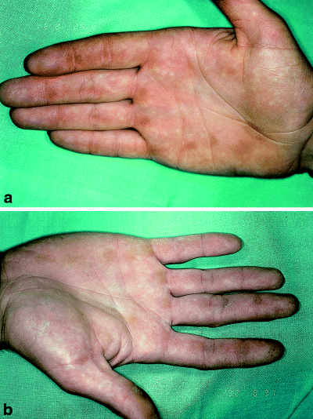
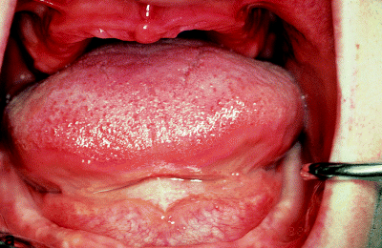

Slide 26
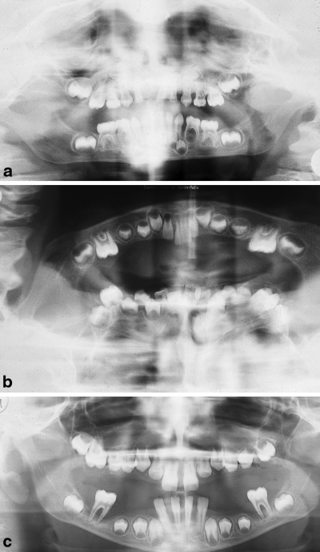

Slide 27
Chediak Higashi Syndrome
Rare, autosomal recessive disorder
Abnormalities in the cytoplasmic granules
fusion of phagosome and lysosome to form the bactericidal phagolysosome is impaired (large azurophilic inclusions within the cytoplasm)
Primarily affects neutrophils .
Average life span is 6 years.
Clinical features:
Partial albinism, mild bleeding disorders, recurrent bacterial infections, rapidly destructive periodontitis
Bone loss is usually generalized and severe.
Patients do not respond to periodontal therapy, leading to premature loss of both deciduous and permanent dentitions.
BMT: treatment of choice.

Slide 28
Histiocytosis X
Langerhans cell histiocytosis
Eosinophilic granuloma
Localized periodontitis in an otherwise healthy dentition
Loss of alveolar bone and replaced by soft tissue
Delayed healing after extraction of teeth
Premature loss of teeth
Foul breath
Hand-Schüller-Christian
Generalized stomatitis, soreness
Hemorrhage from the gums
Ulceration and necrosis of the oral mucosa
Progressive bone destruction of the alveolar process
Loosening and premature loss of teeth
Facial asymmetry
Letterer-Siwe
Ulceration of oral mucosa
Diffuse destruction of bone
Premature loss of teeth
Hemorrhage
Foul breath
Suppuration
Meyle & Gonzales 2001

Slide 29
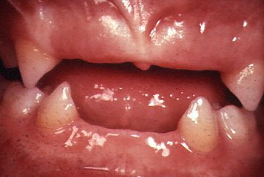
Hypophosphotasia
Rickets, poor cranial bone formation
characterized by:
  deficiency of serum alkaline phosphatase
  increased urinary excretion of phosphoethanolamine
  defective bone and tooth mineralization,
  cementum hypoplasia or aplasia
  premature
  exfoliation of the primary teeth
  Localised aggressive periodontitis
  In permanent teeth

Slide 30
Ehlers-Danlos Syndromes
group of connective tissue disorders
Defective collagen synthesis
classiﬁed into 10 types on the basis of inheritance and clinical symptom
characterized by hypermobility of joints, hyperextensibility of skin, and increased tissue friability and delayed wound healing.
Type VIII is associated with aggressive early-onset periodontitis, Skin hyperextensibility and fragility, tendency to bruising with minor trauma, tissue scarring, and hyperextensible finger joints
EDS type IV:
  defect in formation of collagen III
  Life threating,rupture in major blood vessels
Type VIII, IV: similar clinically, except that periodontal involvement is not usually seen in type IV

Slide 31
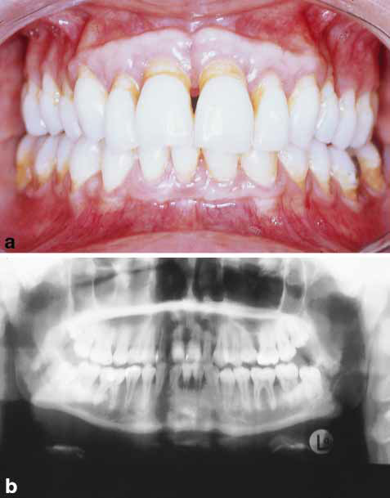
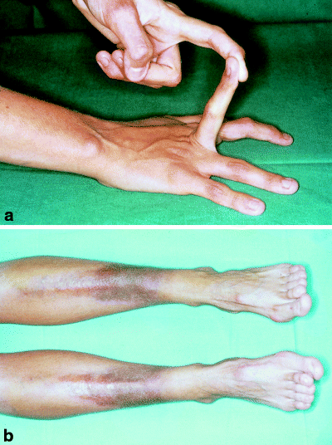
Ehlers-Danlos Syndromes

Slide 32
Other systemic conditions
Metal intoxication: Nausea, vomiting, headaches, excessive salivation
Bismuth: a narrow black- bluish discoloration of the gingival margin in areas with preexisting inflammation
Lead: steel grey linear pigmentation of the gingiva “Bertunian line”
peculiar sweetish sensation, ulcerartion
Mercury: pigmentation, ulceration of gingiva and destruction of underlying bone

Slide 33
Òther Systemic conditions
Osteoporosis:
Low bone mass
Females
Bone mineral density
Consequences: risk of fracture
Limited evidence indicates increased risk of attachment loss, bone loss and tooth loss in osteoporosis.
Less attachment loss and less gingival bleeding have been reported in postmenopausal women receiving estrogen replacement therapy (ERT) compared with estrogen-deficient postmenopausal women

Slide 34
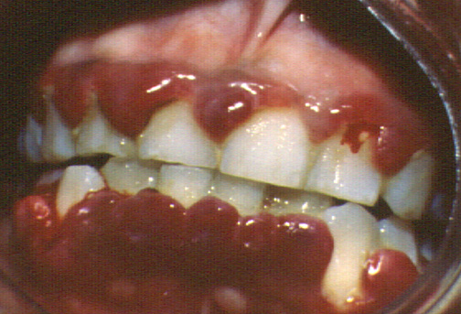
Nutritional deficiency
Needs to be prolonged and severe before any dramatic periodontal manifestations are observed
Scurvy (Vitamin C deficiency)

Slide 35
Immune suppression
HIV/AIDS
Corticosteroids

Slide 36
HIV infection
Retrovirus
Affect immune cells carrying CD4 surface receptor.
Anti-retroviral agents and protease-inhibiting drugs improved health status of these patients by lowering viral counts but never eradicate it completely.
Life-long treatment.
the presence of at least 1 of 25 specific clinical conditions constitute transition from HIV infection to AIDS
Plasma CD4-T lymphocytes less than 200/mm3 or CD4-T lymphocyte percentage less than 14% of total lymphocytes

Slide 37
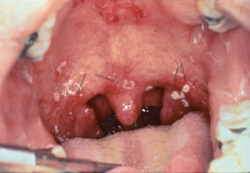
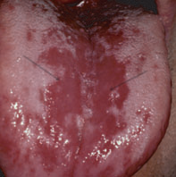
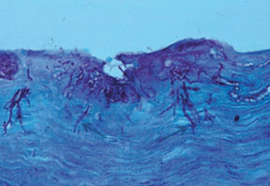
Oral features of HIV-positive patients
Candidiasis:
  most common oral lesion in HIV patients
  Pseudomembranous, erythematous, hyperplastic or angular cheilitis.

Slide 38
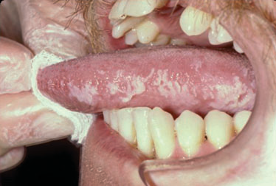
Oral Features of HIV-positive patients
Oral Hairy Leukoplakia : EBV

Slide 39
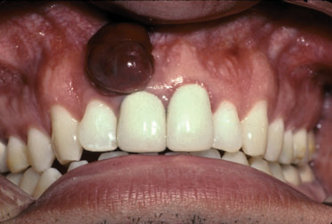
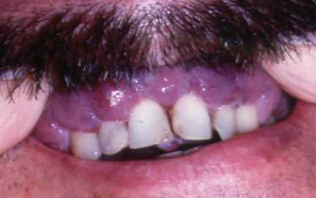
Oral Features in HIV-positive patients
Kaposi Sarcoma : HHV-8

Slide 40
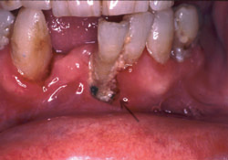
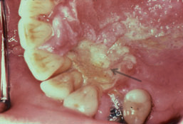
Oral Features in HIV-positive patients
Necrotising Ulcerative Stomatitis

Slide 41
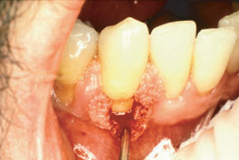
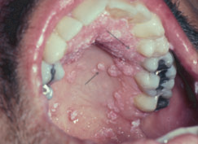
Oral Features in HIV-positive patients
Viral Infections:
Herpetic infections (most common)
HPV

Slide 42
HIV infection
Periodontal manifestations:
Linear Gingival erythema
Atypical periodontal lesions (necrotising forms of periodontitis (NUG,NUP))
Typical periodontal lesions;
  Chronic periodontitis more recession and attachment loss
  pre-existing periodontitis may be exacerbated (modifier for periodontitis)

Slide 43
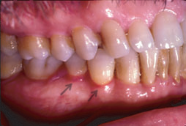
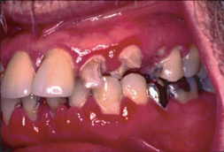
Linear Gingival Erythema
Mostly Candidal infection
The clinical appearance is somewhat similar to the plaque-induced gingival disease.
these lesions usually do not respond to conventional treatment of plaque debridement and plaque control.
These lesions often resolve with topical and ⁄ or systemic antifungal treatment.

Slide 44
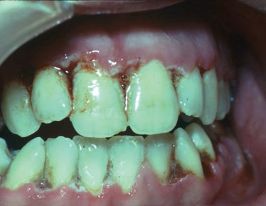
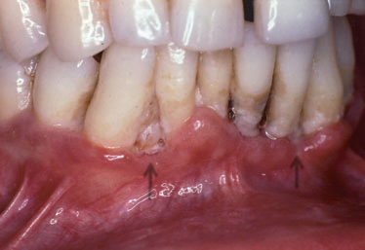
Necrotising Ulcerative Gingivitis/periodontitis

Slide 45
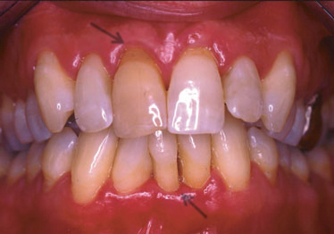
Chronic periodontitis in HIV-positive patients

Slide 46
Special condiserations
HIV-positive individuals can be generally managed with nonsurgical periodontal treatment
Patients with low viral loads and near-normal CD4 count, periodontal surgery and implant placement is possible after detailed consultation and clearance from the patient’s physician.

Slide 47
Necrotising lesions can progress dramatically in HIV-positive patients, treatment involves local therapy combined with systemic antimicrobials and mouthwashes and meticulous oral hygiene by the patient. They should be seen daily until tissue heal to ensure that the tissue destruction is controlled.

Slide 48
Management
Prevention
Conservative treatment: OHI, scaling, root debridement, local antiseptic mouthwashes, fluoride application, frequent maintenance visits (2-3 months).
Antimicrobial agents
Local haemostatic agents

Slide 49
References
Periodontal manifestations of systemic disease; A review. DF Kinane, GJ Marshall. Australian dental Journals 2001;46:(1):2-12
Influences of systemic diseases on periodontitis in children and adolescents J. Meyle & J. R. Gonzales. Periodontology 2000, Vol. 26, 2001, 92–112
Periodontal disease in HIV⁄ AIDS. Ryder, W. Nitayananta, M. Coogan, D. Greenspan & J. S. Greenspan. Periodontology 2000, Vol. 60, 2012, 78–97.
Periodontitis as manifestation of systemic diseases. In: Newman MG, Takei HH, Klokkevold PR, Carranza FA. Carranza’s Clinical Periodontology. 11th ED, Elsevier Saunders.
Systemic Factors Impacting the Periodontium. Rose LF, Mealey BL, Genco RJ,Cohen W. BS.Periodontics:medicine, Surgery, and implants.

