Slide 1
Haematological disorders

Slide 2
Anaemia
Decreased Hb level
Normal values for Hb, RBC count, hematocrit
 | Male | Female
RBC count (million/μl) | 4.5-6 | 4-5
Haemoglobin level (g/dl) | 13-16 | 12-15
Hematocrit % | 40-50 | 35-45

Slide 3
Anaemia/classification
Anaemia is classified according to the size and morphology of RBC into :
Microcytic (decreased MCV < 78fl):
Macrocytic (increased MCV > 99fl)
Normocytic (normal MCV 78-99fl)

Slide 4
Anaemia/ causes
Decreased RBC and Hb production
Haematinics deficiency (e.g. Iron, B12, Folate)
Bone marrow failure (e.g. a plastic anaemia)
Bone marrow replacement (e.g. leukaemia, lymphoma)
Hypothyroidism
Chronic renal failure (e.g. erythropoietin deficiency)
Increased destruction or excessive loss of RBC
Acute haemorrhage
Chronic blood loss (e.g. haemorrhoids, menorrhagia, peptic ulcer, cancer)
Haemolytic anaemia (e.g. congenital or acquired)

Slide 5
Anaemia/ clinical features
Signs and symptoms of anaemia are variable and depend on:
The severity of anaemia
Cause of anaemia
Rapidity with which it develops

Slide 6
Anaemia/ clinical features
General: pallor, weakness, malaise, tiredness, vertigo
CNS: lack of concentration, decreased memory, syncope, seizures
CVS: palpitation, dyspnoea, angina, congestive heart failure
GI: anorexia, nausea, taste disturbance

Slide 7
Anaemia/ investigations
To assess the type, severity, and cause of anaemia
Hb
MCV
RBC count
Haematinics
Disease specific investigations

Slide 8
Deficiency anemias
Iron deficiency
B12 deficiency
Folic acid deficiency

Slide 9
Iron deficiency
Is the most common cause of anaemia worldwide.
Causes:
chronic blood loss (menstruation, peptic ulcer, haemorrhoids, oesophageal varices, GI malignancy)
nutritional deficiency (inadequate diet)
Increased demand (pregnancy, adolescence)
Malabsorption (gastrectomy, Crohn`s ....)

Slide 10

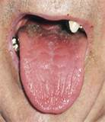
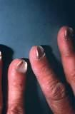
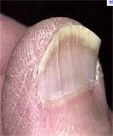
Iron deficiency
Clinical features
koilonychia (spoon-shaped nails)
Dysphagia due to post crecoid webs (Peterson-Kelly or Plummer-Vinson syndrome)

Slide 11
Iron deficiency
Diagnosis
Clinical features
Hb, microcytic anaemia, serum ferritin, TIBC
GI endoscopy

Slide 12
B12 deficiency
Causes
Poor intake (vegetarians)
Malabsorption (pernicious anaemia, Crohn`s disease (ileum), gastrectomy, intestinal resection)

Slide 13
B12 deficiency
Clinical features
Premature greying of hair
Neurological manifestations
Paresthesia
Ataxia
Psychosis
Forgetfulness

Slide 14
B12 deficiency
Diagnosis
Clinical features
Hb, macrocytosis, B12
Auto-antibodies against gastric parietal cells and intrinsic factors (pernicious anaemia)
Schilling test (radiolabeled B12 absorption test)

Slide 15
Folate deficiency
Causes
Inadequate diet (leafy vegetables)
Alcohol
Increased demand (pregnancy)
Malabsorption (coeliac disease)

Slide 16
Folate deficiency
Clinical features
Folate deficiency during pregnancy predispose to neural tube defects and facial clefts
Diagnosis
Clinical features
Hb, macrocytosis, serum and red cell folate

Slide 17
Dental aspect
Patients with low Hb level are poor candidate for GA
Elective oral surgical procedures should be avoided in severely anaemic patients (<10 g/dl) because of increased risk of infection and impaired wound healing
Patients presenting with oral signs of deficiency anaemia should have their FBC and haematinics examined.

Slide 18
Dental aspect
Oral manifestations of deficiency anaemia include:
Glossitis
Angular chelitis
Aphthous ulcers
Burning/sore tongue
Candidiosis
Pallor of oral mucosa

Slide 19
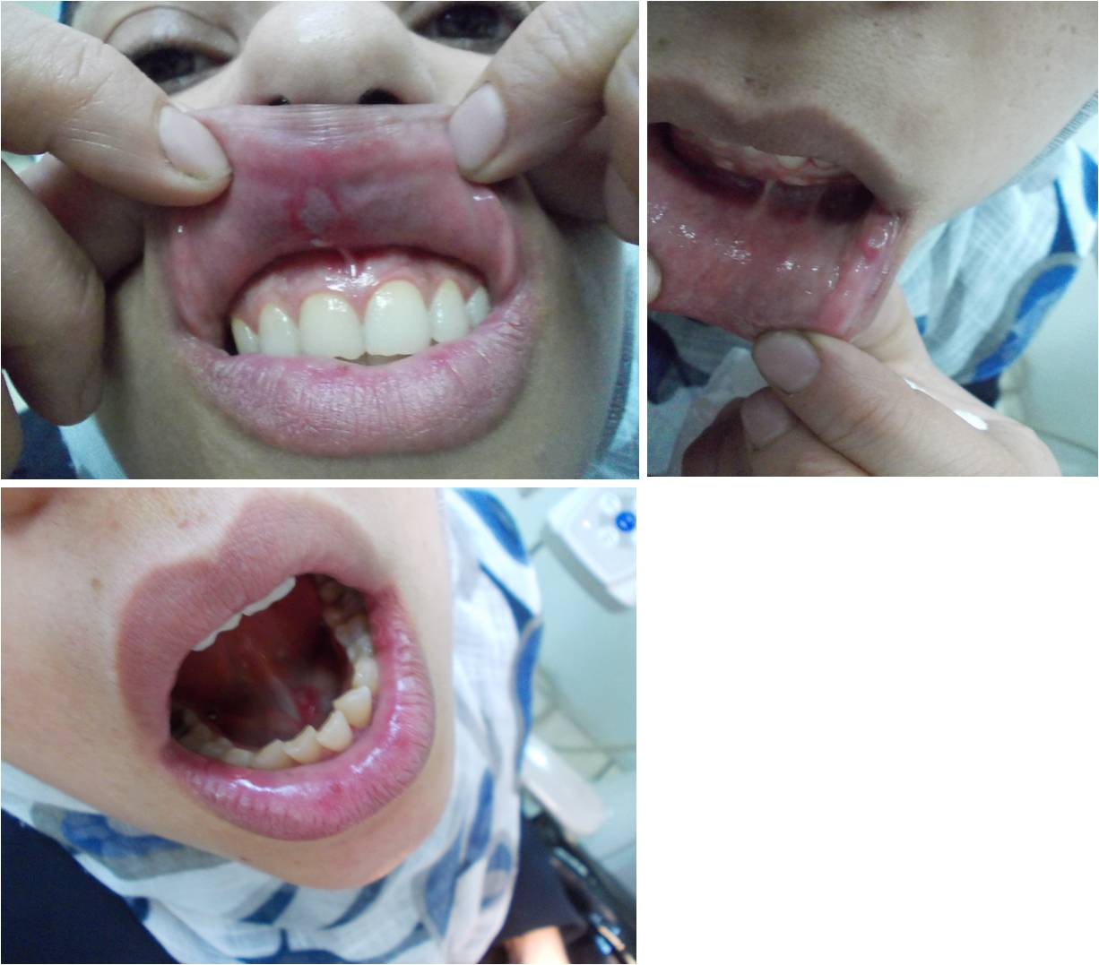
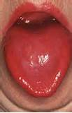
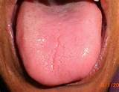
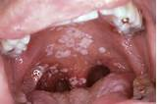
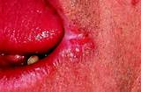
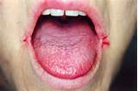
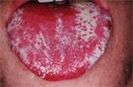

Slide 20
Haemolytic anemias
heterogeneous group of disorders that are characterised by increased destruction of RBCs with a reduction of their circulatory life span (normally 100-120 days).
Increased destruction of RBCs is accompanied by compensatory bone marrow hyperplasia and increased production of reticulocytes (immature RBCs).
In addition, hyperbilirubinaemia occurs because of increased haemoglobin
Sickle cell anaemia
Thalasamia

Slide 21
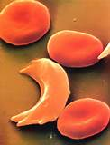
Sickle cell anaemia
An autosomal recessive disorder that results in the formation of haemoglobin with abnormal physical and chemical properties (HbS)
In the deoxygenated state, HbS undergoes polymerisation within the erythrocytes which become rigid, sickle shaped and unable to pass through capillaries
It exists in two forms; a homozygous form (sickle cell anaemia) and a heterozygous form (sickle cell trait) in which only one chromosome carries the abnormal gene.

Slide 22
Sickle cell anaemia
Clinical features
Symptoms usually appear in the first year of life and include:
Anaemia
Sickle crisis, infarction (fever, malaise, acute pain)
Chronic haemolysis

Slide 23
Sickle cell anaemia
Diagnosis
Clinical features
Hb, reticulocytes, sickled erythrocytes
Hb electrophoresis (S-band)

Slide 24
Sickle cell anaemia
Dental aspect
Elective oral surgical procedures should be avoided in severely anaemic patients because of increased risk of infection and impaired wound healing
Sickle crisis can be induced by hypoxia, dehydration, infection
Post operative pain is best managed by acetaminophen and codeine. Excessive use of aspirin containing compounds should be avoided
Patients who had repeated blood transfusion are at risk of blood born infections (HIV, HBV) and therefore represent a cross infection issue

Slide 25
Sickle cell anaemia
Oral manifestations
Delayed eruption and dental hypoplasia
Increased bone radiolucency and formation of gross trabecular pattern due to marrow hyperplasia
Bone trabeculae in the alveolar bone between the roots of the teeth appear as horizontal rows, creating a step ladder appearance.
Thickened skull diploe with vertical trabiculations (hair on end appearance)
Isolated radiopaque areas representing areas of past bony infarction
sickle crisis can lead to orofacial pain in the absence of odontogenic pathology. Infarcts occurring in the mental vessels can lead to mental nerve neuropathy manifesting as temporary anaesthesia or parasthesia of the lower lip

Slide 26
Thalasamias
Inherited disorders characterised by reduced rate of production of the alpha or beta globin chain in the haemoglobin molecule.
Depending on the affected chain, there are two types of thalasaemia; alpha and beta
Beta thalasamia is the most common type and exists in two types; a homozygous form (thalasamia major) and a heterozygous form (thalasamia minor)

Slide 27
Thalasamias
Clinical features
Symptoms of thalasamia are variable and depend on the severity of the disease
Thalasamia minor is usually asymptomatic or presents as mild anaemia
Thalasamia major is characterised by failure to thrive, skeletal abnormalities, iron overload

Slide 28
Thalasamias
Diagnosis
Clinical features
Hb, microcytosis
Haemoglobin electrophoresis shows HbF

Slide 29
Thalasamias
Dental aspect
Oral surgical treatment in thalassaemia patients is influenced by three major problems, anaemia; susceptibility to infection, and associated organ damage due to iron overload
Routine dental procedure can be carried out safely in thalassaemia minor patients
Elective oral surgical procedures should be avoided in severely anaemic patients because of increased risk of infection and impaired wound healing

Slide 30
Thalasamias
Anti biotic prophylaxis before surgical procedures is indicated in splenectomised patients and in patients with hypersplenism
Oral surgery can be complicated by the associated organ damage (e.g. liver dysfunction, diabetes, cardiac disease, etc)
Patients who had repeated blood transfusion are at risk of blood born infections (HIV, HBV) and therefore represent a cross infection issue

Slide 31
Thalasamias
Oral manifestations
Teeth discoloration due to iron deposition in developing teeth
Characteristic facial appearance described as “chipmunk faces”
Malocclusion; anterior open bite, spacing, and protrusion of upper labial segment
Thickened skull diploe with vertical trabiculations (hair on end appearance)

Slide 32
Thalasamias
Increased bone radiolucency and formation of gross trabecular pattern due to marrow hyperplasia
Facial nerve palsy can happen due to widening of diploe bone
Pain, swelling, and impaired function of parotid gland caused by iron deposition
Retarded pneumatisation of the maxillary sinus

Slide 33
