Slide 1
Endodontic Materials:
Root canal obturation materials

Slide 2

Obturating materials
After cleaning and shaping of canals, they are filled.
Ideal properties of root canal filling materials:
  Antimicrobial
  Biocompatible.
  Good flow
  Adhesive in nature
  Dimensionally stable
  Not affected by moisture
  Radio-opaque
  Good handling
  Easily removed, post prep or retreat
  Does not stain dentine
  Cheap
Notes:
2

Slide 3
Gutta Percha
Gutta percha “ Isoprene” (C₅H₈) is one of the oldest and most common root filling material in use today.
A natural latex (rubber) produced from a genus of tropical trees
Polymers of isoprene:
  Cis-natural rubber
  Trans-gutta percha.
Notes:
3

Slide 4

Gutta percha points used in clinic consists of:
Gutta percha 20%
Zinc oxide 60-75%
Metal sulphides, waxes, resin, opacifiers
Gutta percha is available in 2 phases; Alpha and Beta.
Notes:
4
4

Slide 5
Gutta percha taken from trees is the Alpha phase.
Gutta percha in points used in the clinic is the Beta phase.
Both phases differ in Melting temperature, volumetric changes and flow characteristics when molten.
Notes:
5

Slide 6
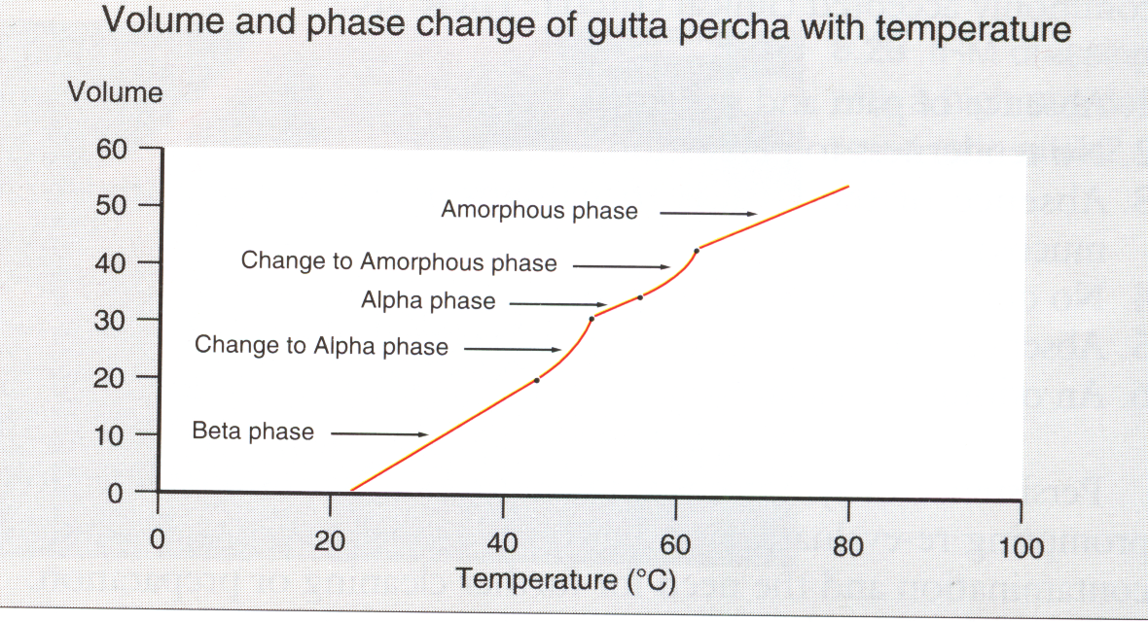
Notes:
6

Slide 7
Gutta percha
Advantages of gutta percha:
Biocompatible
Dimensionally stable
Compactable
Easily removed
Cheap
Disadvantages of gutta percha:
Does not adhere to dentine
Lacks rigidity
Notes:
7

Slide 8
Metal points
Silver (gold, tin, lead and titanium have been used)
Introduced in 1930’s
Silver preferred due to antibacterial effect
Rigid, unyielding
Impossible to adapt to canals
Poor seal as canal not commonly circular in shape
Corrosion
Difficult to remove for post
Titanium- biocompatible and avoids corrosion
Notes:
8

Slide 9
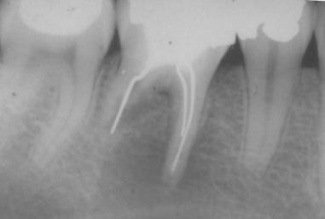
Silver Point Failure
Notes:
9
9

Slide 10
Sealers
Sealers are used in association with Gutta percha.
Functions of sealer
  Cementing (luting, binding) the core material (gutta percha) into the canal.
  Filling the discrepancies between the canal walls and core material
  Acting as a lubricant to enhance the positioning of the core filling material
  Acting as a bactericidal agent
Notes:
10

Slide 11
Root canal sealers
Most sealers are toxic when freshly mixed
Toxicity substantially reduced when set
Most sealers are absorbable to some extent when exposed to tissue fluid
Ideally sealer should flow backwards out of the canal
  However, no evidence that apical extrusion reduces success rate providing preparation and obturation are meticulous
Notes:
11

Slide 12
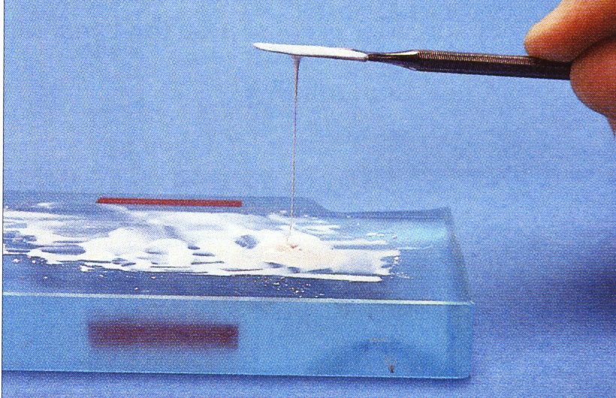
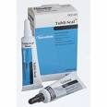
Zinc-oxide eugenol
Grossmans, Tubliseal
Antibacterial
Radio-opaque
Slightly toxic when freshly mixed.
Good flow and working time
Does not adhere
soluble
Notes:
12

Slide 13
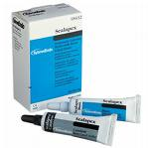
Calcium hydroxide based sealers
Sealapex, Apexit
Radio-opaque
Soluble
Biocompatible
Antimicrobial
Does not adhere
Notes:
13

Slide 14

Resin based sealers
AH26, AH Plus, Endorez, Epiphany, RealSeal.
Adhesive
Antibacterial
Toxic when freshly mixed
Show setting shrinkage when set
Notes:
14

Slide 15
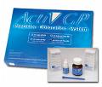
Glass-ionomer based sealers
Ketac Endo and ActiV GP sealer.
Mildly antibacterial
Adheres to dentine
Slightly soluble
Unset GIC is cytotoxic but when set this reduces with time
Very difficult to be removed
Notes:
15

Slide 16
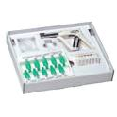
Silicone based sealers
Roekoseal sealer.
Slightly expands when set.
Addition type silicone.
GuttaFlow is Roekoseal sealer with added gutta percha particles.
Does not adhere to root canal.
Notes:
16

Slide 17
New root canal filling materials
Resilon: resin-based cones. Similar in appearance and handling to gutta percha cones. Used with any resin-based sealer.
Endorez cones: resin-coated gutta percha. Used with endorez sealer or any other resin-based sealer.
ActiV GP: glass ionomer coated gutta percha. Used with glass ionomer based sealers.
Notes:
17

Slide 18
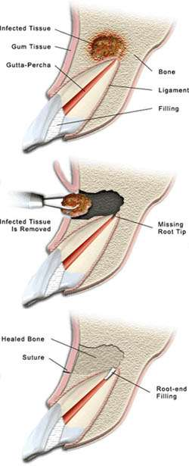
Retrograde root filling materials
Ideal properties
  Seals apex
  Biocompatible
  Ease of handling
  Moisture and blood tolerant
  Low solubility
  Radio-opaque
  Good tissue response
  Bonds to dentine
Notes:
18

Slide 19
Amalgam
Corrosion
Apical inflammation
Poor sealing ability
Mercury toxicity
Notes:
19

Slide 20
IRM
Modified zinc oxide-eugenol
Seals better than amalgam
Need high powder to liquid ratio to decrease toxicity and solubility
Short working time
Notes:
20

Slide 21
Super EBA
Modified zinc oxide-eugenol
High compressive and tensile strength
Neutral pH
Low solubility
Not affected by blood
Good tissue response
Notes:
21

Slide 22
Composite
Problems with moisture control
Some good results in sealing ability but further work required
Notes:
22

Slide 23
Glass Ionomer Cements
Bonds to tooth substance
Biocompatibilty (Toxicity reduces when set)
Some antibacterial properties
Seal superior to amalgam
Notes:
23

Slide 24
New materials
Diaket (Tricalcium phosphate paste)
  Polyvinyl resin
  Good tissue response
  ?cementum forming
Mineral Trioxide aggregates (MTA)
  Seals better than amalgam or super EPA
  Not adversly affected by blood
  Marginal adaptation better than amalgam, IRM or super EBA
  ?cytotoxicity
Laser
Hydroxyapatite
Notes:
24

Slide 25

MTA
Mineral trioxide aggregate:
Pulp capping
Pulpotomy and partial
Pulpotomy.
Perforation repair
Internal and external resorption.
Nonsurgical apical closure
Surgical root end filling
Notes:
25

