Slide 1
BLOOD TRANSFUSION
Dr. Khaled Daradka
University Of Jordan
School Of Medicine
General Surgery Department

Slide 2
A Transfusion Dilemma
A 72 year old woman presents to ER with a nosebleed. This is her second visit in 24 hours with the same complaint. Her nose is packed and the bleeding stops.
Past history includes congestive heart failure and a transient ischemic attack. She takes Lasix, Isordil and aspirin.
A CBC is requested.

Slide 3
The questions??
Hgb = 8.5g/dL
WBC = 6.2
Platelets = 95 x 10⁹/L
Would you recommend a red cell transfusion before sending her home?
What about a platelet transfusion?
What are the risks and benefits of Transfusion?

Slide 4

Vampire therapy
Throughout history, cultures across the globe have extolled the properties of youthful blood, with children sacrificed and the blood of young warriors drunk by the victors.
could reverse ageing!!! Specailly youthful bld

Slide 5
Blood Management
Improved
Patient
Outcomes
Patient
Centered
Blood
Conservation
Appropriate
Transfusion
Practices
Blood management is the appropriate provision and use of blood, its components and derivatives, and strategies to reduce or avoid the need for a blood transfusion.

Slide 6
BLOOD GROUP SYSTEMS
Over 400 red cell antigens described
Each antigen is defined by a specific antibody
Antigens are divided into blood group systems > 25 systems
The most important blood group system
ABO

Slide 7
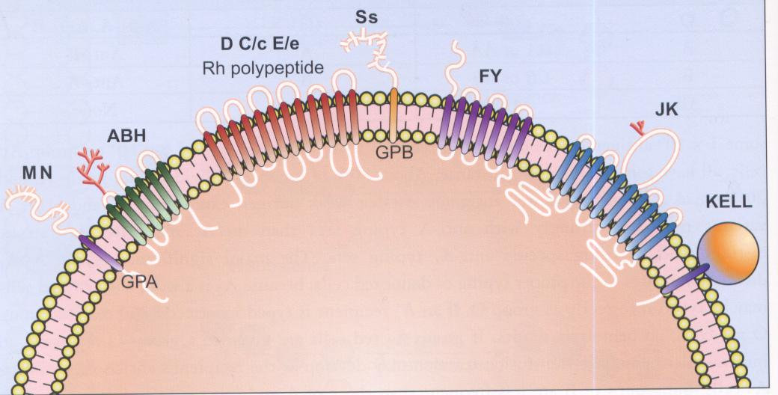

Slide 8
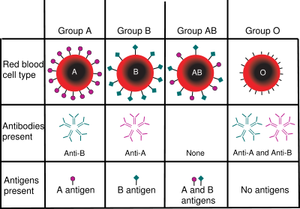
ABO blood group antigens present on red blood cells and IgM antibodies present in the serum

Slide 9
Why do we have Anti-A or Anti-B Antibodies???
They are not present in the newborn
They develop in the first years of life
Exposure to plant, bacterial, viral antigens provokes this response
Natural occurring antibodies

Slide 10
Major Blood Groups
Rhesus
47 Antigens make up the Rhesus Blood Group
The most significant is the D antigen
There is no naturally occurring Anti D
Production of Anti D in the RH negative recipient requires previous exposure to the D antigen (in utero or by transfusion)

Slide 11
Why do we care?
Intravascular hemolysis of donor RBC’s

Slide 12
Population Distribution of
Major Blood Groups
O bld group 45%
Rh pos 38% Rh neg 7%
A bld group 40%
Rh pos 34% Rh neg 6%
B bld group 11%
Rh pos 9% Rh neg 2%
AB bld group 4%
Rh pos 3% Rh neg 1%

Slide 13
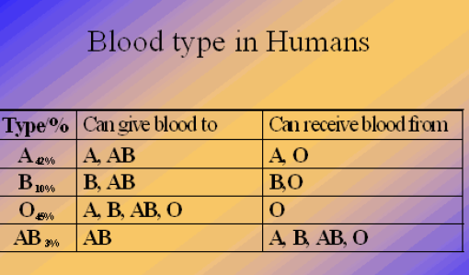

Slide 14
Blood Donation
Whole blood is collected from healthy donors who are required to meet strict criteria concerning:
    Medical and Physical health
    Sexual behavior
    Drug use
    Travel to areas of endemic disease (e.g., malaria)
    Have a hemoglobin level which meets the established standard.
    Wait 2 to 3 months before giving another donation of whole blood.

Slide 15
Blood testing
Donated blood is tested by many methods, but the core tests recommended by the World Health Organization are these four:
Hepatitis B Surface Antigen
Antibody to Hepatitis C
Antibody to HIV, usually subtypes 1 and 2
Serologic test for Syphilis

Slide 16
Alternatives to homologous transfusion
Autologous Predonations
occurs when a person donates his or her own blood for personal use, transfusion reactions may still occur.
Isovolemic Hemodilution
the patient's blood is collected prior to surgery and replaced with a plasma expander. The theory is that any bleeding during surgery will lose fewer RBC's. Then the previously collected, higher hematocrit blood can be given back.

Slide 17
Intraoperative autotransfusion (Cell Saver)
to collect blood in the operative field during surgery, wash it, and return it to the patient. This will work as long as the operative field is not contaminated with bacteria or with malignant cells.
Wound drainage
blood is collected from cavities (such as a joint space into which bleeding has occurred) and returned through a filter.

Slide 18
Blood Products Available
PRODUCT | VOLUME | INDICATIONS/ STORAGE
Red Blood Cells (RBC) | 250 mls red cells 100 ml SAGM | 0₂ transport 1-6 ºC ~ 42 days
Platelets SDP(single donor,apheresis) Buffy coat derived (4 donors, 1 plasma) | 200-300 ml plasma 300x10⁹platelets/unit | Thrombocytopenia/ Dysfunctional Platelets 22ºC x 5 days

Slide 19
PRODUCT | VOLUME | INDICATION STORAGE
Frozen Plasma (FFP) | 100 - 150 ml/unit | All coagulation factors -20ºC x 12 months
Cryoprecipitate | 10-15ml/unit | VWF VIII:c Fibrinogen XIII
Albumin/Pentaspan/ Voluven | Variable | Volume expansion

Slide 20
Blood Typing and Cross-Match
BLOOD TYPING tests the recipient’s RBCs for antigens and SCREENS the recipient's serum for antibodies.
CROSS MATCHING done by mixing the recipient’s serum with the donor's RBCs to check for performed antibodies.
Type O/RH negative is a universal donor.

Slide 21
Principles Of Blood Component Therapy
Be aware of the indications, risks and benefits of the transfused product
The cause of the deficiency should be identified and alternatives to transfusion considered
Only the deficient component should be replaced
The product should be as safe as possible
Informed consent and documentation should be part of the process

Slide 22
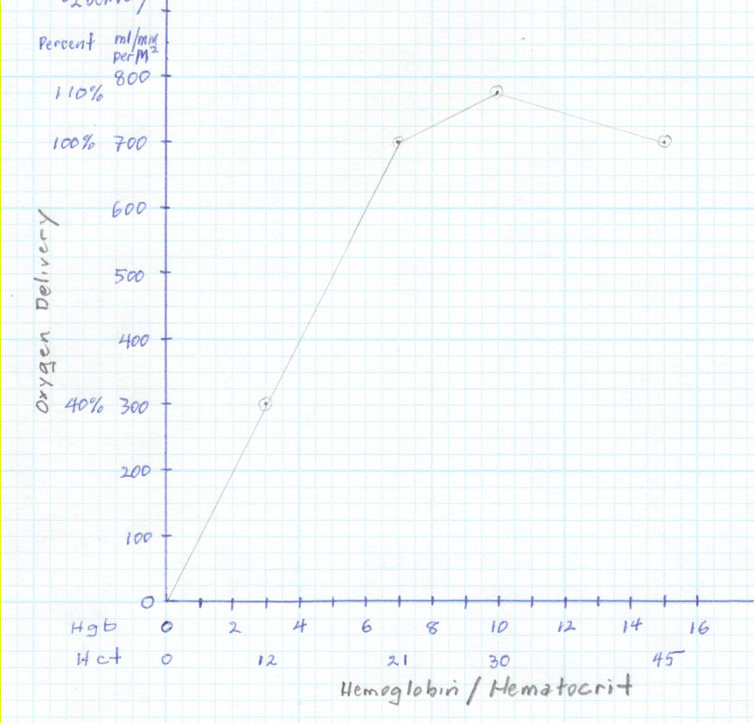
What hgb do you need?
Critical
Hematocrit
And O₂D

Slide 23
Effect of Restrictive versus Liberal RBC Transfusion Regimens in Critically Ill Patients
NEJM 1999
Prospect randomized study
(“TRICC” study-Transfusion Requirements in Critical Care)
838 patients with Hgb < 9.0
Randomized to:
Restrictive regimen
Transfused if hemoglobin < 7.0, maintained at 7-9
Liberal regimen
Transfused if < 10.0, maintained 10-12
22% Hospital Mortality
28% Hospital Mortality

Slide 24
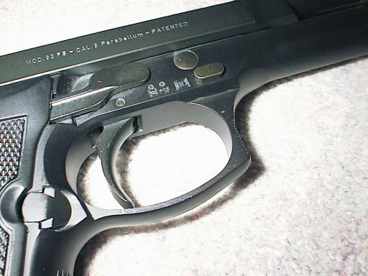
So Hgb 7 is the trigger?
Notes:
24

Slide 25
Indicators for Considering RBC Transfusion
(in absence of continued bleeding)
Normovolemic anemia (Hgb≤7) WITH signs or
symptoms of inadequate oxygen delivery
Acute MI or acute coronary syndrome
NICU
Septic shock
Possible EXCEPTIONS to Hb=7

Slide 26
General Guidelines for Platelet Transfusion
Bone Marrow Failure <10 x 10⁹/L
Risk of spontaneous bleeding
Prophylaxis for Surgery
invasive procedures: <50 x 10⁹/L
blood loss > 500ml or major surgery
neurosurgery <100 x 10⁹/L
Massive transfusion
Platelet function disorders variable

Slide 27
UK Healthcare
2010 Guide for Blood Component Transfusion
PRBC’s
Hct < 21% + symptoms/signs of inadequate oxygen delivery
FFP
INR ≥ 1.5 or PTT ≥ 46sec + active bleeding and can’t be corrected by Vitamin K
Platelets
<50,000 during and for 24 hours following surgery
<10,000 in non-bleeding patient
Cryoprecipitate
Fibrinogen <100 mg/dl
Notes:
27

Slide 28
Risks of Blood Transfusion
infevtion (HIV, HBV, HCV, CMV, bacteria, parasites)
Transfusion reactions
Allergic reactions.. To donated plasma proteins
Febrile non Hemolytic reactions.. To donated WBCs
Hemolytic reactions.. fatal
Delayed hemolytic.. To other than ABO
Transfusion Related Acute Lung Injury (TRALI)
Graft vs host disease GVHD.. To immunocompetent T cells
Notes:
TRALI is a development of acute lung injury or ARDS within 6 hours of transfusion. Typically characterized by SOB, Hypoxia, and bilateral patchy infiltrates on CXR. More likely to have hypotension.
TACO is development of acute pulmonary edema with transfusion. Typically begins near end of transfusion or within 6 hours. Headache common. Typically presents with SOB, Hypoxia, and tachycardia. More likely to have hypertension.

Slide 29
Risks of Blood Transfusion
Transfusion Associated Circulatory Overload (TACO)
Massive bld transfusion:
Electrolyte abnormalities: hypocalcaemia, hyperkalemia
citrate toxicity
hypothermia
coagulopathy

Slide 30
Transfusion Reactions
Hemolytic Reactions
  the recipient's serum contains antibodies directed against the corresponding antigen found on donor red blood cells.
  can be an ABO incompatibility or an incompatibility related to a different blood group antigen.
  Disseminated intravascular coagulation (DIC)
  renal failure
  death are not uncommon following this type of reaction.
  The most common cause for a major hemolytic transfusion reaction is a clerical error!!!

Slide 31
Transfusion Reactions
Allergic Reactions
Allergic reactions to donated plasma proteins can range from complaints of hives and itching to anaphylaxis.
Most common

Slide 32
A Transfusion Dilemma
A 72 year old woman presents to ER with a nosebleed. This is her second visit in 24 hours with the same complaint. Her nose is packed and the bleeding stops.
Past history includes congestive heart failure and a transient ischemic attack. She takes Lasix, Isordil and aspirin.
A CBC is requested.

Slide 33
Would you recommend a Red Cell Transfusion ?
Hb 85g/L but… likely to rebleed?
history of cardiac disease
history of TIA
currently on ASA
What about a platelet transfusion?
Platelets 95 x 10⁹/L but…
currently on ASA
? PT/PTT
why thrombocytopenic?

Slide 34
Red cell transfusion - maybe
assess clinical status
ECG
assess distance from home
observation in ER
ensure sample available for a Type and Hold
Platelet transfusion not indicated
hold ASA
assess PT/PTT
referral for assessment of low platelets

Slide 35
Case
A 67 y/o M. CAD s/p CABG, CKD stage III, HTN, DM is admitted for fever, cough, and SOB. He is diagnosed with pneumonia. Hemoglobin at admission is 8.2. There is no evidence of active bleeding. At baseline the patient is able to climb 2 flights of stairs without SOB or CP. During hospitalization, the patient received multiple blood draws. After 4 days, Pt’s symptoms have improved. He is AF, HR is 70, BP 120/80, RR 20, 95% on RA. You are planning discharge today. Hemoglobin this morning is 7.3.
What is the best approach to managing this pt’s Anemia?

Slide 36
Case
Transfuse 2 units PRBC
Transfuse to goal Hg >10
Recheck Hg/Hct
Discharge with outpatient follow-up
Blood transfusion is not indicated in this patient at this time. His anemia is asymptomatic. He has a h/o CAD but no active ischemia. His Hg is likely not lab error given that he has been in the hospital for multiple days and has received numerous blood draws likely leading to phlebotomy associated anemia.

Slide 37
